Slide 1
Overview of Senate Bills 9 & 10 and Implications to Planning Policy & Zoning Regulations Planning Commission Study Session
December 1, 2021

Slide 2
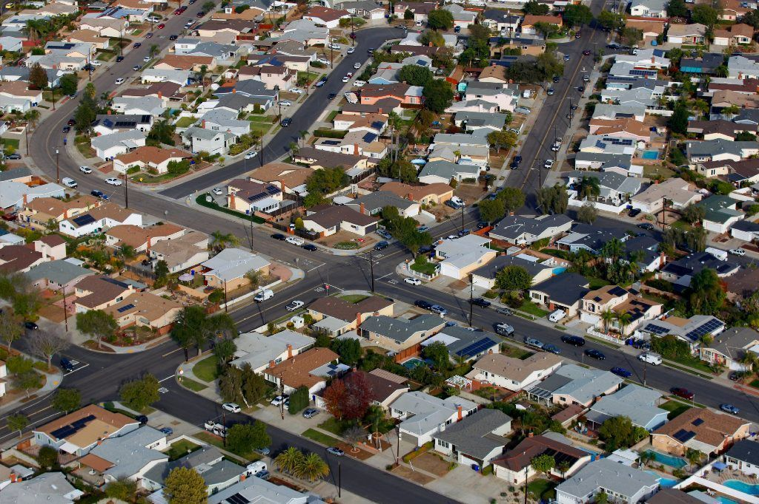
Agenda
SB 9 Overview
Implementing SB 9 in San Jose
SB 10 Overview
Discussion
www.sanjoseca.gov/planning

Slide 3
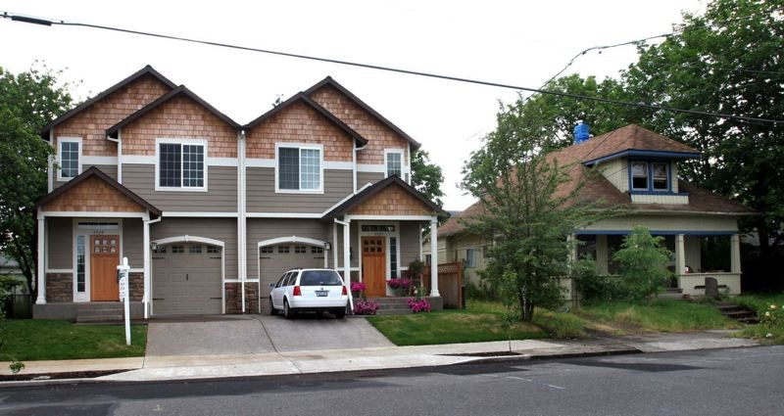
Senate Bill 9 - Overview
Applies to all cities and charter cities
Applies to properties zoned single-family
R-1 & Planned Development Zoning Districts
Exempts properties that meet certain criteria
Allows subdivision of one lot into two lots
Allows construction of two units on each lot
Includes mandatory development standards
Allows cities to adopt their own standards, with limitations
Effective January 1, 2022
www.sanjoseca.gov/planning

Slide 4
SB 9 “Urban Lot Splits”
Allows lot to be subdivided into 2 “roughly proportional” lots.
One lot may be no less than 40% of the size of the other lot
No lot may be less than 1,200 square feet, unless city adopts a lower lot size standard
City is not required to permit more than 2 units per lot, including ADUs and JADUs
Existing 10,000 square foot lot
New Lot A
6,000 square feet
New Lot B
4,000 square feet
Elm Street
www.sanjoseca.gov/planning

Slide 5
SB 9 “Urban Lot Splits” - continued
Owner-occupancy requirement: Applicant must attest they plan to live on one of the lots for at least 3 years
Same applicant cannot subdivide adjoining lots
Lot can only be subdivided once
Ministerial approval – no CEQA review
Access and Utility Requirements:
May require property has access to a public right-of-way
May require easements for public services (e.g. utilities)
May not require right-of-way dedication or construction of off-site improvements
www.sanjoseca.gov/planning

Slide 6
SB 9 – Excluded Lands
Protected farmlands
Wetlands
Within a very high fire hazard severity zone, unless certain requirements are met
A hazardous waste site
Within delineated earthquake fault zone, unless the project design meets building codes for such a zone
Within special flood hazard area or regulatory floodway, unless certain requirements are met
Lands protected for conservation
Habitat for protected species
Within a historic district or on a site that is designated as historic
www.sanjoseca.gov/planning

Slide 7
SB 9 – Protection for Existing Housing
Units created by SB 9 cannot be rented for terms of 30 days or less.
Projects cannot alter or demolish the following:
Rent controlled units
Deed restricted affordable units
Units where the Ellis Act has been exercised to remove the unit from the rental market
Units that have been occupied by a tenant in the last three years
www.sanjoseca.gov/planning

Slide 8
SB 9 – Development Standards
Cannot require more than 4-foot side and rear setbacks
Cannot require any setback for existing structures
Must allow construction of attached units
Attached units must be designed to standards required for selling individually
Cities may apply objective development standards
Cannot conflict with mandatory standards
Must allow construction of at least 800 square foot units
Objective: standards that involve no personal or subjective judgment by a public official and are uniformly verifiable by reference to an external and uniform benchmark or criterion
www.sanjoseca.gov/planning

Slide 9
SB 9 - Parking
No more than 1 parking space per unit is required
No parking required for projects within ½ mile of “high quality transit corridor” or “major transit stop”, or if there is a car share vehicle on the block.
“High quality transit corridor” is defined as a corridor with fixed route bus service with service intervals no longer than 15 minutes during peak commute hours.
“Major transit stop” is a rail or bus rapid transit stop, or the intersection of two or more major bus routes with a frequency of service interval of 15 minutes or less during the morning and afternoon peak commute periods.
ADUs can use current parking exceptions
www.sanjoseca.gov/planning

Slide 10
SB 9 – Number of Units Allowed
May combine single-family unit, duplexes, ADUs, or JADUs
Potential for up to 5 units per lot when combined with San Jose’s ADU ordinance or 10 units across a subdivided lot.
Does not require a city to permit more than 2 units on a property created by SB 9 subdivision, however, using this provision requires a Zoning Ordinance update.
Alternate interpretation: Cities must allow 2 new units to be constructed on a property that already contains a single-family dwelling, even with ADUs. Staff does not concur with this interpretation and is awaiting clarification from the State.
* ADU = accessory dwelling unit; JADU = junior accessory dwelling unit
www.sanjoseca.gov/planning

Slide 11
SB 9 – Example 1
New ADU
New ADU
Existing: Vacant Lot
Proposed under SB 9, without subdivision:
Construct duplex (allowed by SB 9)
Later: Construct 2 detached ADUs (allowed by state law and ADU Ordinance)
Convert duplex garage to ADU (allowed by state law and ADU ordinance)
Total: 5 units
New Duplex
New ADU
www.sanjoseca.gov/planning

Slide 12
SB 9 – Example 2
ADU
New Single-family Residence
Existing: 1 single-family residence
Proposed under SB 9, without subdivision:
1 new single-family residence (allowed by SB9)
1 ADU
1 JADU (allowed by existing zoning + state law)
Total: 4 Units
Single-family Residence
JADU
www.sanjoseca.gov/planning

Slide 13
SB 9 – Example 3
New Duplex
Assumes update to the Zoning Ordinance
Existing: 1 Single-family residence
Proposed under SB 9, with subdivision:
Build new duplex (allowed by SB 9)
Build 1 new ADU (allowed by state law and ADU Ordinance)
Total: 4 units
New Property Line
New ADU
Single-family Residence
www.sanjoseca.gov/planning

Slide 14
SB 9 – Example 4
New ADU
New Duplex
Assuming no change to the Zoning Ordinance and sufficient lot size
New ADU
New ADU
Existing: 1 single-family residence
Proposed under SB 9, with subdivision:
Convert existing house to duplex, build 1 new duplex (allowed by SB 9)
Later: Build 4 detached ADUs and convert duplex garages to ADUs (allowed by state law and ADU ordinance)
Total: 10 units
New Property Line
New ADU
New ADU
Single Family Residence
New Duplex
New ADU
www.sanjoseca.gov/planning

Slide 15
Implementing SB 9 in San Jose

Slide 16
SB 9 - Practical Implications
Current expectation that most eligible properties will not use SB 9
Findings - Terner Center for Housing Innovation, UC Berkeley:
SB 9 will have limited impacts; most parcels cannot feasibly build new homes
~ 97% of existing single-family homes would be retained
Most parcels are too small to feasibly subdivide
Of 331,000 single-family parcels in Santa Clara County, Terner Center estimates 30,500 are market-feasible for new units.
Most financially advantageous model is a duplex out of existing structures
Terner Center findings generally consistent with City’s Opportunity Housing feasibility analysis
www.sanjoseca.gov/planning

Slide 17
SB 9 - Implementation
Before January 1, 2022, staff must:
Clarify how SB 9 intersects with Permit Streamlining Act, Housing Accountability Act, Housing Crisis Act of 2019, and ADU legislation
Develop process/forms for SB 9 project applications
Develop process to enforce compliance with owner-occupancy provision & to verify if unit has been rented in past three years.
Determine staffing needs to implement SB 9
www.sanjoseca.gov/planning

Slide 18
SB 9 – Implementation - continued
Additional action items:
Adopt ordinance prior to January 1, 2022 to implement SB 9 in San Jose:
Apply the intent of SB 9 provisions of 4 units total (2 units per subdivided lot)
Clarify how existing development standards apply to SB 9 projects
Propose new development standards where necessary
Develop detailed design standards and update SB 9 ordinance
Ordinance would require extensive outreach
An ordinance to implement SB 9 is exempt from CEQA
Ordinances are limited by SB 330 prohibition on “downzoning”
www.sanjoseca.gov/planning

Slide 19
SB 9 and SB 330
SB 330 prohibits:
Reducing the intensity of land use within an existing zoning district below what was allowed as of January 1, 2018.
Reducing the intensity includes reductions to height, density, or floor area ratio, new or increased open space or lot size requirements, or new or increased setback requirements, minimum frontage requirements, or maximum lot coverage limitations, or anything that would lessen the intensity of housing.
SB 9 development standards cannot include greater setbacks, lower heights, lower Floor Area Ratio, etc. than what was allowed as of January 1, 2018
www.sanjoseca.gov/planning

Slide 20
Implementing SB 9 - Considerations
Additional Considerations and Challenges:
Many single-family residences in San Jose are zoned R-2 Two Family. Should SB 9 allowances be extended to cover R-2 zoned property?
Could impact approximately 9,000 properties
Should SB 9 be applied to historic properties if resource not impacted?
Staff estimate that implementing SB 9 will require at least one full-time Planner position.
Additional staff resources to process SB 9 applications and inquiries not fully known – uncertainties about demand
www.sanjoseca.gov/planning

Slide 21
About Senate Bill 10

Slide 22
Senate Bill 10 - Overview
SB 10 is voluntary, not required.
Streamlines work for cities who proactively plan for infill projects that meet certain criteria
If a city adopts a General Plan update, ordinance update, or other regulation to zone any parcel for up to ten units, at heights specified by the city in the ordinance, if it is within a transit rich or urban infill area, adoption of that ordinance, update, or policy is exempt from review under CEQA
SB 10 ordinance must allow every eligible property to build up to ten units
www.sanjoseca.gov/planning

Slide 23
Conclusion
There are some unanswered questions about SB 9 and SB 10 provisions
Staff is coordinating with other cities and state Department of Housing & Community Development on SB 9 interpretations and implementation strategies
SB 9 & 10 overview can be found on City's Opportunity Housing webpage: www.bit.ly/SJOpportunityHousing
SB 9 & 10 is incorporated into staff’s recommendation for Opportunity Housing
www.sanjoseca.gov/planning

Slide 24
Questions and Discussion

