Slide 1
Code Enforcement Multiple Housing Tier 1 Permit Payments Process and Self-Certification
2023

Slide 2
Objectives
In this presentation you will understand how to:
Create an account and Login into Sjpermits.org
Certify your Tier 1 property
Make an online payment for Tier 1 properties
Contact support assistance
What you will need to begin:
Your Residential Occupancy Permit Invoice (ROP)

Slide 3
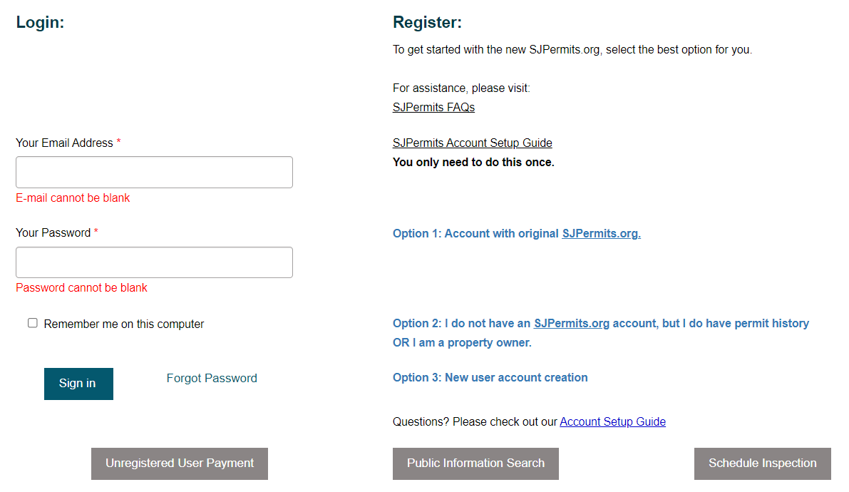
To create an account, you can select one of the options to create an account to login.
www.sanjoseca.gov/CodeEnforcement

Slide 4
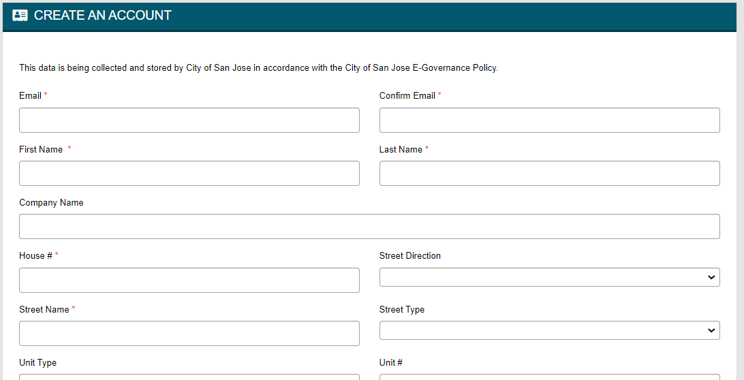
Option 1: This option is for users who had accounts within the original SJPermits portal (before Nov. 5, 2020), and who want to move their accounts into the updated portal. Complete the form and receive the verification account email to complete the setup process.
www.sanjoseca.gov/CodeEnforcement

Slide 5
Once you complete the registration page, you receive instructions to verify your email.
www.sanjoseca.gov/CodeEnforcement

Slide 6
After making a selection on the previous screen and finished creating an account, you will receive an email to proceed with verifying your account. Click the link in the email to complete the setup process and proceed.
www.sanjoseca.gov/CodeEnforcement

Slide 7
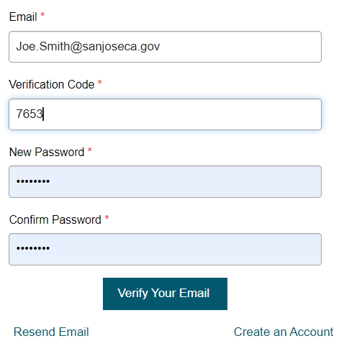
Once you click the portal link, you will be taken to the verify your email page. On this page, you will input your verification number and create a password, then click Verify Your Email.
www.sanjoseca.gov/CodeEnforcement

Slide 8
Once you create a password and click verify. You will see a confirmation page that your account is setup.
www.sanjoseca.gov/CodeEnforcement

Slide 9
Option 2: I do not have an SJPermits account, but I do have permit history OR I am a property owner. This option is for users who lack an SJPermits account but have permit records and active applications with the City and would like these records associated with the creation of a new SJPermits account. Make a yes or no selection and proceed to create an account page.
www.sanjoseca.gov/CodeEnforcement

Slide 10
After making a selection on the previous screen and finished creating an account, you will receive an email to proceed with verifying your account. Click the link in the email to complete the setup process and proceed with making your payment.
www.sanjoseca.gov/CodeEnforcement

Slide 11
Once you click the portal link, you will be taken to the verify your email page. On this page, you will input your verification number and create a password, then click Verify Your Email.
www.sanjoseca.gov/CodeEnforcement

Slide 12
Once you create a password and click verify. You will see a confirmation page that your account is setup.
www.sanjoseca.gov/CodeEnforcement

Slide 13
Option 3: New user account. This option is for users who either have never had an account or who simply want to create a new account. Once you receive the confirmation email, click the link in the email to complete the verification account process.
www.sanjoseca.gov/CodeEnforcement

Slide 14
Once you will receive the email proceed with verifying your account. Click the link in the email to complete the setup process and proceed with making your payment.
www.sanjoseca.gov/CodeEnforcement

Slide 15
Once you click the portal link, you will be taken to the verify your email page. On this page, you will input your verification number and create a password, then click Verify Your Email.
www.sanjoseca.gov/CodeEnforcement

Slide 16
Once you create a password and click verify. You will see a confirmation page that your account is setup.
www.sanjoseca.gov/CodeEnforcement

Slide 17
Self-Certifying your Tier 1 property
www.sanjoseca.gov/CodeEnforcement

Slide 18
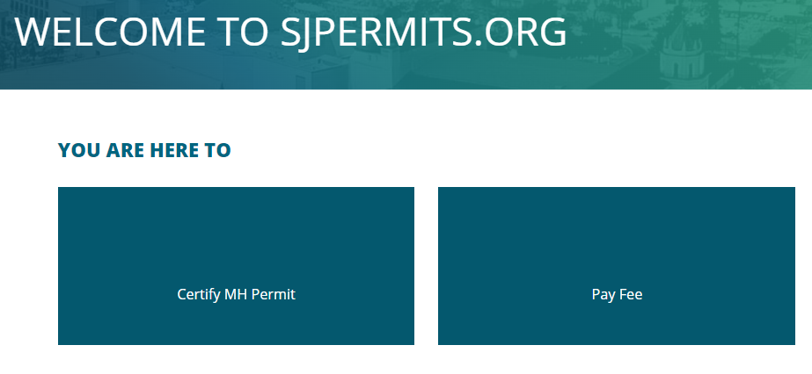
Once logged in, follow the link on your invoice to self certify
www.sanjoseca.gov/CodeEnforcement

Slide 19
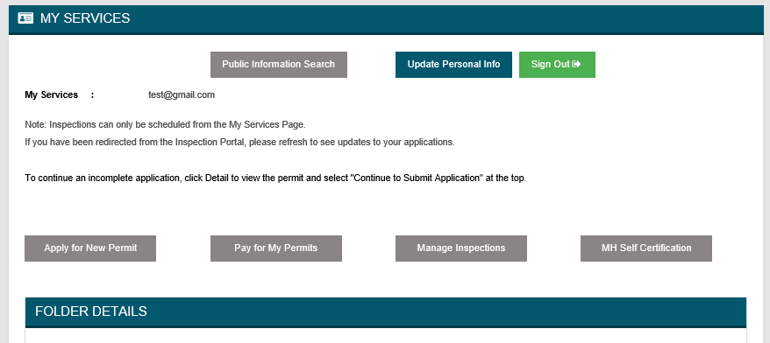
After logging, select “MH Self Certification”
www.sanjoseca.gov/CodeEnforcement

Slide 20
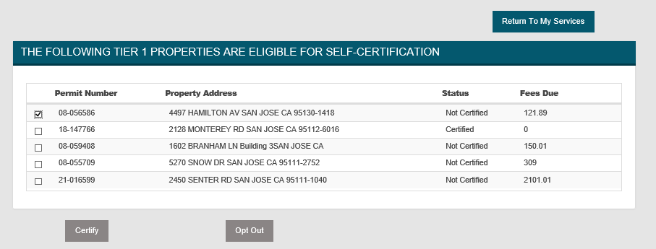
You will see a list of your Tier I properties and their certification status. Check the boxes next to the properties you want to certify. Then click “Certify”.
www.sanjoseca.gov/CodeEnforcement

Slide 21
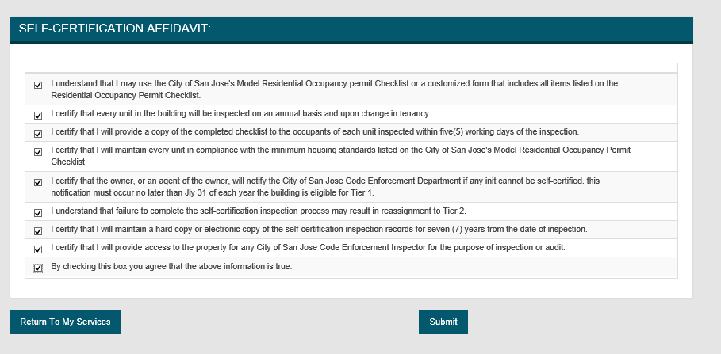
An owner or owner's agent who wishes to maintain Tier 1 status must agree to check every unit in the building on an annual basis and, upon change in tenancy, must provide a copy of the completed Self-Certification Checklist. An affidavit agreeing to these conditions must be completed at SJPermits.org during the renewal process for the Residential Occupancy Permit as a requirement for keeping Tier 1 status. Check all the checkboxes on the Self-Certification Affidavit page, then click “Submit”.
www.sanjoseca.gov/CodeEnforcement

Slide 22
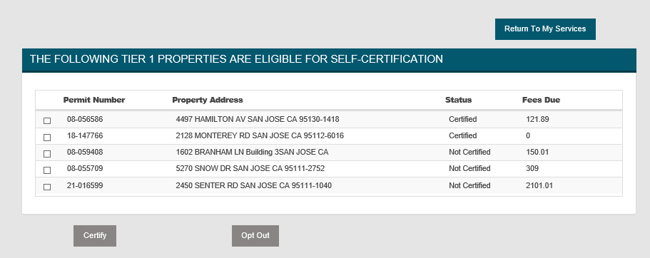
The Self-Certification screen reappears and the items which were selected for certification show as “Certified” The Next step is to make your payment by clicking Return To My Services.
To pay fees, click Return to My Services
www.sanjoseca.gov/CodeEnforcement

Slide 23
If you choose to remove a property from the self-certification program, check the box next to the property and click “Opt Out”. The property will be moved to Tier II and a new bill will be generated for the additional fee amount for Tier II properties. The Next step is to make your payment by clicking Return To My Services.
www.sanjoseca.gov/CodeEnforcement

Slide 24
If you experience any IT related issues with self-certifying your property online, please email Mhporgram@sanjoseca.gov for additional assistance. Please provide your property’s address or APN, your Invoice RSN number as well as any contact information. Please be patient as City Hall will be closed to the public during the holidays, December 19-29, 2022
www.sanjoseca.gov/CodeEnforcement

Slide 25
Making your online payment.
www.sanjoseca.gov/CodeEnforcement

Slide 26
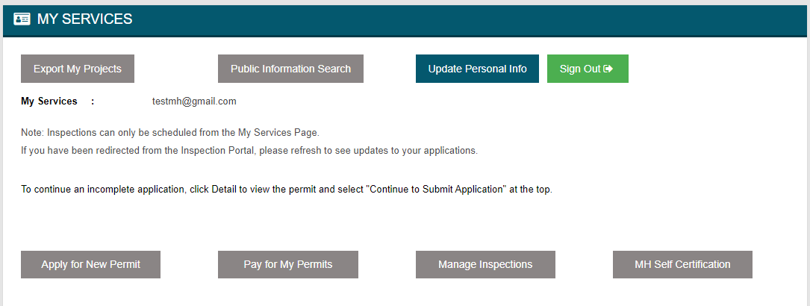
Once you certified your Tier 1 property or Opt out, you will be back at My Services, click Pay for My Permits to make your payment.
www.sanjoseca.gov/CodeEnforcement

Slide 27
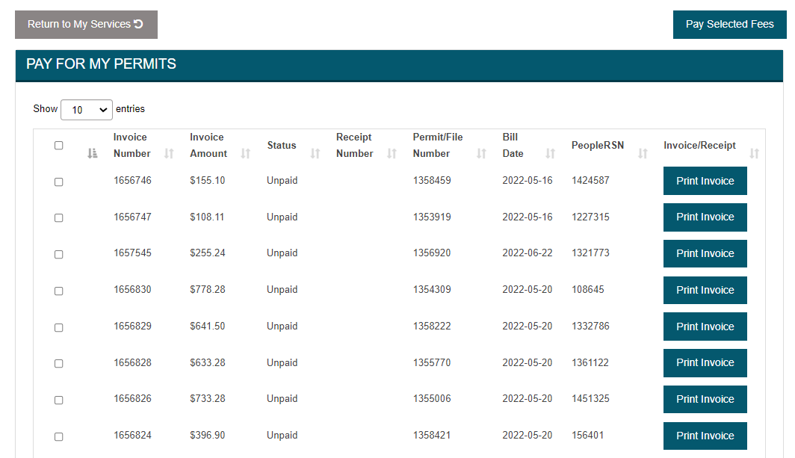
On the Pay For My Permits screen, you will see your property or list of properties. Select check box for the permit you wish to make a payment for then select Pay Selected Fees. Be sure to check any additional boxes that may include Housing fees associated with that same permit number.
www.sanjoseca.gov/CodeEnforcement

Slide 28
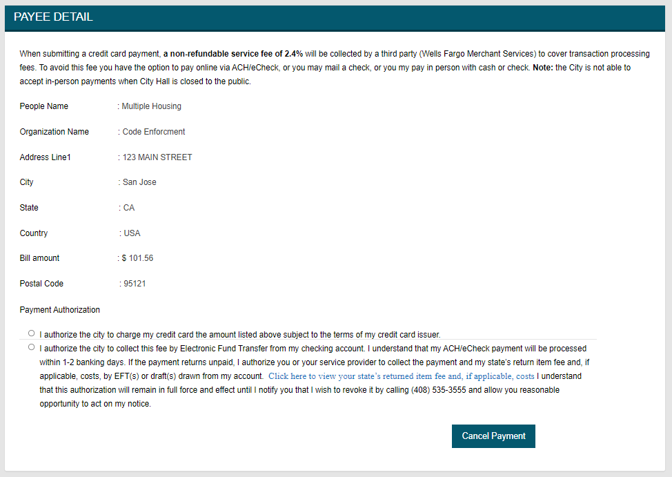
Once you selected Pay Selected Fees, you will see the Payee Detail screen confirming your information and making a payment authorization. Select your option to pay by credit card or eCheck.
www.sanjoseca.gov/CodeEnforcement

Slide 29
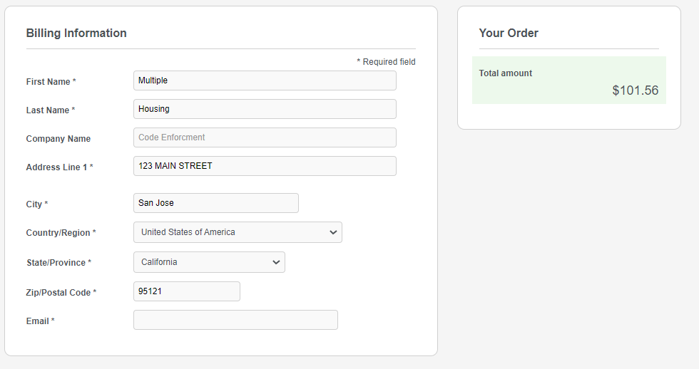
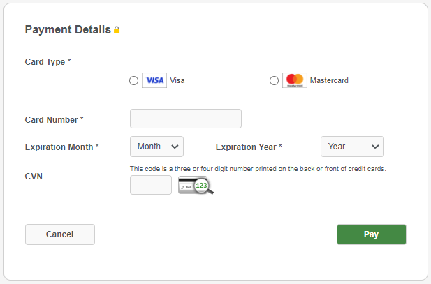
Add your billing and payment details then select Pay
www.sanjoseca.gov/CodeEnforcement

Slide 30
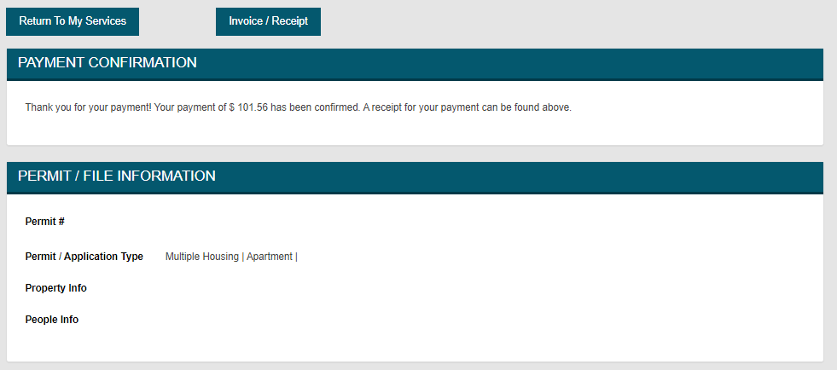
You will then see Payment Confirmation. You can also view and print your receipt or return to My Services.
www.sanjoseca.gov/CodeEnforcement

Slide 31
This concludes the process to self- certify your Tier 1 property as well as making your annual online payment. You will receive an email confirmation that your Tier 1 property completed the self-certification process.
www.sanjoseca.gov/CodeEnforcement

Slide 32
Questions?
If your data or information about your property is not accurate, please contact MHProgram@sanjoseca.gov for IT support.
If you have questions about your ROP invoice, email MHProgram@sanjoseca.gov attention Accounting Department, for any payment confirmations, balances or any other accounting related issues.
You can request copies of your routine inspections as well as copies of any validated complaints by emailing https://sanjoseca.govqa.us/WEBAPP/_rs/(S(2riwahoo14bgi4ljflolth0x))/supporthome.aspx
You can review your property’s permit history by going online to the permit center.
You can update your ROP mailing address by emailing CEAddressUpdate@sanjoseca.gov.
You can follow up with Housing Fee’s by emailing RSP@sanjoseca.gov
www.sanjoseca.gov/CodeEnforcement

Slide 33
FAQs
Tier 1 properties that fail to certify before the deadline will automatically reassessed to a Tier 2 status and fees.
Service level tier assignments will be reviewed after the inspection cycle is completed. More information about the Multiple Housing Program is available in the FAQs.
The requirements to move to tiers consists of 1) no major (permit) violations; 2) less than two minor violations average per unit inspected at the time of the routine inspection; 3) no substantiated complaints and 4) no expired permits.
This is a fee for service program. The Residential Occupancy Permit invoice includes SJ Fire inspection costs plus Housing Department program fee.
www.sanjoseca.gov/CodeEnforcement

