Slide 1
Code Enforcement Multiple Housing Permit Payment Process Tier 2 and Tier 3 properties
2023

Slide 2
Objectives
In this presentation you will understand how to:
Make an online payment for Tier 2 and Tier 3 properties
What you will need to begin:
Your Residential Occupancy Permit Invoice (ROP)

Slide 3
Making your online payment.
www.sanjoseca.gov/CodeEnforcement

Slide 4
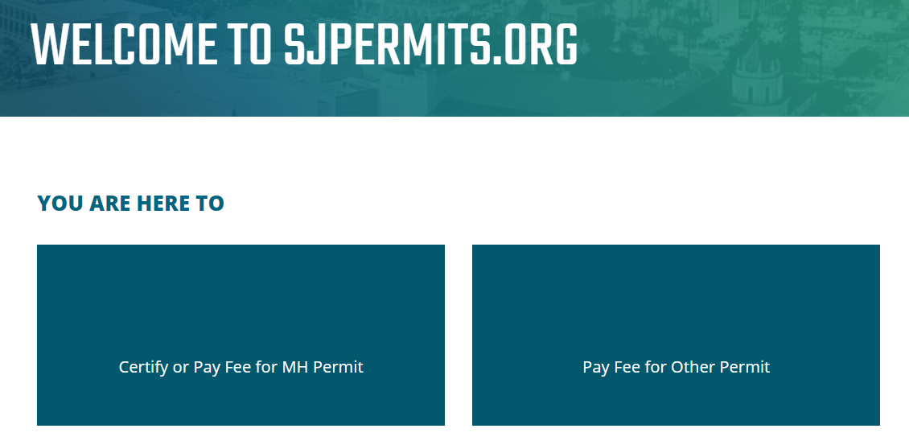
Follow the link on your invoice to make a payment
www.sanjoseca.gov/CodeEnforcement

Slide 5
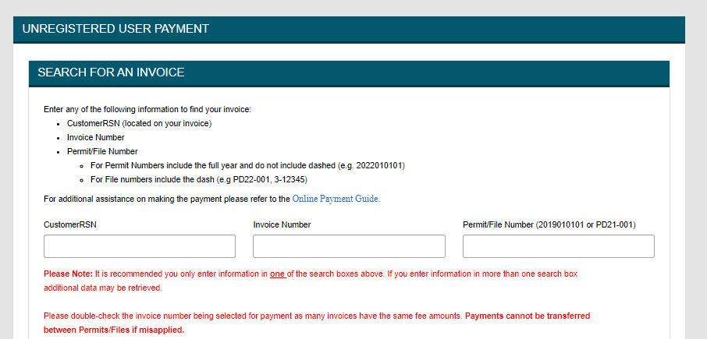
Using your ROP invoice, input your RSN number, then click Enter
www.sanjoseca.gov/CodeEnforcement

Slide 6
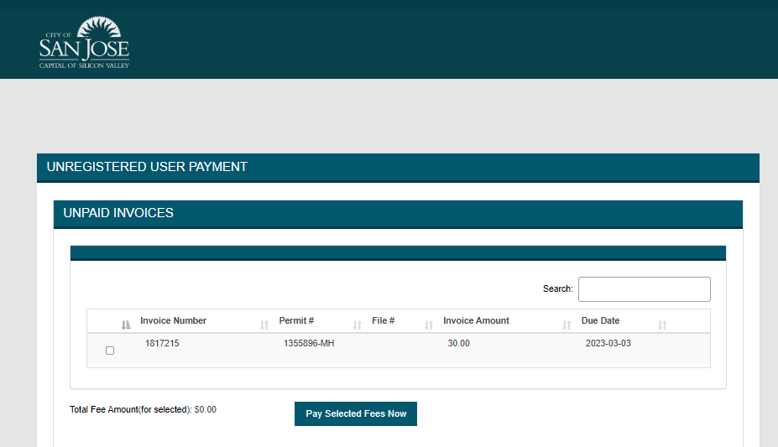
Verify you entered the correct ROP number and confirm the record is correct, then click Continue to proceed.
1111111
1111111
www.sanjoseca.gov/CodeEnforcement

Slide 7
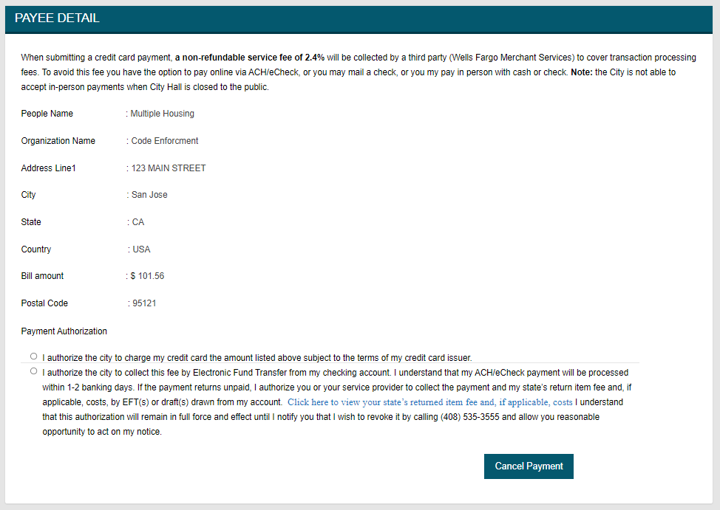
Once you selected Pay Selected Fees, you will see the Payee Detail screen confirming your information and making a payment authorization. Select your option to pay by credit card or eCheck.
www.sanjoseca.gov/CodeEnforcement

Slide 8
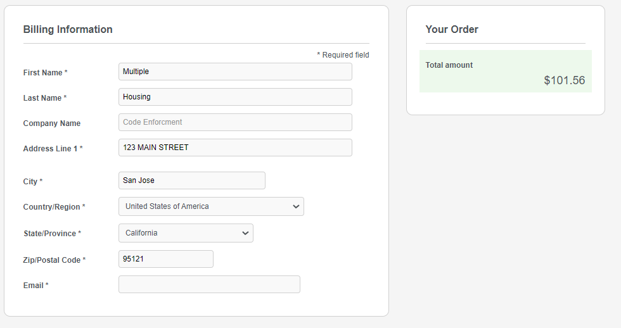
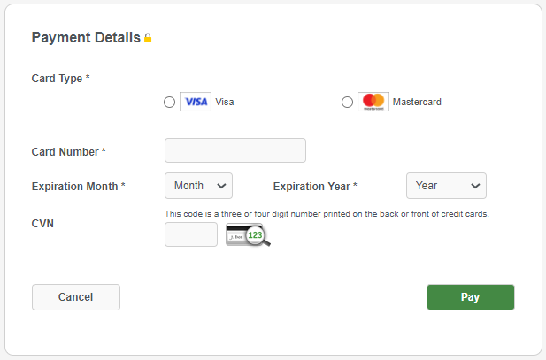
Add your billing and payment details then select Pay
www.sanjoseca.gov/CodeEnforcement

Slide 9
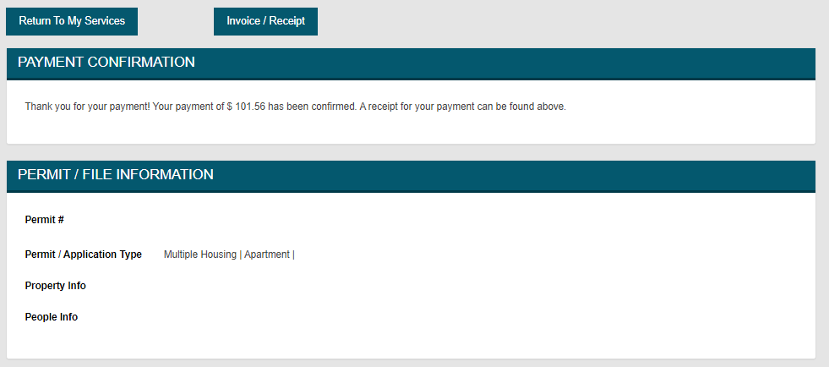
You will then see your Payment Confirmation that your payment was completed. You can also view and print your receipt or return to My Services.
www.sanjoseca.gov/CodeEnforcement

Slide 10
This concludes the online payment process.
www.sanjoseca.gov/CodeEnforcement

Slide 11
Questions?
If your data or information about your property is not accurate, please contact MHProgram@sanjoseca.gov for IT support.
If you have questions about your ROP invoice, email MHProgram@sanjoseca.gov attention Accounting Department, for any payment confirmations, balances or any other accounting related issues.
You can request copies of your routine inspections as well as copies of any validated complaints by emailing https://sanjoseca.govqa.us/WEBAPP/_rs/(S(2riwahoo14bgi4ljflolth0x))/supporthome.aspx
You can review your property’s permit history by going online to the permit center.
You can update your ROP mailing address by emailing CEAddressUpdate@sanjoseca.gov.
You can follow up with Housing Fee’s by emailing RSP@sanjoseca.gov
www.sanjoseca.gov/CodeEnforcement

Slide 12
FAQs
Accounts that fail to pay ROP fees before the deadline will automatically reassessed for penalty and interest fees.
Service level tier assignments will be reviewed after the inspection cycle is completed. More information about the Multiple Housing Program is available in the FAQs.
The requirements to move to tiers consists of 1) no major (permit) violations; 2) less than two minor violations average per unit inspected at the time of the routine inspection; 3) no substantiated complaints and 4) no expired permits.
This is a fee for service program. The Residential Occupancy Permit invoice includes SJ Fire inspection costs plus Housing Department program fee.
www.sanjoseca.gov/CodeEnforcement

