Slide 1
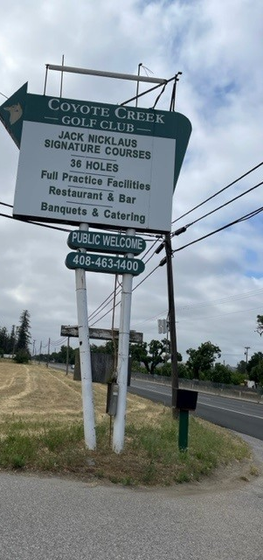
Coyote Valley Corridor Study
Stakeholder Workshop| February 1, 2024

Slide 2
City of San José
Brent Carvalho, Project Manager
Martina Davis, Division Manager, Citywide Planning
Aparna Ankola, Supervising Planner
Michael Brilliot, Deputy Director of Planning
PlaceWorks
Greg Goodfellow
Charlie Knox
Angelica Garcia
Project Team

Slide 3
Presentation
Study Area & Parcels
City Council Direction
Previous Feedback
Guided Discussions
Introduction
Land Use Outcomes and Character
Subarea Mapping
Reports Back from Tables
Next Steps
Workshop Agenda

Slide 4
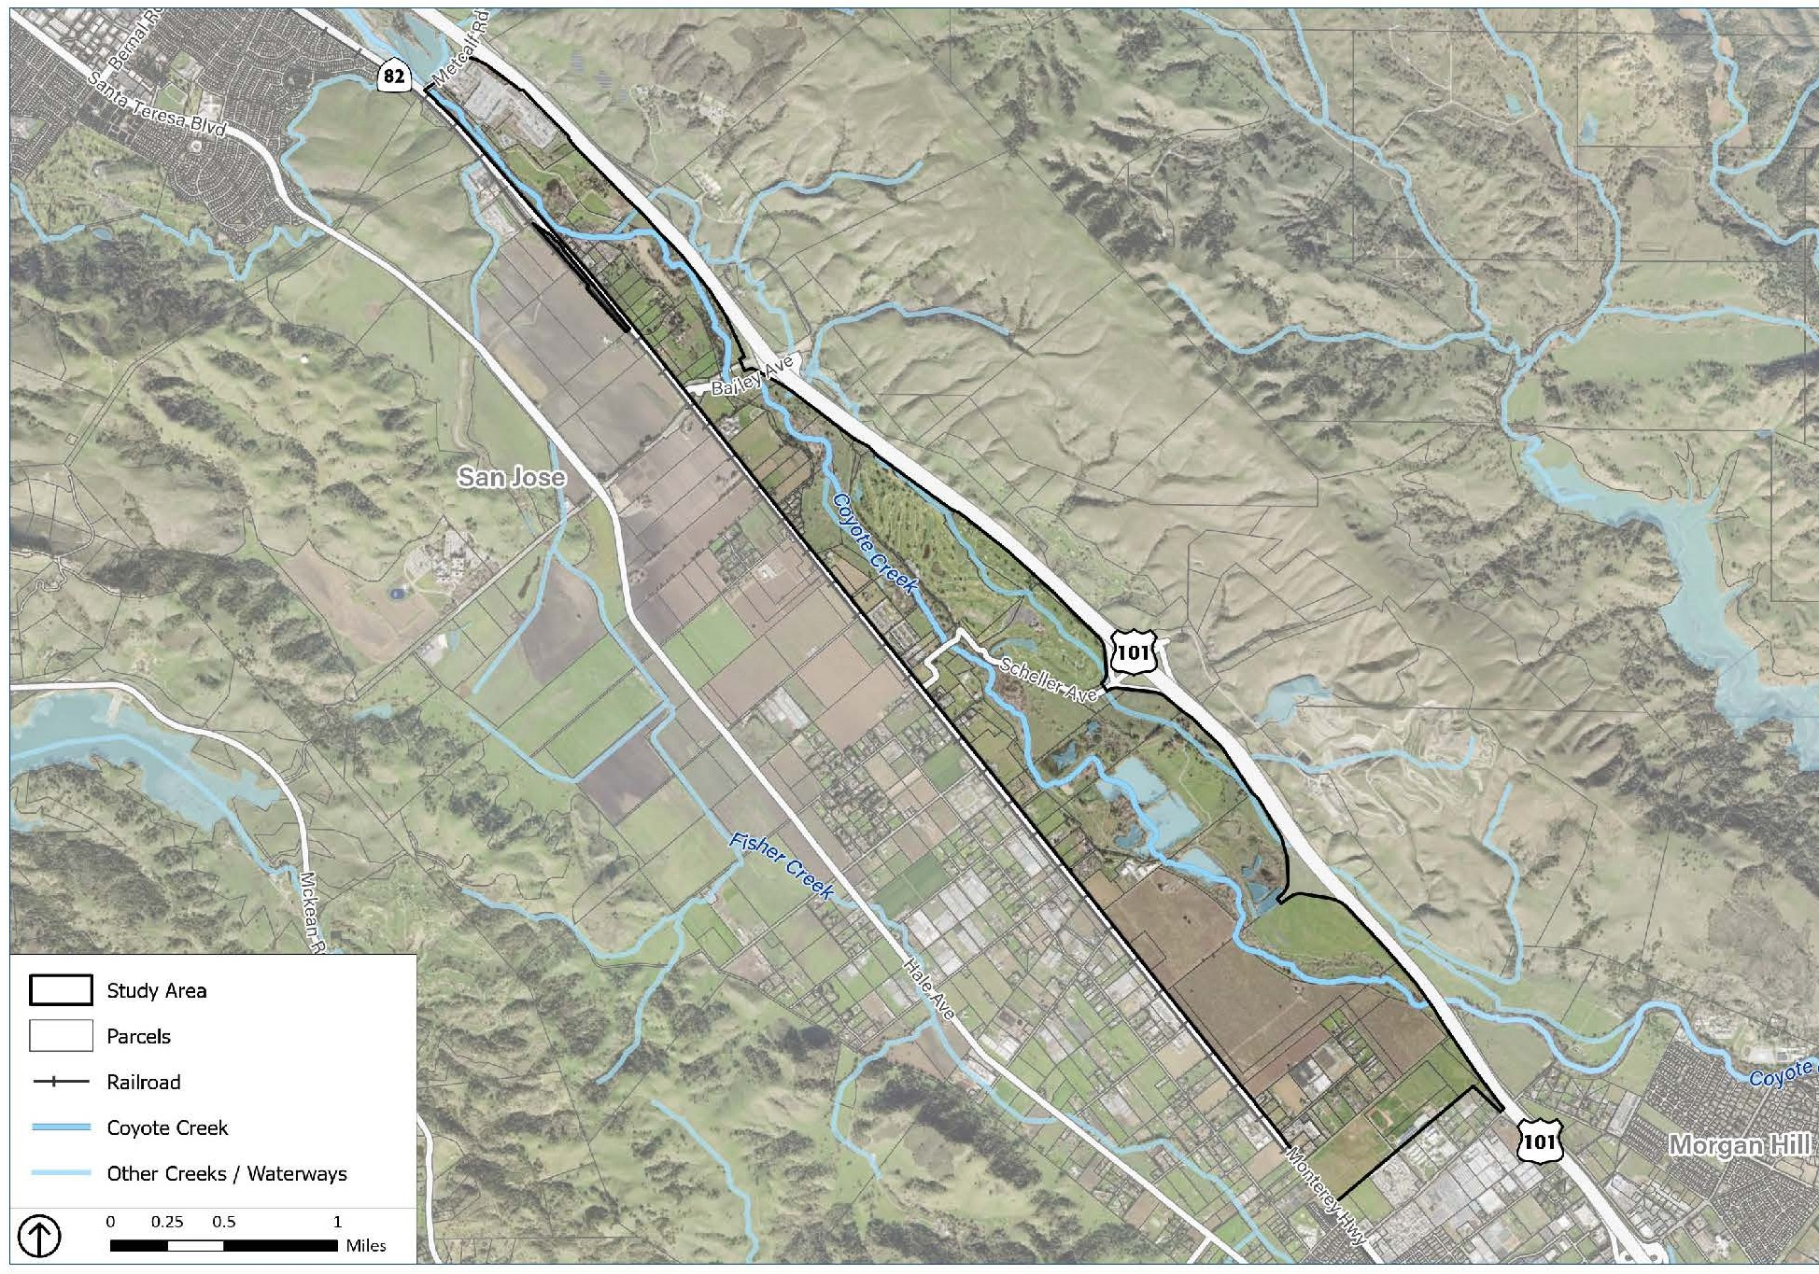
Study Area

Slide 5
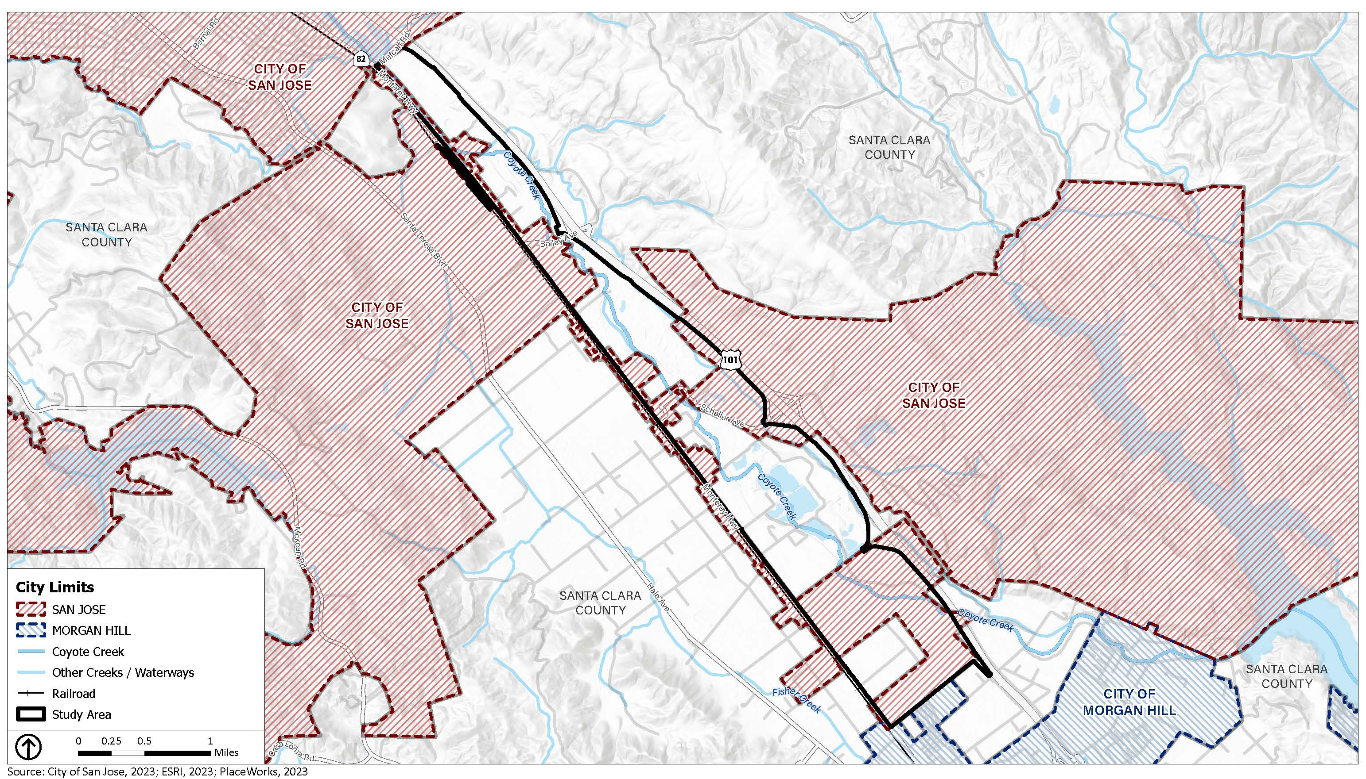
City Limits

Slide 6
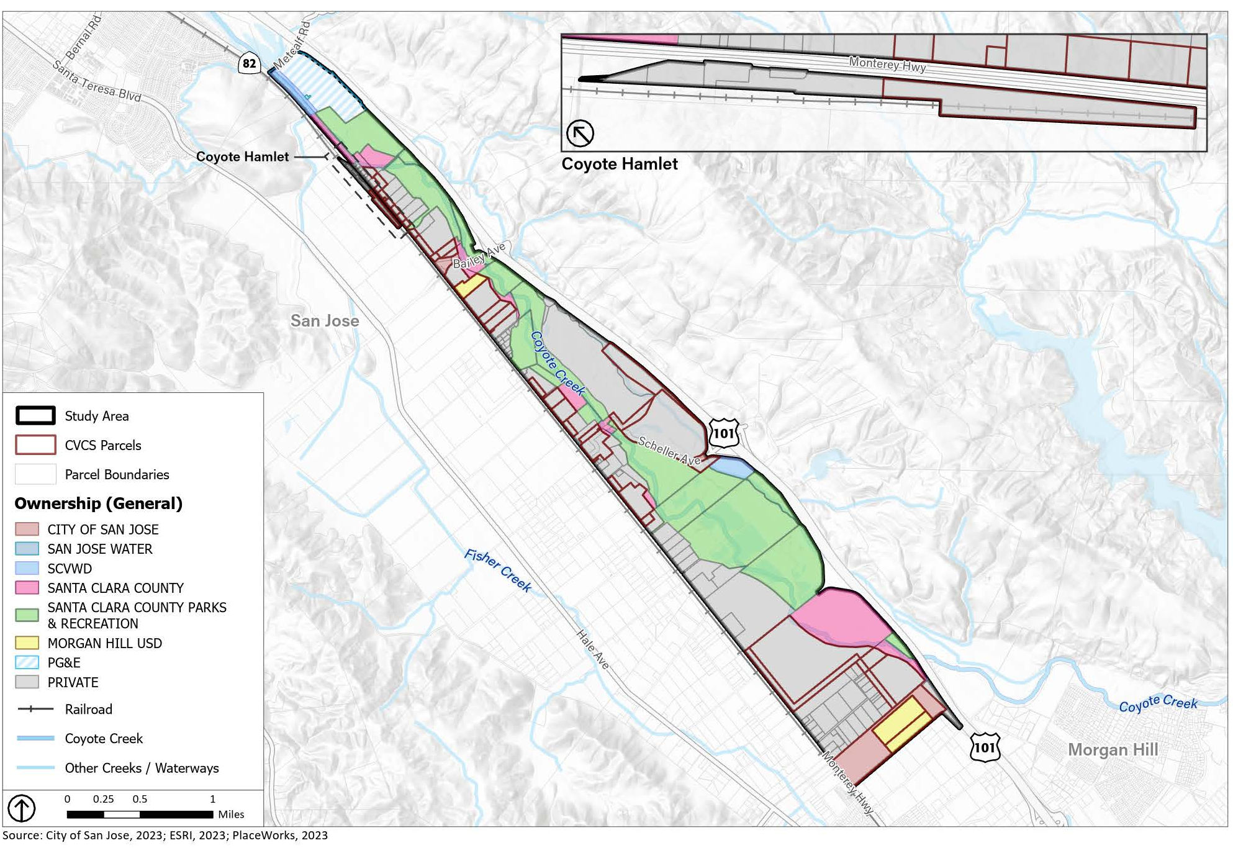
Parcels

Slide 7
CVCS Parcels
44 Private and City-owned parcels in City limits
673 Acres
About 7.5% of Coyote Valley
4% of 17,200-ac. AB 948 Conservation Program Area
Coyote Valley Corridor Study

Slide 8
City Council Directives
Acknowledge “distinct character and nature” of the corridor.
Adopt regulation for “expanded” non-residential land use:
Recreational and commercial uses
Design, development, operational standards
Coyote Valley Corridor Study
Notes:
R

Slide 9
City Council Requirements
Obtain “substantial stakeholder input”
Recognize “economic development and placemaking potential” of the study area
Work within 2021 city adopted vision for open space and agriculture in Coyote Valley
Coyote Valley Corridor Study
Notes:
R

Slide 10
Previous Feedback
Protect land values and the economy
Coordinate with other projects
Coordinate with current County agricultural policy
Protect natural resources
Coyote Creek Corridor
Wildlife linkages
Biodiversity
Protect & preserve agriculture
Diversify development
Coyote Valley Corridor Study
Notes:
R

Slide 11
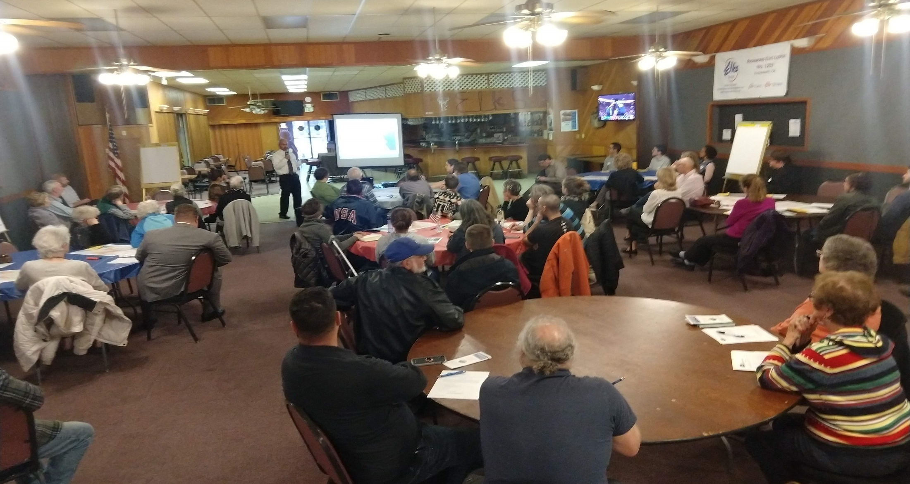
Guided Discussions

Slide 12
CVCS Outcomes & Character
What are your top three outcomes for new land use in the study area?
What are your top three characteristics of new development in the study area?

Slide 13
North Corridor

Slide 14
What are your top three potential new land uses in this subarea?
How would you balance new development with resource conservation in this subarea?
Coyote Valley Corridor Study

Slide 15
Central Corridor

Slide 16
What are your top three potential new land uses in this subarea?
How would you balance new development with resource conservation in this subarea?
Coyote Valley Corridor Study

Slide 17
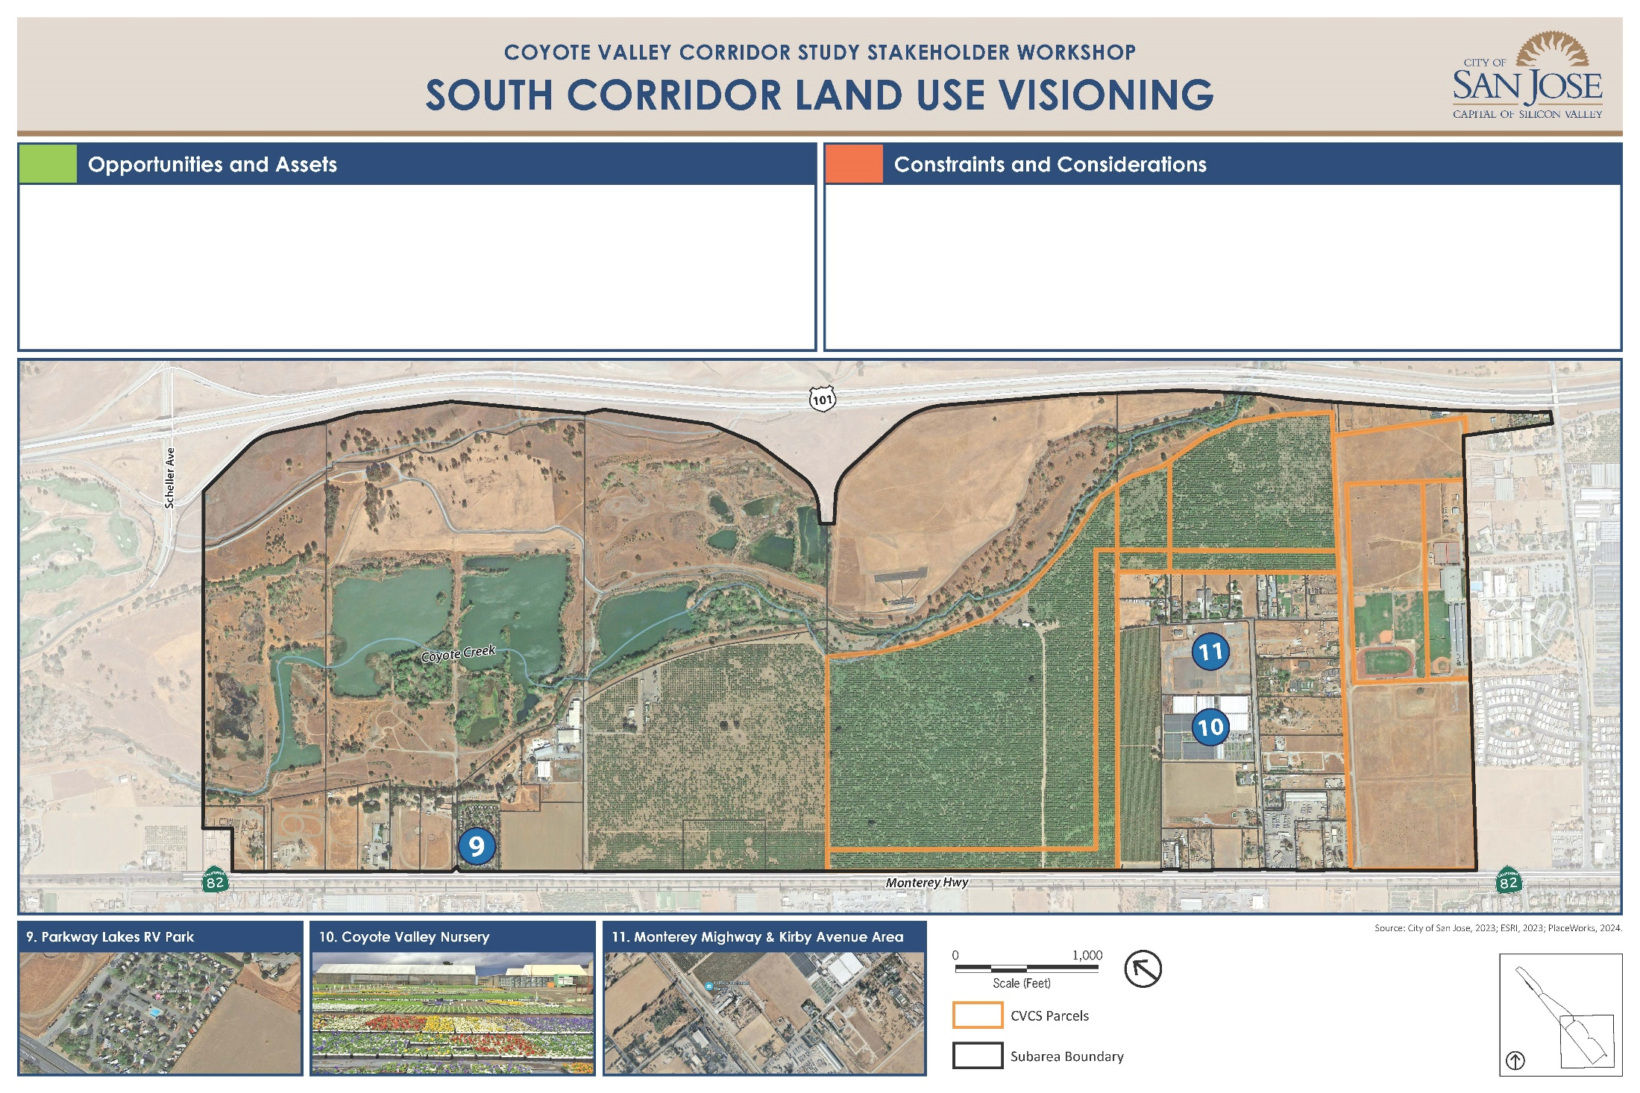
South Corridor

Slide 18
What are your top three potential new land uses in this subarea?
How would you balance new development with resource conservation in this subarea?
Coyote Valley Corridor Study

Slide 19
Reports Back

Slide 20
Summer 2023: Initial Outreach—Learn and ask questions
March, 2024: Land Use and Economic Report
Preliminary list of land uses studied
April, 2024: Preferred Land Uses
Stakeholder Outreach & Public Meeting
June, 2024: Development and Design Regulations
Draft zoning document
Early 2024: Preferred Land Uses—What is your response?
Late 2024: Final Report, CEQA certification and adoption
Next Steps

