Slide 1
Disabled Access Compliance for Small Businesses: A City Grant Can Help
Building Safety Open House
May 2, 2024

Slide 2
Overview
Introduction – City’s Small Business Ally Program
Business Coaching Center Website
Disability Access Improvement Grant Program
Questions & Answers
www.sanjoseca.gov/businesscoach

Slide 3
Small Business Ally Program
Here to help small businesses
I’ll inform you of your project’s permit process including steps, schedule, and costs
“Coach” you on:
- Permit processes, including “Streamlined Restaurant Program”
- Inspection requirements
- Business registration requirements
- Disability access improvement grants
www.sanjoseca.gov/businesscoach

Slide 4
Small Business Coaching Center Website
www.sanjoseca.gov/businesscoach
Guide: How to open a business in San José
Outlines permit and inspection processes and business registration requirements
Information is organized in 3 phases:
- Begin
- Coach
- Launch
www.sanjoseca.gov/businesscoach

Slide 5
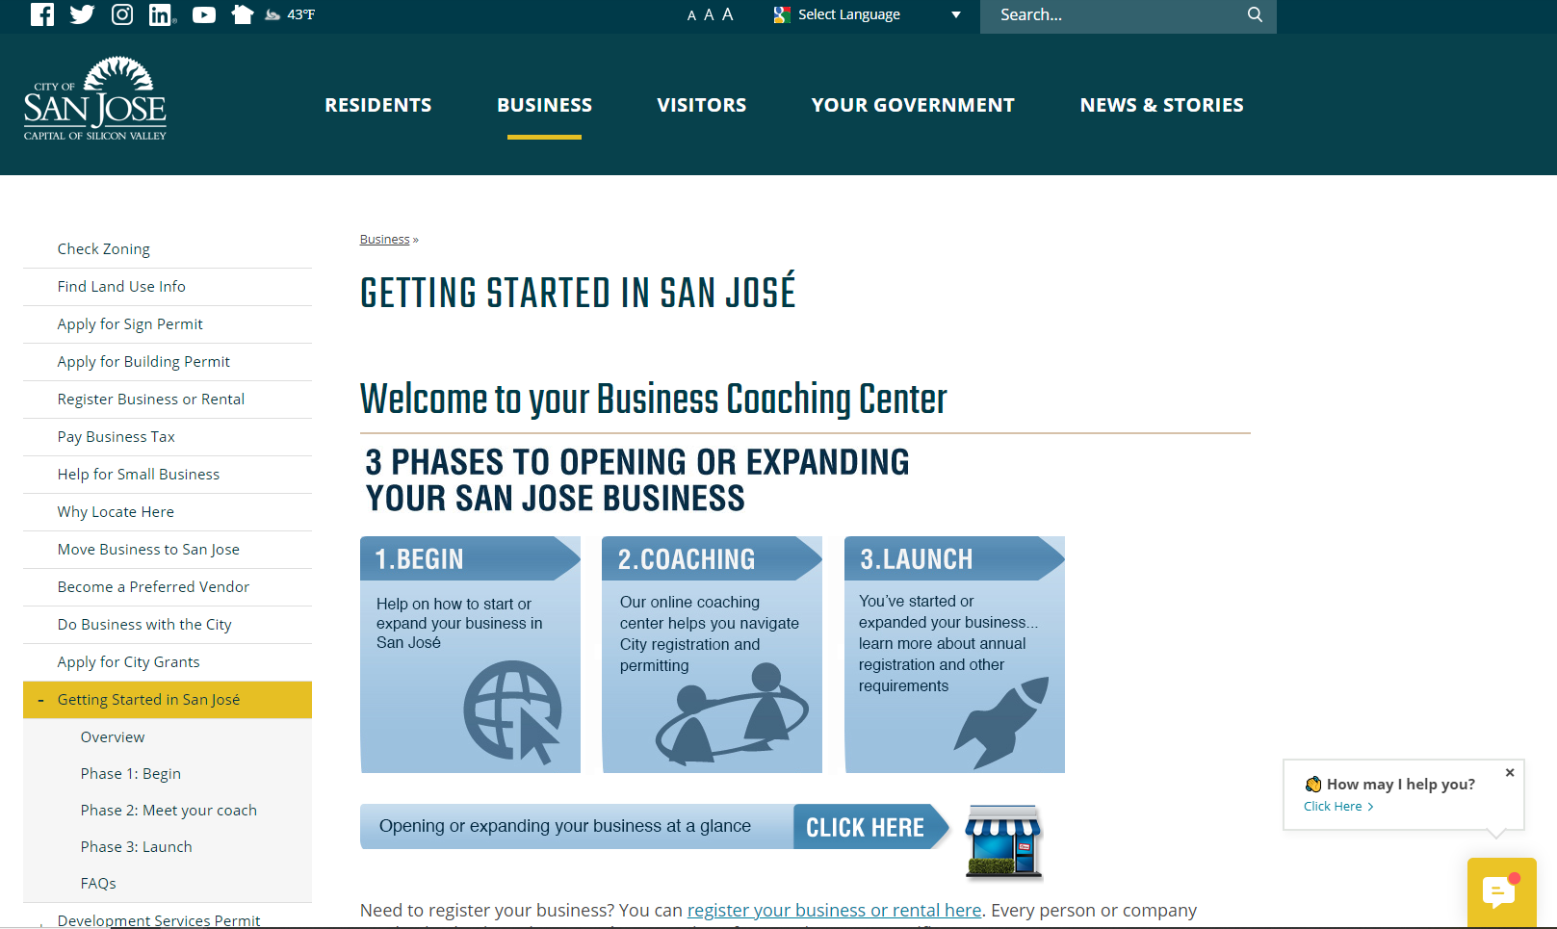

Slide 6
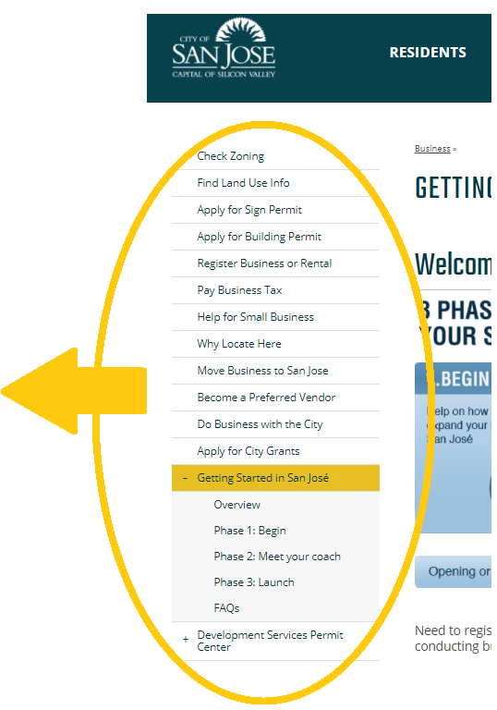
Small Business Coaching Center Website
Resources to open a business:
- Check your zoning
- Apply for a building permit
- Register your business
- Doing business with the City
- Apply for City Grants
Contact your Small Business Ally
www.sanjoseca.gov/businesscoach

Slide 7
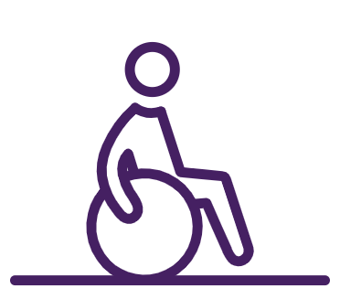
Disability Access Improvement Grant
GOALS – help small businesses in San José:
Make interior and exterior spaces accessible to all community members
Comply with federal Americans with Disability Act (ADA)
Comply with state building code requirements
Avoid an ADA lawsuit
Website: www.sanjoseca.gov/ADAgrant
www.sanjoseca.gov/ADAgrant

Slide 8
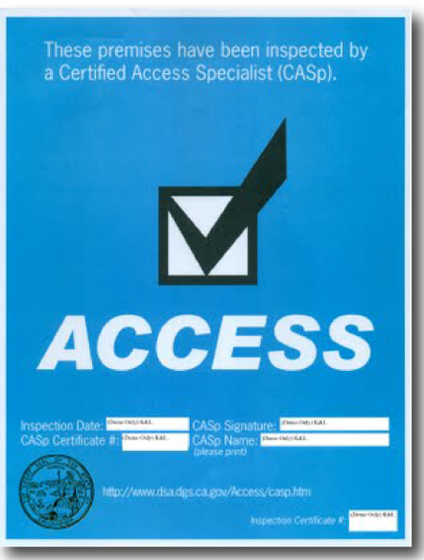
Phase 1 Grants
Credit of up to $8,000 for:
Cost to hire a Certified Access Specialist (CASp) inspector to conduct an initial survey and prepare a CASp Report (when City permits/inspections are required)
Fees for plan review, permits, and inspections related to removing accessibility barriers as identified in a CASp Report.
www.sanjoseca.gov/ADAgrant

Slide 9
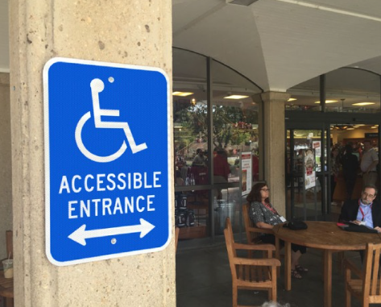
Phase 2 Grants
Based on a remediation estimate, grant provides reimbursement and funding of up to $25,000 for:
Professional design services to prepare plans to remove accessibility barriers as identified in the CASp Report and when a City permit is required.
Construction and labor costs to remove accessibility barriers.
Purchase and installation costs for accessible furniture, fixtures, and equipment.
Initial CASp survey and report when a City permit is not required.
Final CASp inspection after completion of accessibility remediation work.
www.sanjoseca.gov/ADAgrant

Slide 10
Grant Criteria
MUST BE
A commercial business, a non-residential property or business, or a nonprofit business
Located in San José
Open with 50 employees or less
MUST HAVE
Valid City Business Tax Certificate, (“business license”)
Tenants must have at least 1 year remaining on their lease
www.sanjoseca.gov/ADAgrant

Slide 11
How to apply for a Phase 1 grant
Contact the Small Business Ally.
Hire a private CASp Inspector to prepare a CASp Report that identifies required ADA remediations
If a City permit/inspection is required, hire a licensed architect or engineer to prepare plans.
Submit:
A completed Grant Application
W-9 form
Signed Grant Contract
Paid CASp invoice
Building Plans, if required
Hire a licensed contractor if a City permit/inspection is required.
www.sanjoseca.gov/ADAgrant

Slide 12
How to apply for a Phase 2 grant
Continue working with the Small Business Ally
Submit:
Paid invoice for professional design fees
Construction cost estimate
Furniture, fixture and equipment cost estimate
CASp inspection/report invoice (if Phase 1 permit/inspection was not required)
A signed Contractor’s Attestation Form for required use of prevailing wages
www.sanjoseca.gov/ADAgrant

Slide 13
Additional Resources
www.sanjoseca.gov/ADAgrant
Frequently Asked Questions (FAQs)
Web link to State of California’s list of private CASp inspectors
Web link to California Commission on Disability Access
Grant Application and Grant Contract
Grant Information Handout
Disabled Access Requirements Handout
www.sanjoseca.gov/ADAgrant

Slide 14
Common Questions
1. Will getting a CASp report make me more liable because I or others would know that my property is out of compliance?
No. Your property is required to be free of barriers regardless of your knowledge of accessibility standards. If a CASp inspection of your property is done before any litigation is filed, the CASp report provides these legal advantages:
An early evaluation conference.
A 90-day stay of court proceedings.
A reduction in ADA violation liability amounts by 75%, from $4,000 to $1,000 per offense if the violations are corrected within a certain time frame.
www.sanjoseca.gov/ADAgrant

Slide 15
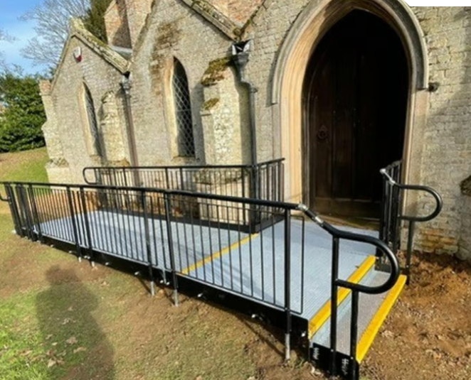
Common Questions
2. Are historical buildings exempt from ADA/accessibility compliance?
No. Historical buildings are NOT exempt, although there are special allowances for the preservation of historic features.
The ADA law contains no “grandfathering” provisions. Regardless of when built, all places of public accommodation are required to comply if it is accomplishable without significant burden or expense.
Failure to comply leaves you vulnerable to a discrimination claim or lawsuit.
www.sanjoseca.gov/ADAgrant

Slide 16
Common Questions
3. In addition to the City’s grant, is there other financial support?
Yes:
Federal tax credits and deductions - Consult your tax accountant to confirm allowable expenditures.
California Capital Access Program Americans with Disabilities Act (CalCAP/ADA) Financing Program – Assists with financing the costs to comply with ADA requirements. Qualifying small businesses may receive more favorable loan terms if enrolled in the program. Learn more: http://treasurer.ca.gov/cpcfa/calcap/ada
www.sanjoseca.gov/ADAgrant

Slide 17
Questions?
Juan Borrelli, AICP
Small Business Ally Program Manager
juan.borrelli@sanjoseca.gov
(408) 975-2655
www.sanjoseca.gov/ADAgrant

