Slide 1
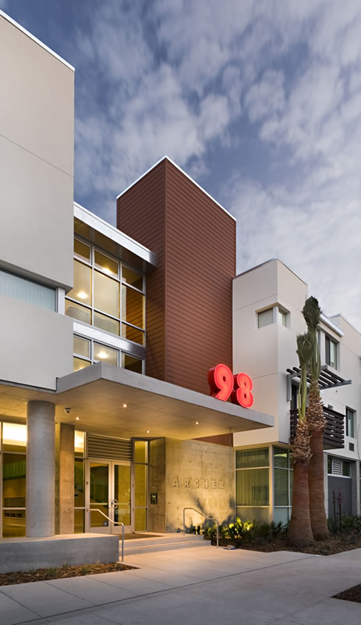
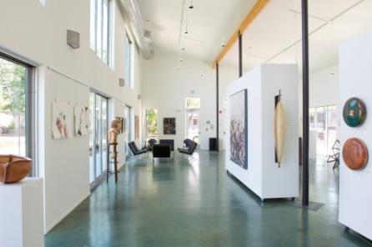
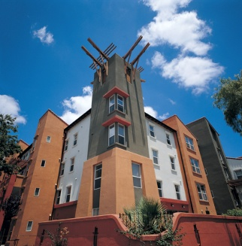
Housing Impact Fee
City of San José Department of Housing
2015 Homeless Census Results and Homelessness Response Update
Neighborhoods Commission
October 14, 2015
Michelle Covert
Housing Department
michelle.covert@sanjoseca.gov
City of San Jose Department of Housing
Notes:
1

Slide 2
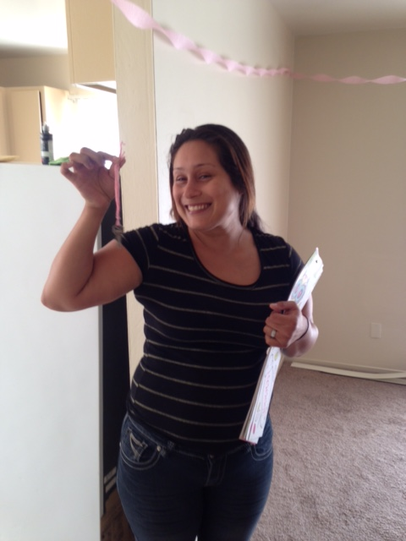
Census Results
4,063 homeless individuals
15% reduction from 2013
Notes:
2

Slide 3
Encampments in San Jose
778 residing in encampments
37% reduction from 2013
Notes:
3

Slide 4
Sub-populations
498 veterans
388 individuals in families
503 Youth (18-24)
32 minors
1,409 chronics
Notes:
4

Slide 5
Barriers to Exiting Homelessness
69% report an inability to afford rent
57% report lack of income
Notes:
5

Slide 6
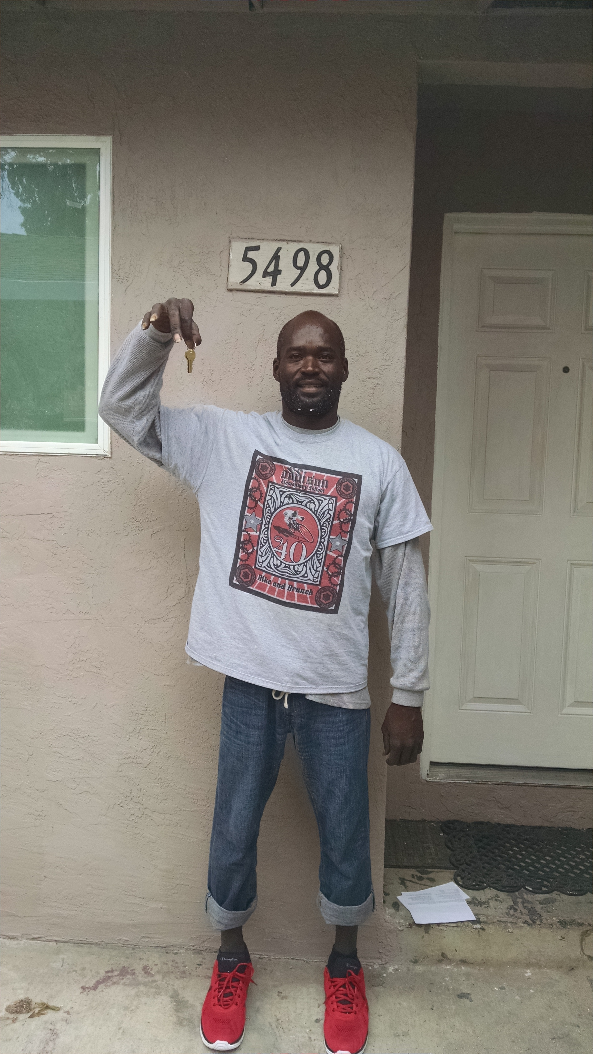
Success in Partnership
Place-based rapid re-housing
City/County collaboration
Destination:Home
Notes:
6

Slide 7
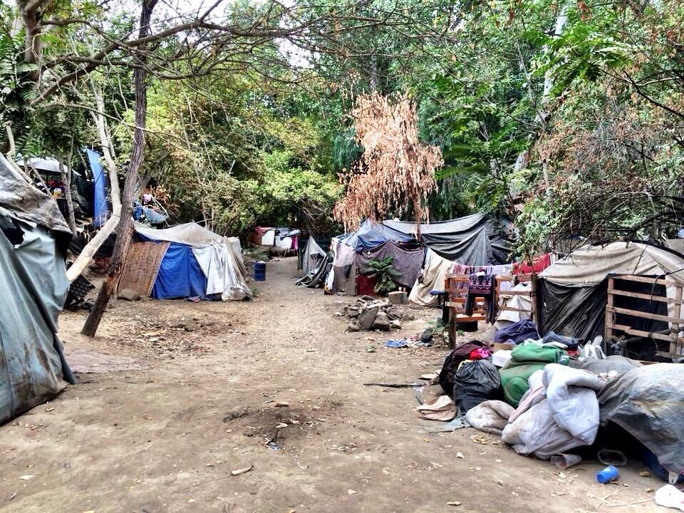
Challenges
Tight rental market
New development: location, timing, cost
Urgency of need
Notes:
7

Slide 8
Next Steps
New targeted strategies
Downtown and City-wide outreach
Chronic case management
Home Court
Groundwerx-Downtown Streets Team partnership
200 rental subsidy coupons
Transition in Place (TIP) apartments
Notes:
8

Slide 9
Next Steps
Short-term interventions
Warming Centers
Mobile hygiene and support services
Hotel master leasing and conversion (100+ units)
Safe Parking pilot (30 spaces)
Transitional Communities (100+ units)
Notes:
9

Slide 10
Next Steps
600 permanent supportive housing units
Second Street Studios
Downtown Supportive Housing Project
Senter Road
Balbach
Vermont House
North San Pedro
Notes:
10

Slide 11
Homeless Hotline
outreach@homefirstscc.org
408-510-7600 option 3
Centralized outreach response/ Abatement Planning

