Slide 1

2013

Slide 2
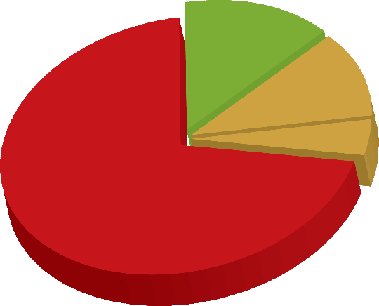
Who Receives Benefits from Social Security?
Over 56 Million People
4.3 million
Widows/ Widowers
8.4 million Disabled
Workers, 2.1 million
Dependents
1.9 million
Children
36.4 million
Retired Workers
2.9 million
Dependents
10/2012
Notes:
This graph is simply meant as an overview of the number of beneficiaries that we pay. Currently, about one in every six people in America is receiving a Social Security benefit. It can be used to reflect the fact that the majority of our beneficiaries are retired. This is a graphic representation of how important Social Security is to the national economy.
It also represents the fact that Social Security is more than retirement...it is a family protection plan (1/3 of the benefits paid are for disability and survivors)

Slide 3

Preparing for Retirement
Social Security replaces
about 40% of pre- retirement
earnings.
The average monthly Social Security
retirement check in 2013 is $1,261
($1,240 in 2012)
Social Security is the
foundation on which to
build retirement security;
you’ll also need
pension & savings

Slide 4
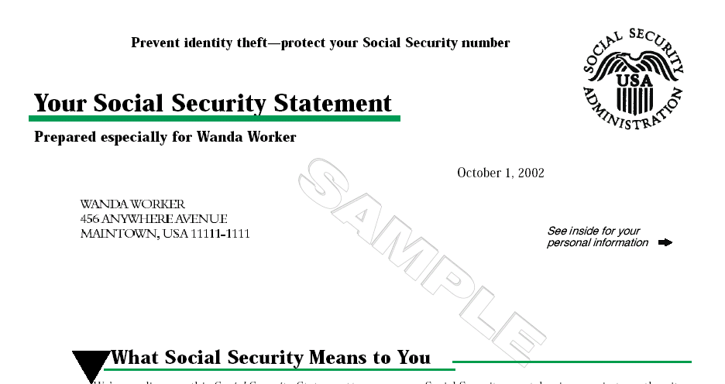
The Social Security Statement
“The Future’s In Your Hands”
VERIFY
REVIEW
PLAN
Notes:
This slide is offered as a summary piece to your presentation.

Slide 5
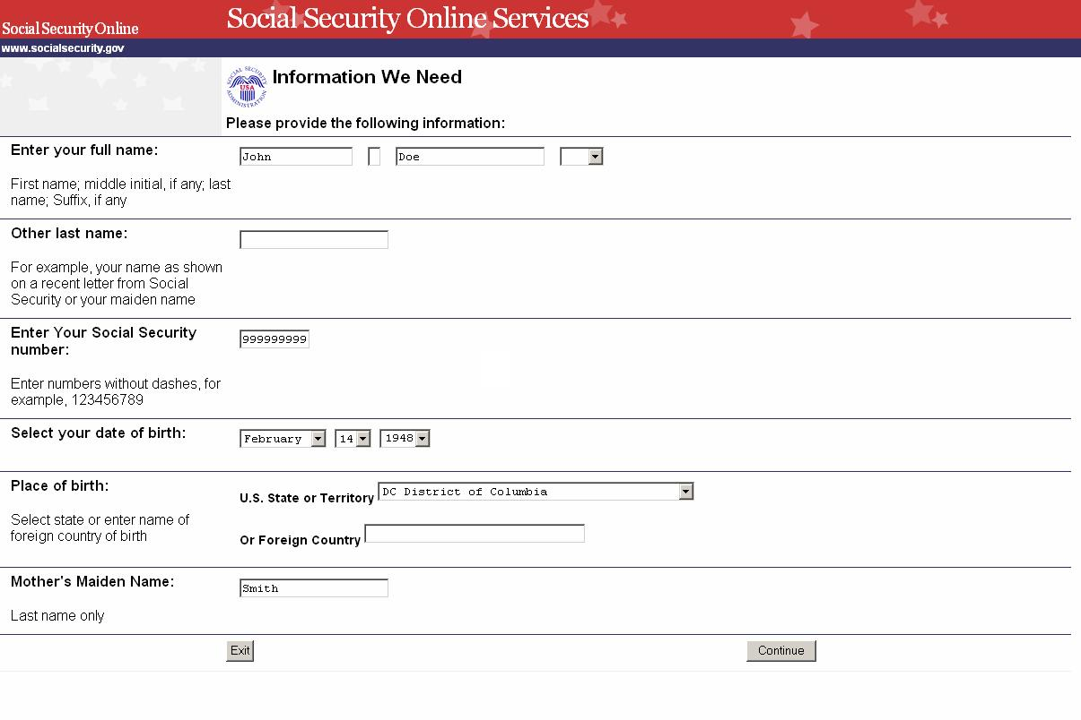

Slide 6
Calculating the Retirement Benefit
All earnings where Social Security taxes
were paid are used to compute benefits.
The highest 35 years of earnings are used in the calculation
There is a limit in how much earnings are taxed for Social Security each year, and counted towards the calculation.
In 2013, the maximum amount taxable for Social Security is $113,700 ($110,100 in 2012)
Because of these maximum limits, a maximum monthly payment of $2,533 can be yielded in 2012 ($2,313 in 2012)

Slide 7

When Do Benefits Begin?
As early as age 62 (reduction in benefits)
At Full Retirement Age (no reduction-100%)
Delayed retirement (increase in benefits up to age 70)
( Or any month in between these intervals)

Slide 8

You Can Work
& Still Receive Benefits
2013
If You Make More,
2013 You Can Make Some Benefits Will
Calendar Year Up To Be Withheld
Under Full $15,120 ($1,260/mo.) $1 for every $2
Retirement Age
Months Before $40,080 ($3,340/mo.) $1 for every $3
Full Retirement Age
Month of Full Retirement Age No Limit
& Above
Notes:
The annual earnings test for beneficiaries under age 65 is determined annually by the average increase in wages in the U.S.
The explanation of the elimination of the annual earnings test can become complicated due to the fact that full retirement age has been increased. For workers turning age 65 in 2001, the explanation is quite simple. They are not affected by the A.E.T. after attaining age 65 because their full retirement age has not changed.
Members of your audience that were born after 1937 have seen their full retirement age increased. For example:
A worker born in 6/1939 will attain age 65 in 6/2004.
Since their full retirement age is now 65 and 4 months,
they will not reach full retirement age until 10/2004.
They will be subject to the age 65 A.E.T. through
9/2004. As of 10/2004, the month wage earner attained
full retirement age, wage earner is no longer subject to
the A.E.T.
The over age 65 amount was determined by legislation in 1996.

Slide 9

Who Can Get Medicare?
65 & older
-or-
Receiving Social Security disability
benefits at least 24 months
-or-
Permanent kidney failure
-or-
Amyotrophic Lateral Sclerosis (ALS)
Notes:
You may wish to remind your audience that although the full retirement age has been increased above age 65, Medicare eligibility is still at age 65.

Slide 10
Medicare Coverage
Part A: Hospital Insurance
      Covers most inpatient hospital expenses
      No monthly premium with 40 SS or Medicare credits
      2013 Deductible: $1,184* for up to 60 days in the hospital
      $296* daily deductible for days 61 through 90
      $592* daily deductible for days 91 through 150
      ( *without an employer health plan or Medi-gap policy)
Part B: Supplementary Medical Insurance
      Covers 80% doctor bills & other outpatient medical
      expenses after $147 in approved charges.
      2013 Monthly Premium $104.90*
  Part D: Medicare Prescription Drug Plan
      Covers a major portion of prescription drug costs
      for Medicare beneficiaries.
      2013 average Monthly Premium $63.00
      Annual deductible and co-payments vary by plan
www.medicare.gov or 1-800-MEDICARE
Notes:
You may wish to remind your audience that there is no monthly premium for Part A if you are insured for retirement benefits.
Many people question the need to file for Part B of Medicare. They should be reminded that their health insurance when they retire will pay only after Medicare pays. Many supplemental plans actually require people to file for Part B. The Medicare premium that beneficiaries pay represents 1/4 of the actual cost; the federal government (covers the balance of the cost.
Part D Medicare Prescription Drug Plan covers a major portion of prescription drug costs for Medicare beneficiaries. Average monthly premium $32.

Slide 11
New Part B Premiums in 2013
Medicare beneficiaries with income greater than $85,000 ($170,000/couple)
Part B Premiums in 2013 will be calculated on a sliding scale based on the modified adjusted gross income reported on IRS tax returns
Under $85,000 ($170,000/couple): Part B premium $104.90
$85,000-$107,000 ($170,000-$214,000/couple): Part B premium $143.90
$107,000-$160,000 ($214,000-$320,000/couple): Part B premium $209.80
$160,000-$214,000 ($320,000-$428,000/couple): Part B premium $272.70
Over $214,000 ($428,000/couple): Part B premium $335.70
Automated data from IRS used to calculate the premium
Income from two years prior will be used to compute the premium (i.e. adjusted gross income for 2011 used to calculate the premium in 2013)
Appeals available if income has changed due to divorce, death of a spouse, retirement, natural disaster, etc.

Slide 12
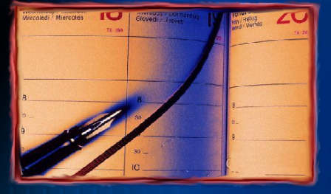
When Can I Sign Up for Medicare Part B?
Part B Medicare Enrollment Periods:
Initial Enrollment – 3 months before and after age 65
Special Enrollment - if still working or spouse is still working
General Enrollment* - January-March; becomes effective July
*10% Penalty for every 12 months of delayed filing of Part B
Notes:
The Initial Enrollment Period starts 3 months before the month that you turn age 65 and extends 3 months past the month that you turn 65. If you are not receiving benefits, you should inquire about filing for Medicare 3 months prior to turning age 65 so that your coverage can start the month you turn 65. If you are receiving benefits, you will receive your Medicare card generally about a month before turning age 65, reflecting your Part A and Part B coverage (by far, most people want Part B, even though it's optional).
The Special Enrollment Period is for people (and their spouses) that continue to work past age 65. Since Medicare pays second after their employer group health plan pays first, they are not required to file for Part B. Since Medicare pays second there may be no need for Part B coverage. It is extremely important for workers to check with their employer group health plan for specific guidance. For this reason, they are offered a special period in which to file for Medicare. As a general rule, we can recommend that people file for Part A 3 months prior to turning age 65, and then on the day they stop working call SSA to file for Part B.
The General Enrollment Period is for those people that missed their Initial or Special Enrollment Periods. The window to file is January to March with coverage not beginning until July. If one files in the General Enrollment Period, they will be assessed a 10% penalty for each year after their Initial period.

Slide 13
Benefits Can Be Taxable
Individual Tax Return
$25,000 to $34,000
50% of Social Security Benefits are Taxable
Over $34,000
85% of Social Security Benefits are Taxable
Married Filing a Joint Tax Return
$32,000 to $44,000
50% of Benefits are Taxable
Over $44,000
85% of Benefits are Taxable
Notes:
You may wish to explain how a widow or widower can receive a survivors benefit at age 60 and then switch to a benefit on their own work record at age 62. Or, how a widow or widower could receive a reduced survivors benefit at age 60 and then file for an unreduced benefit on their own work record at their full retirement age.

Slide 14
File a Retirement Application Online in less than 15 minutes!

Slide 15
Apply for Medicare Online Now

Slide 16
What If I Receive a Pension from a Job Where I Did Not Pay Social Security?
Your Social Security benefits can be reduced:
Windfall Elimination Provision
and/or
Government Pension Offset

Slide 17
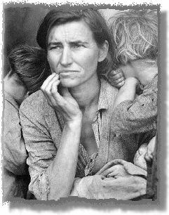
Why a Reduction?
Social Security is a historic national social program
In times of loss of income due to retirement, a disability or a death in the family, Social Security replaces the loss of income and raises the standard of living of lower income workers.
The benefit formula factors in a higher rate of return for lower income workers. (See Comparison Chart on later slide)
The average retirement payment of a worker contributing in the Social Security system for 35 work years is $1,261/month and a maximum of $2,533/month in 2013. (and with probability of no company pension)

Slide 18
Windfall Elimination Provision (WEP)
You have earned 40 Social Security credits and qualify for benefits on your own Social Security record.
If any part of your government pension is based on work where you were not required to pay the Social Security tax (also known as a “non-covered” pension)
A “weighted” formula is used to calculate benefits instead of the standard formula, but you will always receive a payment
The weighted formula is only applied to
the Social Security payment if you are
receiving both the non-covered pension
and Social Security benefits.

Slide 19
The “Weighted” Formula
Social Security benefits are calculated using 35 highest years of earnings (adjusted for inflation) in your work history.
The total is divided by 420
(35 years x 12 months) to compute the average monthly amount
The “weighted” formula is applied to derive the full unreduced monthly Social Security payment instead of using the regular formula

Slide 20
The “Weighted” Formula for those turning 62 in 2013
Using the Average Monthly Amount
Standard Computation WEP Computation
90% of first $791 40% of first $791
32% of next $4,768 32% of next $4,768
15% of remainder 15% of remainder
Maximum Difference is 50% of $791= $395.50

Slide 21
Example
SSA Work History: SSA Work History (Govt. Employee)
20 years of $10,000 10 years of $20,000
15 years of $0.00 25 years of $0.00
35 total years = $200,000 35 years of $200,000
$200,000 divided by 420 months = $476/month
If age 62 in 2012: first tier of computation is 90% up to $791
90% of $476 = $428/month (standard computation)
vs.
40% of $476 = $190/month (with non-covered pension)
Note: Reduction is never more than $395.50 for those turning 62 in 2013

Slide 22
Exceptions to the Reduction of the“Weighted” Formula
Federal worker first hired after December 1st, 1983 -OR-
Employed by a nonprofit organization exempt from Social Security on December 1st, 1983 -OR-
Your only pension is based on railroad employment -OR-
Your only work where you did not pay Social Security was before 1957 -OR-
You have earned 30 or more “substantial” years of Social Security earnings (see next chart)

Slide 23
Substantial Years of Work Covered Under Social Security
What Qualifies as Substantial Earnings
1937-50 $ 900
1951-54 $ 900
1955-58 $1,050
1959-65 $1,200
1966-67 $1,650
1968-71 $1,950
1972 $2,250
1973 $2,700
$3,300
1987 $8,175
1988 $8,400
1989 $8,925
1990 $9,525
1991 $9,900
1992 $10,350
2008 $18,975
2009 $19,800
$19,800
$19.800
$20,475
$21,075
Total # of Years
of Substantial Percentage
Earnings used in formula
30 or more 90 percent
29 85 percent
28 80 percent
27 75 percent
26 70 percent
25 65 percent
24 60 percent
23 55 percent
22 50 percent
21 45 percent
20 or less 40 percent
1993 $10,725
1994 $11,250
1995 $11,325
1996 $11,625
1997 $12,150
1998 $12,675
1999 $13,425
2000 $14,175
2001 $14,925
1975 $3,525
1976 $3,825
1977 $4,125
1978 $4,425
1979 $4,725
1980 $5,100
1981 $5,550
1982 $6,075
$6,675
1984 $7,050
1985 $7,425
1986 $7,875
2002 $15,750
2003 $16,125
2004 $16,275
$16,725
2006 $17,475
2007 $18,150

Slide 24
Government Pension Offset
(GPO)
If you receive a government pension based on your own work where Social Security was not paid
Benefits filed as a spouse on your spouse’s record may be reduced to zero.
Social Security benefits filed as a spouse or divorced spouse, and death payments as a widow or divorced widow may be reduced to zero.

Slide 25

How Much is the Reduction?
Two-thirds of the amount
of the Government pension
Example:
$1,200 Government pension 2/3 =$800
Social Security Spouse Benefits =$600
No cash benefit payable as a spouse
Notes:
The Government Pension Offset (GPO) affects people who earned a pension while working in non-covered government employment. Unless a federal worker switched to FERS and worked under FERS for at least 5 years, the GPO will affect the amount of the wife’s/husband’s or widow’s(er’s) benefits payable to them.
Generally, the concept of spouse’s benefits have the inherent concept of dependency. The notion that a spouse is working in non-covered employment and thereby earning a pension from that employment argues against the notion of dependency. As a result, the GPO was passed as part of the 83 Amendments.
The fact sheet, "Government Pension Offset," provides a very good detailed overview of the GPO and all of the exceptions.
Understanding the WEP and GPO by themselves is not a problem. Many people become confused when they mix the principles of each together. It is very possible for a worker to be affected by the WEP on their own work record due to their government pension and to have any potential spousal benefit payable to them affected by the GPO.

Slide 26
WEP vs. GPO
WEP reduces benefits on your own Social Security record if you receive a pension where you worked and did not pay Social Security.
(Reduced, but will always receive a payment)
GPO reduces any benefits you may be eligible for on your spouse’s Social Security record if you receive a pension where you worked and did not pay Social Security.
(Reduced by two thirds of the government pension with possibility of no payment due)

Slide 27
Common Exceptions
PERS, STRS, OPM pension is based on work where all earnings were subject to Social Security tax.
WEP and GPO reductions do not apply to Social Security benefits until the “non-covered” pension is received.
30 years of “substantial” Social Security earnings
Receipt of a non-covered pension (PERS, STRS, OPM) as a spouse or survivor is not subject to WEP or GPO because the non-covered pension is not based on their own work.

Slide 28
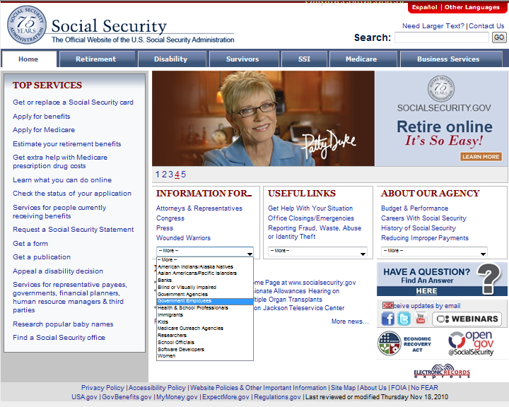
Do you receive a government pension?

Slide 29


Visit Our Website or Call!
1-800-772-1213
www.socialsecurity.gov
Notes:
You may wish to use this slide as a segway into our online services offered on the next slide.

