Slide 1
Digital Inclusion Strategy
San José Youth Commission
Office of Civic Innovation and Digital Strategy
February 27, 2017

Slide 2
Digital Inclusion
Digital Inclusion Creates Opportunity
Outcomes
Teenagers with home broadband
6-8% more likely to graduate from high school
CPS, NLSY
0.3% employment increase for every +1% of digital inclusion
- Brookings Institute
Online learning blended with in-person instruction reduces subject learning time 50% increasing course completion rates 200%
- Carnegie Mellon University
Outcomes
Online high school graduates are twice as likely to go to college as those who are not online
- FCC
71% of teens say internet has been primary source for recent school project
- FCC
20% more likely to be re-employed within 12 months with internet access
NTIA
38% fewer hospital admissions in telemedicine trial
- American Journal of Managed Care
Digital
Inclusion

Slide 3
Digital Inclusion
Lack of Digital Equity in San Jose
Source: 2015 American Communities Survey
Percentages are compared to category – overlap occurs

Slide 4
Digital Inclusion
Key Barriers to Inclusion
Affordability
Access
    Devices
    Connectivity
Adoption
    Awareness - understand benefits
    Accessibility - regardless of background, income, disability, or location
    Digital and Information literacy – usage, “what’s real”, and technical skills
    Relevance – driving users to internet which stimulates inclusion (generates demand)
    Safety – cyber security, education, protection
Dynamics impacting inclusion
Technology change
  Devices
  Broadband networks
  Forms of engagement
Demographics
  New arrivals
Market and regulatory forces
  Price reductions
  Broadband reform
Everything digital
  Private and city services
  Internet of Things

Slide 5
Digital Inclusion
Data Driven Strategy Requires Local Research
Lowering price of broadband will increase adoption
Digital Literacy must address multiple facets of adoption
Access
Affordability
Adoption
Source: STATE LEVEL DATA: 2016 Field Poll Survey for California Emerging Technology Fund

Slide 6
Digital Inclusion and Literacy Work Group
Framework and Research Phase Review
Research
Strategy
Action Plans
Implementation
Connectivity Programs
Device Programs
Literacy Programs
New/expanded programs/solutions
Pilots
Lessons learned
Ongoing collaboration
School/City Collaborative
Street Surveys
Outreach
Digital Inclusion
Broadband
Research
Action
High Impact Opportunities and Quick Wins

Slide 7
Research Phase
School City Collaborative
  Focus groups and interviews with school stakeholders
  Questions answered include:
    What are the barriers to 21st century learning at home and at school?
    Are existing programs sufficient?
    Which programs hold promise and might be expanded?
    What opportunities might exist for new programs?
Outreach
  Interviews with NGOs currently playing a role in digital inclusion or having high future potential
  Questions answered include:
    What is the breadth and reach of existing programs? How well are they performing? How might they be expanded?
    What role should the city play in leveraging existing or new resources to focus on digital inclusion?
Street Surveys
  Surveys directly targeting low income households including insights from above
  Questions answered include:
    Is internet access, access to devices, or digital literacy the biggest barrier to adoption?
    What role does language and culture play in digital inclusion barriers?
    What access and literacy programs are being used?

Slide 8
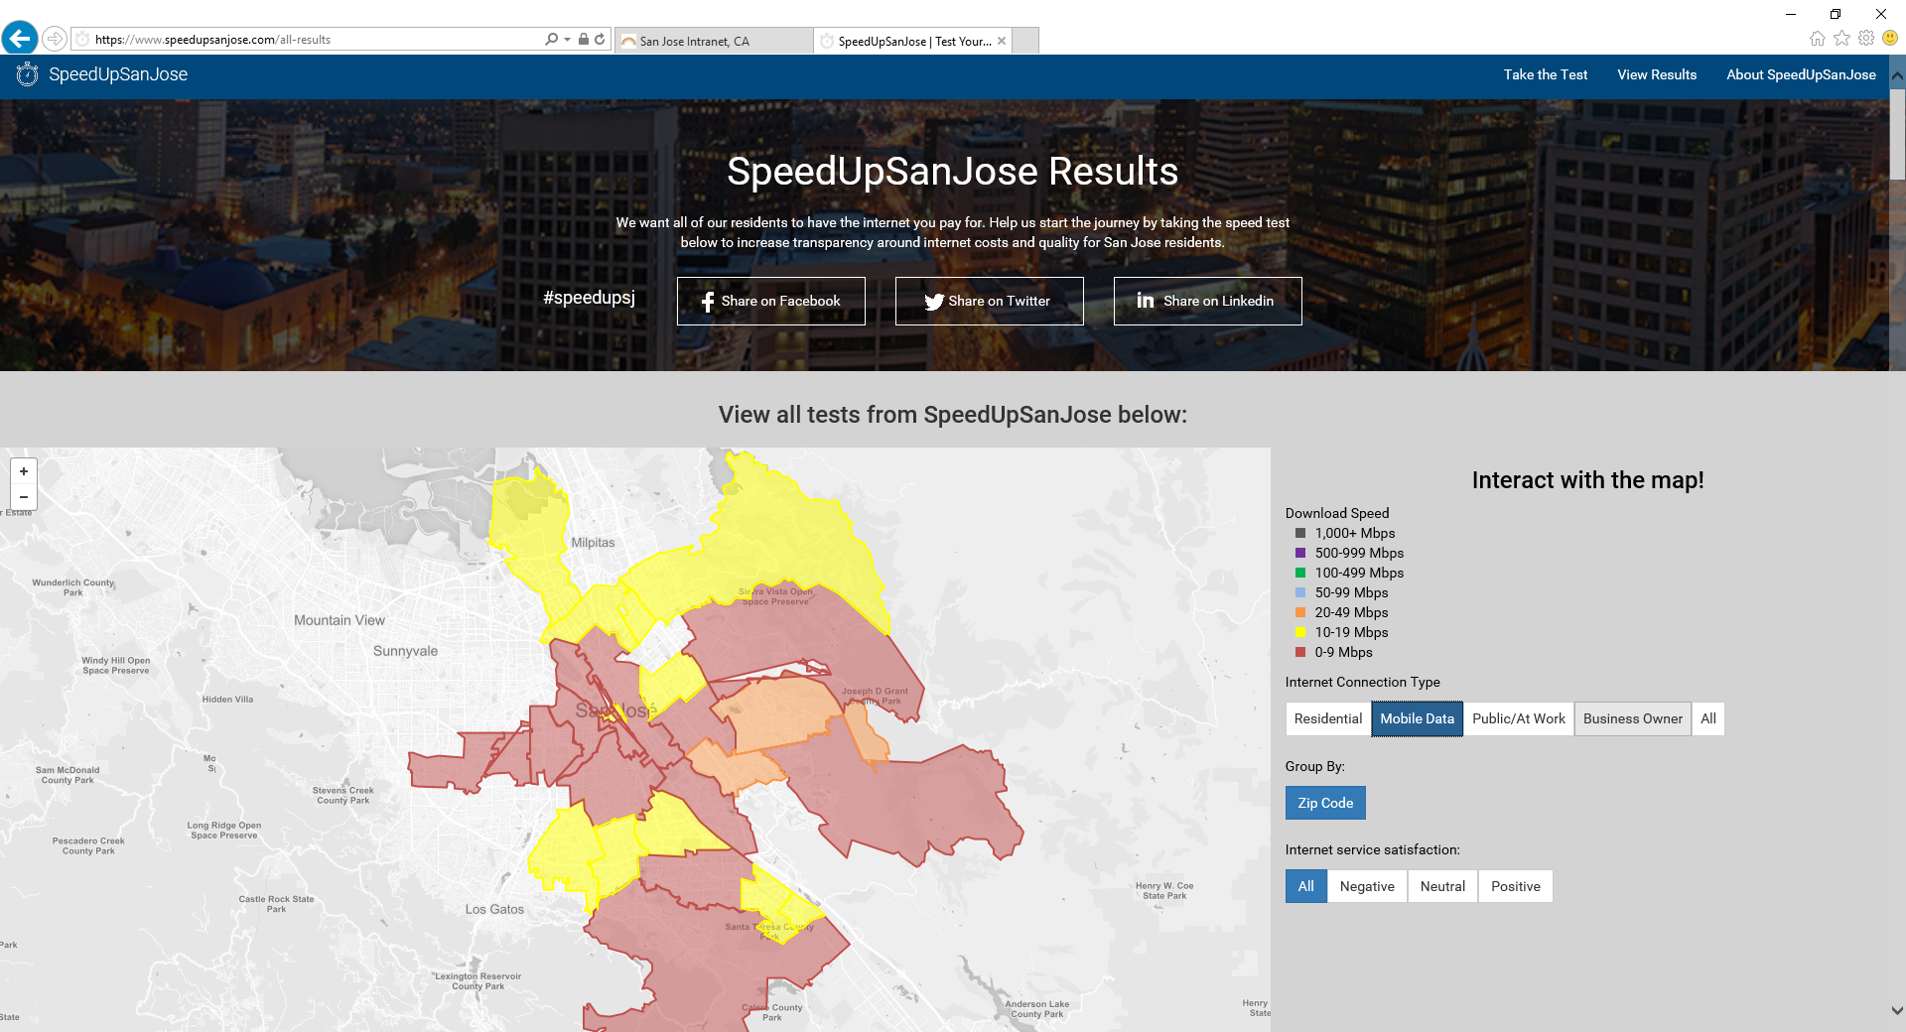
Research Phase
Speedup San Jose
Residential, Mobile, and Public internet testing
Questions answered include:
  What is the Internet service quality in underserved communities?
  Is our digital infrastructure able to support 21st century learning?
  What areas need improvement to enable digital learning from home?

Slide 9
Digital Inclusion
Interconnected City Wide Strategies
Digital Inclusion Strategy
    Identify innovative programs and interventions to address the digital inclusion gap
    Focus on residents, small business/entrepreneurs/incubators
    Iterate on community segments – starting with low income families and seniors
Broadband Strategy
    Assess digital infrastructure in light of San Jose’s Smart City Vision and Digital Inclusion goals
    Understand current market forces, appropriate technology options, governance
    Identify potential strategic interventions necessary to close gaps

Slide 10
Digital Inclusion
Opportunity to Join Forces with Youth Commission
Youth Commission sponsored student research
  Needs, barriers, opportunities, solutions, other ideas
Youth Commission digital inclusion group
Other ideas?!

