Slide 1
City of San José
2016-2017 Proposed
Operating Budget Overview
May 11, 2016
Notes:
0
0

Slide 2
City of San José Budget Overview
2016-2017 PROPOSED CITY BUDGET¹: | $2.9 billion
TOTAL NUMBER OF FUNDS: | 111
TOTAL NUMBER OF POSITIONS (FTE): | 6,099
¹ An adjustment of $611 million is necessary to arrive at the $2.9 billion net 2016-2017 Proposed City Budget to avoid the double-counting of transfers, loans, and contributions between City funds.
Slide 1

Slide 3
2016-2017 Proposed Budget Overview
All funds (General Fund, special and capital funds) brought into balance
General Fund projected surplus of $6.9 million, along with one-time funds, allocated to close projected 2017-2018 shortfall; additional one-time funding available for other high priority needs in 2016-2017
Targeted investments in:
Save (investments to ensure fiscal stability)
Invest and Innovate (investments in safety, economic opportunity, our future, and our community)
Invest in Making San Jose America’s Most Innovative City (investments that support innovation and strategic partnerships and increase transparency and community input)
Modest employee compensation increases included
Positions are up 2.6%, from 5,945 to 6,099 (vast majority offset by revenues/reimbursements/net-zero shifts or added in special/capital funds)
Slide 2

Slide 4
2017-2021 General Fund Forecast
2017-2021 General Fund Forecast
Incremental General Fund Surplus/(Shortfall)
* Excludes Development Fee Programs and was revised from the $5.7 million surplus presented in the February 2016 Forecast based on continued analysis. With no surplus in the Development Fee Programs, the General Fund surplus addressed in the 2016-2017 Proposed Budget remains at $6.9 million.
Does not include:
Impacts associated with any new revenue measures
Implementation of the alternative pension reform settlement framework agreements
Costs associated with services funded on a one-time basis in 2015-2016
Costs associated with the restoration of key services to January 2011 levels
Costs for a Police Staffing Restoration Strategy to increase sworn positions from 1,109 to 1,250
Costs associated with unmet/deferred infrastructure and maintenance needs
One-time revenues/expenses
Slide 3

Slide 5
2016-2017 Proposed Budget – General Fund Funding Sources
TOTAL GENERAL FUND SOURCES: $1,090,183,333
Slide 4

Slide 6
2016-2017 Proposed Budget – General Fund Uses
TOTAL GENERAL FUND USES $1,090,183,333
Slide 5

Slide 7
2016-2017 Proposed Budget – General Fund Uses by Category
TOTAL GENERAL FUND USES $1,090,183,333
Slide 6

Slide 8
2016-2017 Budget Balancing Strategy General Framework and Policy Direction
Mayor’s March Budget Message as approved by the City Council (March 2016)
Budget Balancing Strategy Guidelines contained in the City Manager’s Budget Request (Five-Year Forecast) as approved by the City Council (March 2016)
Guiding Principles for Restoring City Service Levels as approved by the City Council (March 2012)
City of San José Budget Principles as approved by the City Council (September 2008)
Slide 7

Slide 9
2016-2017 Budget Balancing Strategy General Fund
2016-2017 Ongoing
Total General Fund Surplus $ 6.9 M $ 6.9 M
Recommended Balancing Strategy
Changes in Sources $ 43.3 M $ 6.6 M
Changes in Uses 50.2 M 13.5 M
Total Balancing Strategy $ (6.9 M) $ (6.9 M)
Remaining Balance $ 0.0 M $ 0.0 M
Slide 8

Slide 10
2016-2017 Budget Balancing Strategy Changes in General Fund Sources
2016-2017 Ongoing
Beginning Fund Balance
Sales Tax – State Triple Flip Wind Down $ 12.1 M $ 0
2016-2017 Police Overtime Reserve 5.0 M 0
Police Department Vacancy Savings 5.0 M 0
Property Tax – Educational Rev. Aug. Fund Excess 4.6 M 0
Development Fee Program Reserves 3.9 M 2.6 M
Cultural Facilities Capital Maintenance Reserve 3.7 M 0
Police Department Staffing/Operations Reserve 1.6 M 0
Employee Market Competitiveness Reserve 1.3 M 0
Staffing for SAFER Grant Reserve 0.7 M 0
Other Revenue/Reserve Liquidations/Savings 0.9 M 0
Grants/Reimbursements/Fees 3.4 M 3.1 M
Overhead/Transfers from Other Funds 1.1 M 0.9 M
Total Change in Funding Sources $ 43.3 M $ 6.6 M
Slide 9

Slide 11
2016-2017 Budget Balancing Strategy Changes in General Fund Uses
2016-2017 Ongoing
Service Level Enhancements/Urgent Needs $ 13.8 M $ 2.2 M
Unmet/Deferred Infrastructure/Maintenance 10.9 M 0.2 M
2015-2016 One-Time Funded Services 9.1 M 0.1 M
Earmarked Reserves 8.4 M 0.2 M
2017-2018 Future Deficit Reserve 4.1 M 6.9 M
Development Fee Programs 3.3 M 2.2 M
Other Fee Programs/Grants/Reimbursements 2.4 M 2.3 M
New Facilities Operations and Maintenance 1.8 M 2.2 M
Use of Reserves (2.6 M) (2.2 M)
Cost Reductions/Fund Shifts (1.0 M) (0.6 M)
Total Change in Funding Uses $50.2 M $13.5 M
Slide 10

Slide 12
Recommended Budget Actions Save
2017-2018 Future Deficit Reserve
Budget Stabilization Reserve
Contingency Reserve
Securing Future Savings in Pension and Retiree Healthcare (polling costs)
Slide 11
Notes:
11

Slide 13
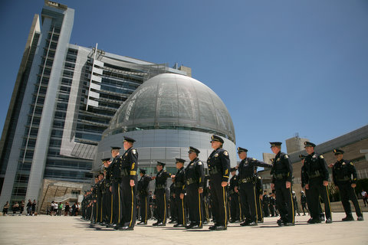
Recommended Budget Actions Invest and Innovate: Safety
Police Overtime
Downtown Police Foot Patrol Program
Police Recruitment Services
Police Body Worn Camera Program
Police Department AIR2 Helicopter Engine Replacement
Medical Marijuana Control Division Staffing and CEQA Review
Police Department Bureau of Technical Services Civilian Leadership
Police Business Permit and Licensing System
Police Intelligence Technology Enhancements
Gang Investigations Technology Enhancements
Anti-Human Trafficking Program
Slide 12
Notes:
12

Slide 14
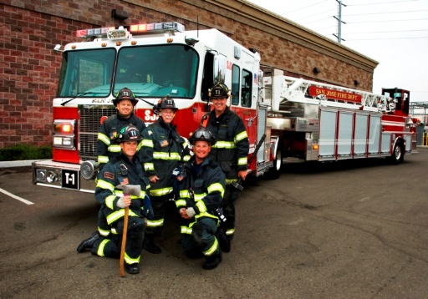
Recommended Budget Actions Invest and Innovate: Safety (Cont’d.)
Crime Prevention Meeting Space
Domestic Violence Prevention Program
Silicon Valley Regional Communications System Reserve
Police Department Staffing/Operations Reserve
Master Address Database
San José Works
Using Technology to Improve Emergency Response
Fire Administrative Staffing Realignment
Office of Emergency Services
Fire Engine 30 and 34/Squad Car Realignment
Fire Department Strategic Diversity Recruitment
Fireworks
Slide 13
Notes:
13

Slide 15
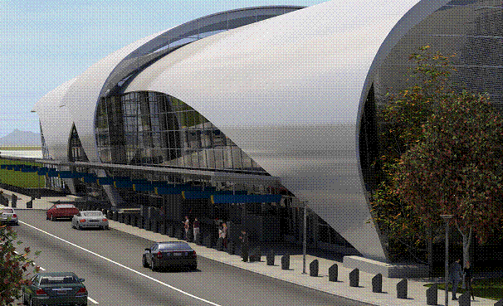
Recommended Budget Actions Invest and Innovate: Economic Opportunity
Opportunity Court
Affordable Impact Fees
Business Improvement District Creation
Manufacturing Jobs Initiative
Airport Attraction Program
San José Sports Authority
Diridon Station Area Planning
Slide 14
Notes:
14

Slide 16
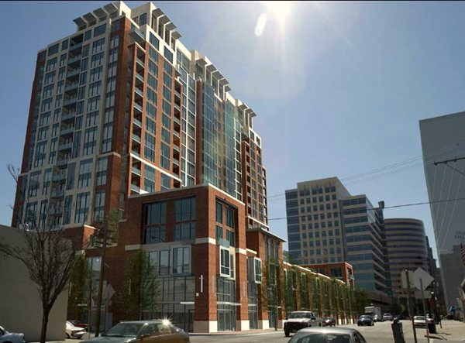
Recommended Budget Actions Invest and Innovate: Economic Opportunity (Cont’d.)
Economic Strategy Activation
Economic Development Pre-Development Activities
Policy and Ordinance Assistance
Development Fee Programs:
Building Development Fee Program
Planning Development Fee Program
Public Works Development Fee Program
Fire Development Fee Program

Slide 17
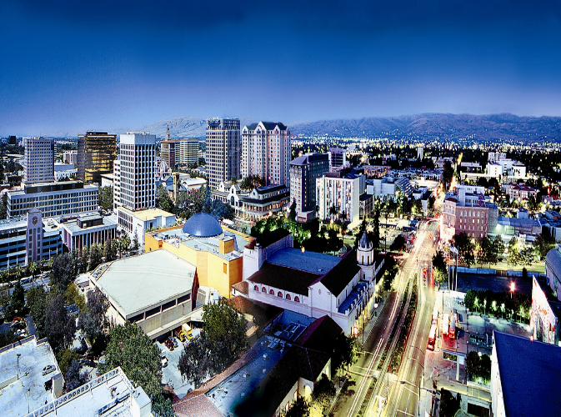
Recommended Budget Actions Invest and Innovate: Our Future
Children’s Health Fluoridation
Community Choice Aggregation Study
Family College Success Center
Single Family Dwelling Waste Materials Processing (Phase III)
Slide 16
Notes:
16

Slide 18
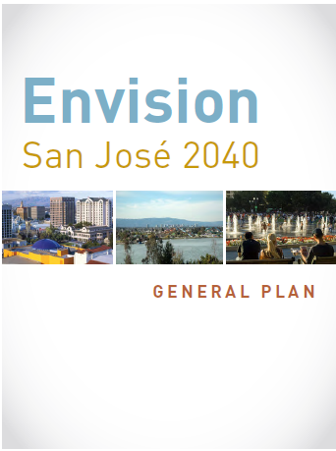
Recommended Budget Actions Invest and Innovate: Our Community
Illegal Dumping Rapid Response Program
Large Item Collections
Neighborhood-Led Beautification Days
Neighborhood Blight Eradication (work experience for homeless individuals)
Clean Creeks/Healthy Communities
Cultural Facilities Capital Maintenance
San José Stage Company Publically Owned Theater Site
Vietnamese-American Community Center
Placemaking: Viva CalleSJ and ¡VivaParks!
Parks Rehabilitation Strike Team
Slide 17
Notes:
17

Slide 19
Recommended Budget Actions Invest and Innovate: Our Community (Cont’d.)
Regional Parks – Monday Opening
Family Camp Experience for Low Income Families
Library Programs
Library Fines and Fees Decrease
PRNS Fee Activity Program
Gardner Community Center
Animal Care and Services
Downtown Parking Garage
Office of Immigrant Affairs
Essential Services Reserve

Slide 20
Recommended Budget Actions Invest in Making San José America’s Most Innovative City
Office of Innovation and Digital Strategy
Transportation Innovation Program Manager
Integrated Permit System
Human Resources/Payroll/Budget Systems
Secondary Data Center Buildout
Virtual Desktop Infrastructure and Windows Upgrades
Remote Facilities Network Upgrades
Silicon Valley Talent Partnership

Slide 21
Recommended Budget Actions Other Budget Actions
City-Owned Facilities – Capital Infrastructure Improvements
Human Resources Assistant Director
Workers’ Compensation Claims Administration Backlog
Employment Services Division Job Class Specification Updates
Employment Services Division Recruitment Staffing
Legal Transactions Staffing
Successor Agency City Subsidy Reduction (Administrative Support)
Slide 20
Notes:
20

Slide 22
Recommended Budget Actions Fee and Charges Adjustments
Utilities:
Storm Sewer Service Fee: No increase
Sewer Service and Use Charge Fee: 5.5% increase
Recycle Plus Rates: 2.5% increase for multi-family dwellings
Municipal Water System Rates: 2.0% increase due to increased operating costs; further adjustments may be required during 2016-2017 (e.g., water usage, sources of wholesale water)
Development Fee Programs: No general fee increases
Other Fee Programs: Fee changes to generally maintain cost recovery
Slide 21

Slide 23
Looking Forward
Budget expected to be relatively stable over the next few years, but is vulnerable to an economic downturn
“Service level deficit”: Absent new revenues, services will remain well below what the community deserves and expects from the City
Sales Tax ballot measure before the voters on June 7th: 2016-2017 Provisional Budget and Ongoing Spending Priorities Plan will be brought forward as part of a Manager’s Budget Addendum
City will continue its commitment to fiscal discipline, innovation, partnership, and community engagement to maximize resources and rebuild services
Slide 22

Slide 24
Next Steps
May 2nd through 26th Community Budget Meetings
May 11th through 16th City Council Budget Study Sessions
May 17th/June 13th Public Budget Hearings
June 3rd Mayor’s June Budget Message Released
June 14th Council Review/Approval of Mayor’s June Budget Message and Budget
June 21st Adoption of the 2016-2017 Budget and Fees and Charges
Slide 23
Notes:
23

Slide 25
FY16/17 Economic Forecast:
Cautious optimism for year ahead
Jobs and Unemployment
GDP and Consumer Spending
Permits and Vacancy
Important Sectors Locally
Slide 24

Slide 26
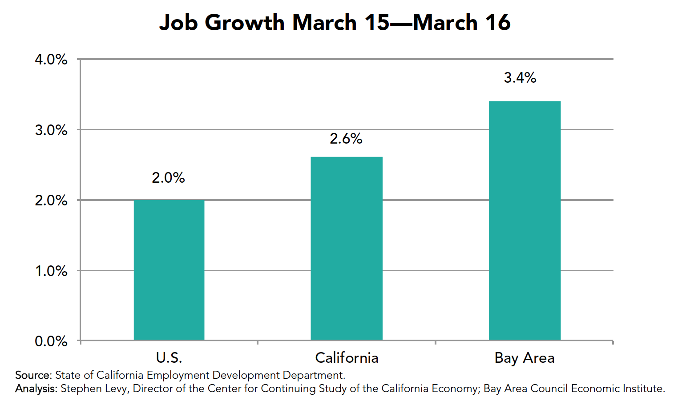
US labor market remains solid; state and regional growth even stronger
Slide 25

Slide 27
US GDP growth continuing but mixed signals ahead
2012
2013
2014
2015
Source: Bureau of Economic Analysis (BEA)
Slide 26

Slide 28
Local Sales Tax Grew 3.5% in 2015
Total Local Receipts: $153M*
Source: MuniServices and City of San Jose
* This total does not include county and statewide tax pools.
Slide 27

Slide 29
Is the Silicon Valley growth engine slowing?
Among region’s 150 largest public firms:
Combined profit rose 4.3% in 2015 from 2014, compared to 23% from 2013 to 2014
Tech sector performance is still strong compared to other industries and the nation as a whole
Slow down dominated by top 10 companies
Corporate restructuring represents new opportunities
Slide 28

Slide 30
Strong industrial permit activity continues; slowing residential permit activity
Source: Planning, Building and Code Enforcement
Slide 29

Slide 31
Local Job Growth Across Most Sectors
Net gain of 13,200 jobs across all sectors
Slide 30

Slide 32
If this is a Silicon Valley Tech Bubble, how will San Jose be affected?
Source: PWC/NVCA MoneyTree TM report
Slide 31

Slide 33
Recap: Expect slower but continued growth in FY16/17
Global and national uncertainty
Metro area job growth continuing; unemployment remaining below 5%
Consumer sales expected to lead GDP, positive effect on sales tax
Local leasing activity expected to drive down vacancy
Major tech corporations leading local growth in key employment areas
Slide 32
Notes:
32

Slide 34
Coming Soon: Monitor San Jose’s Economy Using Online Dashboard

Slide 35
City of San José
2016-2017 Proposed
Operating Budget Overview
May 11, 2016
Notes:
34
34

