Slide 1
ENVIRONMENTAL & UTILITY SERVICES 2016-2017 Proposed Operating Budget OUTCOMES:
Reliable Utility Infrastructure
Healthy Streams, Rivers, Marsh, and Bay
“Clean and Sustainable” Air, Land, and Energy
Safe, Reliable, and Sufficient Water Supply
2016-2017 Budget Study Sessions

Slide 2
ENVIRONMENTAL & UTILITY SERVICES
Environmental Services
Natural and Energy Resources Protection
Potable Water Delivery
Recycled Water Management
Recycling and Garbage Services
Stormwater Management
Wastewater Management
Transportation
Sanitary Sewer Maintenance
Storm Sewer Management
Public Works
Sewer Condition, Capacity, and Asset Management

Slide 3
CSA Expected Service Delivery
Build, Operate, and Maintain the City’s Utilities Reliably and Safely
Promote Pollution Prevention, Water Quality, and Habitat Protection
Oversee Programs to Maximize Solid Waste Diversion from Landfills
Increase Efficiency and Expand the City’s Illegal Dumping Response Efforts

Slide 4
Proposed Budget Actions
Proposed Residential Rate Changes
 | % Change | Monthly $ Change | Proposed Monthly Rate
Muni Water | 2.0%* | $1.45** | Avg. $76.80**
Recycle Plus | SFD: 0% MFD: 2.5% | SFD: $0.00 MFD: $5.55 | SFD: $31.76 MFD: $227.74
Sewer Service and Use Charge | 5.5% | SFD: $1.85 MFD: $1.24 MHP: $1.40 | SFD: $35.60 MFD: $23.86 MHP: $26.88
Storm Sewer Service Charge | 0.0% | $0.00 | SFD: $7.87 MFD (3-4 units): $14.95 MFD (5+ units), Condo: $4.30 MHP: $3.94
* Staff anticipates returning to City Council no later than fall 2016 with additional recommendations related to water rates.
** Average rate based on meter charge and consumption, which will vary by volume.

Slide 5
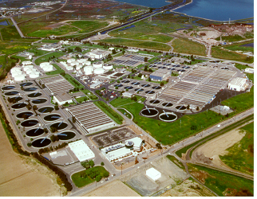
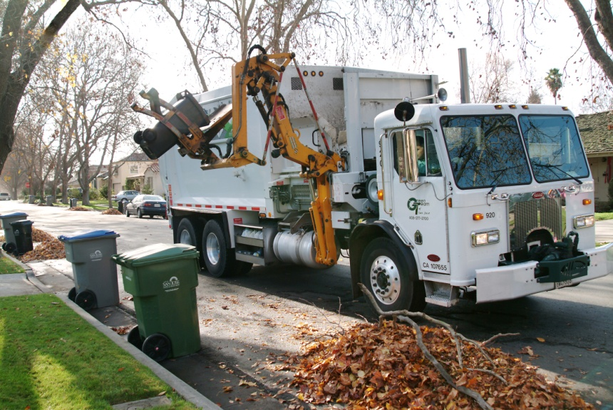
Proposed Budget Actions
Illegal Dumping Response and Prevention
Neighborhood-Led Beautification Days
Large Item Collections
Sorting of Residential Solid Waste (Third Phase)
Wastewater Facility Staffing
Sanitary Sewer Repairs

Slide 6
CSA Workplan Highlights
Sanitary Sewer Program
SSO Reduction, Sewer Repair & Rehabilitation, CIP Delivery
Storm Sewer Program
Master Plan, Long-Term Trash Load Reduction
Solid Waste Management
Advance Zero Waste Goals, Illegal Dumping
Wastewater Management
Plant CIP Delivery, Recycled Water Program

Slide 7
Summary
Lead City-wide Illegal Dumping Response
Rebuild and Revitalize the Wastewater Facility
Continue to Address Sanitary Sewer System Capital Investment Needs
Focus on Reducing Sanitary Sewer Repair Backlog and SSOs
Complete Storm Sewer Master Plan

Slide 8
ENVIRONMENTAL & UTILITY SERVICES 2016-2017 Proposed Operating Budget OUTCOMES:
Reliable Utility Infrastructure
Healthy Streams, Rivers, Marsh, and Bay
“Clean and Sustainable” Air, Land, and Energy
Safe, Reliable, and Sufficient Water Supply
2016-2017 Budget Study Sessions
Notes:
8

