Slide 1
NEIGHBORHOOD SERVICES 2016-2017 Proposed Operating Budget OUTCOMES:
Safe and Clean Parks, Facilities, and Attractions
Vibrant Cultural, Learning, Recreation, and Leisure Opportunities
Healthy Neighborhoods and Capable Communities
2016-2017 Budget Study Sessions
Notes:
Good afternoon (Morning?). I am Jill Bourne Director of the Library and I am joined with and Jon Cicerelli Director of Animal Care and Services, Diane Buchanan Deputy Director for Code Enforcement, and Angeil Rios Jr., Acting Director of the Parks Recreation and Neighborhood Services Department.

Slide 2
NEIGHBORHOOD SERVICES
Library
Formal and Lifelong Self-Directed Education
Access to Information, Library Materials & Digital Resources
Planning, Building and Code Enforcement (PBCE)
Community Code Enforcement
Parks, Recreation and Neighborhood Services (PRNS)
Parks Maintenance and Operations
Recreation and Community Services
Public Works
Animal Care and Services
Notes:
Library Core Services
Library Core Services
Formal and Lifelong Self-Directed Education
Access to Information, Library Materials & Digital Resources
Parks, Recreation & Neighborhood Services Core Services
Parks Maintenance and Operations
Recreation and Community Services
Public Works Core Services
Animal Care and Services
Planning, Building & Code Enforcement Core Services
Community Code Enforcement
No need to read the core service -

Slide 3
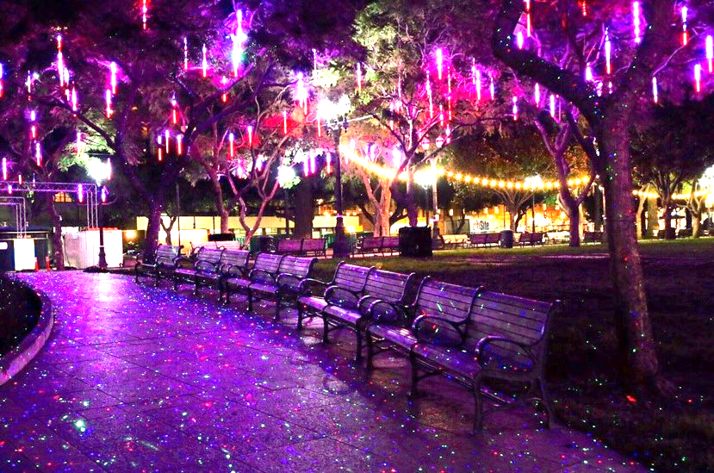
CSA Expected Service Delivery
Cultivate healthy neighborhoods
Support an engaged and informed citizenry
Activate a thriving community
Steward well-managed, effective, and sustainable assets
NEIGHBORHOOD SERVICES 3
2016-2017 Budget Study Sessions
Notes:
3

Slide 4
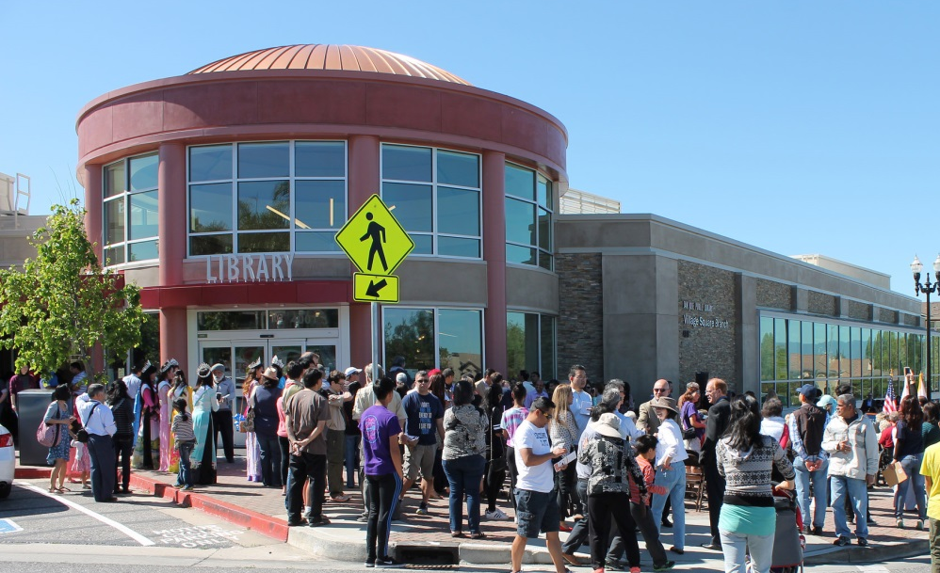
Library Accomplishments and Expected Service Delivery
Village Square Branch
Enhanced Educationally-Focused Services
Radio Frequency Identification
Maker[space]ship
1 Gigabit Connectivity
Notes:
Accomplishments
Grand Opening of Village Square
1st full year of 6 day model
Implementation of 10 of 15 Audit recommendations
Key partnerships including Educare and First 5, Knight Foundation, Microsoft
Expected Service Delivery
Maintain 6 day Branch Library hours
Full Year of operation Village Square
Increase in Educationally focused services (Teen, Early Ed, Education Coordination, STEAM, SJ Works)
Actively engage adult and teen volunteers to support and enhance Library operations
RFID installation
Production and deployment of Maker[Space]ship
CENIC 1 gigabit partnership

Slide 5
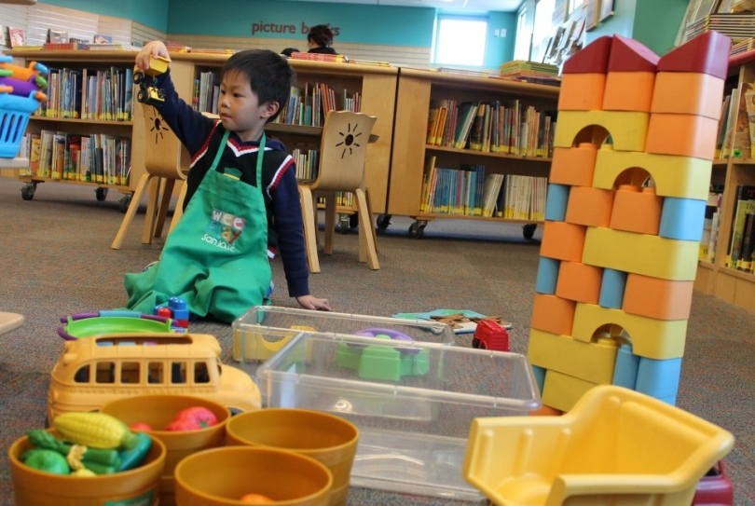
Library Proposed Budget Actions
Library Works Center
Early Education Program Expansion
MLK Library Teen Center
Enhanced Education Coordination and Services
Reduced Library Fines
Notes:
Enhancements supported by Library Parcel Tax funding
Also increasing Security .75 Security Officer to 1.0 FTE Sr. Security Officer
Adjusting Fines and Fees (with one-time reduction of $65,000 NP and $70,000 in PS vacancy savings)

Slide 6
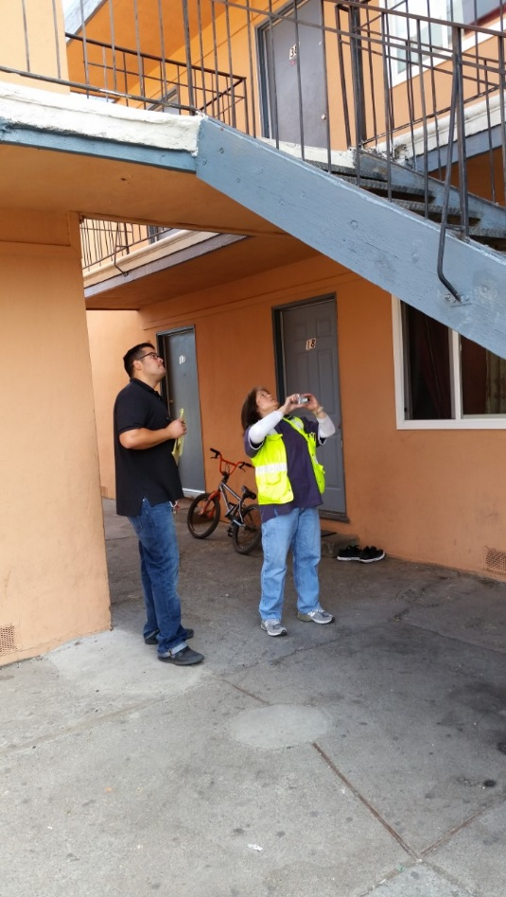
PBCE Accomplishments and Expected Service Delivery
Responded to life safety complaints within 24 to 72 hours
Closure of non-registered Medical Marijuana collectives
Completed second year of redesigned Multiple Housing Program
Notes:
Responded to life safety complaints within 24 to 72 hours
Closure of non-registered Medical Marijuana collectives
Completed second year of redesigned Multiple Housing Program

Slide 7
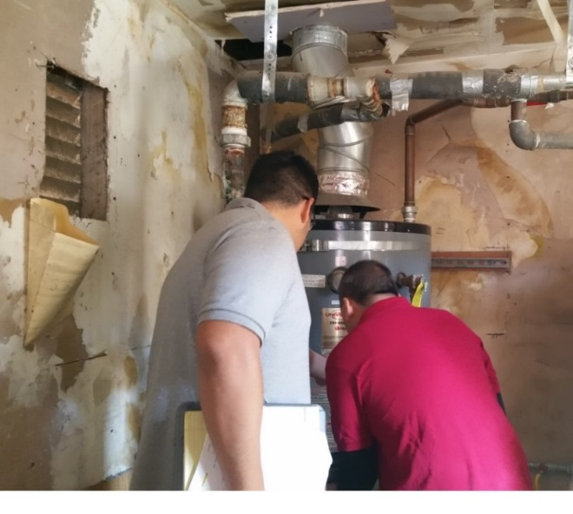
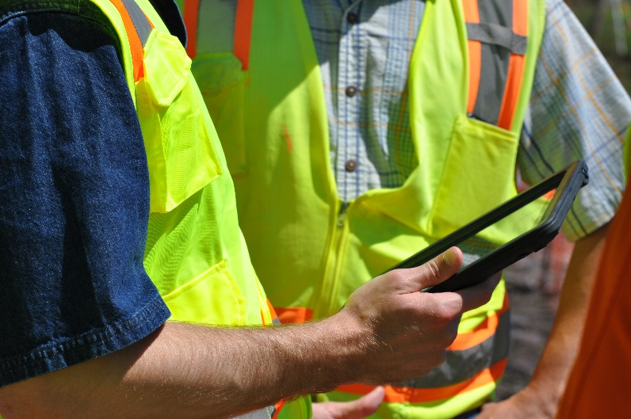
PBCE Proposed Budget Actions
Increase innovative technology using mobile devices and in preparation of new permit system
Add additional funding for the Integrated Permit System Implementation project
Notes:
Transfer city-wide illegal dumping program to Environmental Services
Increase innovative technology using mobile devices and in preparation of new permit system

Slide 8
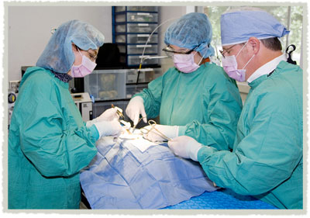
Public Works - Animal Care Accomplishments and Expected Service Delivery
Exceeded Live Release Rate: 87% in 2015-2016
Maintained High Response Rate to Priority Calls
Prioritize Health and Safety Calls
Low Cost Spay and Neuter Services for Public
Notes:
Focus on health and safety related Animal Care and Services calls; grant opportunities; low cost spay and neuter services; and improve outcomes for sheltered animals.
Increase live release rate for animals in shelter
Increase Grant funding and revenues

Slide 9
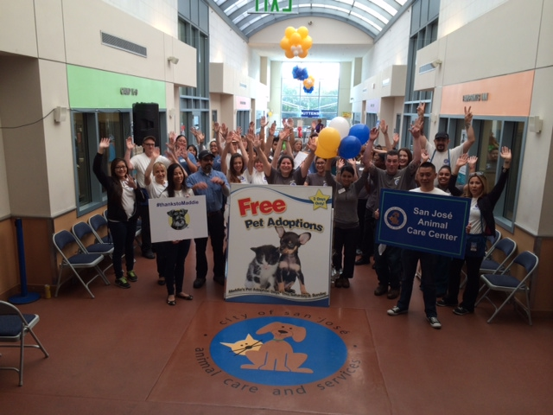
Public Works - Animal Care Proposed Budget Actions
Funds critical facility upgrades:
Animal intake
Adoption area improvements
One new vehicle

Slide 10
PRNS Accomplishments and Expected Service Delivery
Building community through fun
Recreation options for all ages and abilities
Safe neighborhoods
Access to services & financial sustainability
Notes:
Thank you, Jon.
Mayor and Councilmembers, thank you for having us here today. I’m Angel Rios, Jr., Interim Director of Parks, Recreation and Neighborhood Services. I’m honored and proud to share our accomplishments and expectations. We are such a large, diverse department, it can be challenging to sum us up sometimes. I’ll take a shot in four words: Building Community Through #Fun. Let me tell you what that means.
As I mentioned at the April NSE Committee meeting, we have made placemaking a priority. Placemaking is creating quality places, wherein people want to live, work, play, and learn. It’s all about building community by through places that have been thoughtfully designed and programmed to engage people all across the City from all walks of life. Our places and programs serve the entire community, not just one segment. Whether it is our award-winning San Jose Recreation Preschool, afterschool programs, leisure classes, active adult events, community gardens, or our parks and facilities, like the recently opened (???) Rotary PlayGarden at Guadelupe River Park and Gardens, we make fun and meaningful contributions to the lives of children, youth, adults, seniors, and people with disabilities.
One of our many contributions is to the safety of our neighborhoods and youth. Park Rangers play a vital role in patrolling our parks and maintaining safe neighborhoods. Through the efforts of the Mayor’s Gang Prevention Task Force we help address youth-related violence through prevention and intervention efforts, especially in gang-impacted areas within the City. (this is not a great talking point, needs work)
Finally, we have made great strides in the area of financial sustainability, reaching our goal of 40% cost recovery for our General Fund operating budget in 2013-2014. Looking to the coming year, we will continue to explore ways to increase our cost recovery through revenue generation, balanced with ensuring all customers have access. Our redesign of the Citywide Scholarship Program enhances resident access to programs and services.

Slide 11
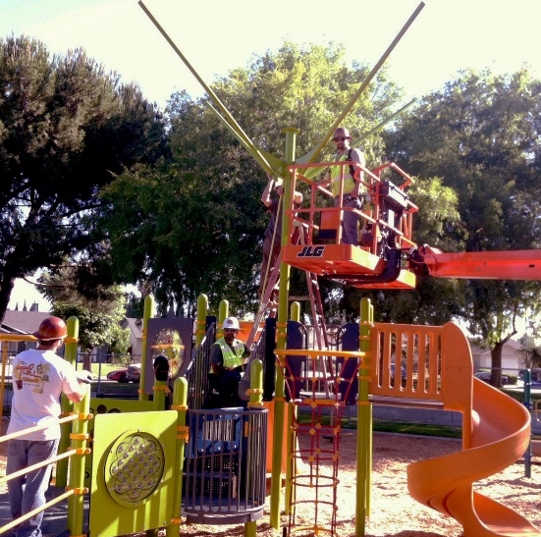
PRNS Proposed Budget Actions
Placemaking: Viva CalleSJ and ¡VivaParks!
Additional revenue-backed programming and scholarship funding
Realignment in youth intervention services, parks maintenance, and volunteer programs
Regional Parks – Monday Opening
Parks Rehabilitation Strike Team
Notes:
To support our efforts, this Proposed Operating Budget helps us build forward into next year and beyond. I can’t go through all our proposals, but want to highlight a few. The addition of 5.75 FTE staff for Lake Cunningham helps us builds towards an adventure sports park. Our Lake Cunningham Regional Skate Park will continue to be a mainstay attraction as the largest skate park in California. And I’m excited to talk with you about the adventure sports park’s five-acre bike element. It will offer riders of all ages and abilities access to trails, tracks, skills challenge courses, dual slalom, free ride area, and pump tracks that embrace a variety of bike disciplines, such as mountain biking, free-style, slope-style, and cycle-cross. To get ready to open in July 2016, hiring will occur in the second half of next year.
This budget also proposes ongoing funding for many items included as one time funded in 2014-2015, including our innovative and successful St. James Park activation. We have also secured grant funding from the Santa Clara County Public Health Department for our Viva Parks program to activate Hillview, Emma Prusch, Mayfair and Roosevelt parks during the summer.
Also made ongoing is BEST and Mayor’s Gang Prevention Task Force funding, including the Safe School Campus Initiative and Safe Summer Initiative. SSCI is a partnership between PRNS, School Districts, and the Police Department to create safer high schools, middle schools, and communities by addressing youth-related violence through prevention and intervention efforts, especially in gang-impacted areas within the City. The Safe Summer Initiative Program provides funding for pro-social recreational activities during the summer months for at-risk, high-risk, gang-impacted and gang-intentional youth. We have also brought forward (or will bring forward) an MBA on the value, results, and positive impacts of the Female Gang Intervention Unit, MGPTF capacity building programs, and the Digital Arts Program (talk about the award we won?).
SJ Works/SJ Learns are two more initiatives the City is developing to enable our youth.
Continuing our efforts to provide community access to our sites and facilities while achieving financial sustainability, this budget proposes the addition of staff who can help individual, non-profits, and for-profit organizations host special events in our parks and along our trails, and rent space in community centers. And, this budget adds some parks maintenance staff to help ensure our new and existing parks and landscapes are well-maintained, attractive, and a source of pride for all of San Jose.

Slide 12
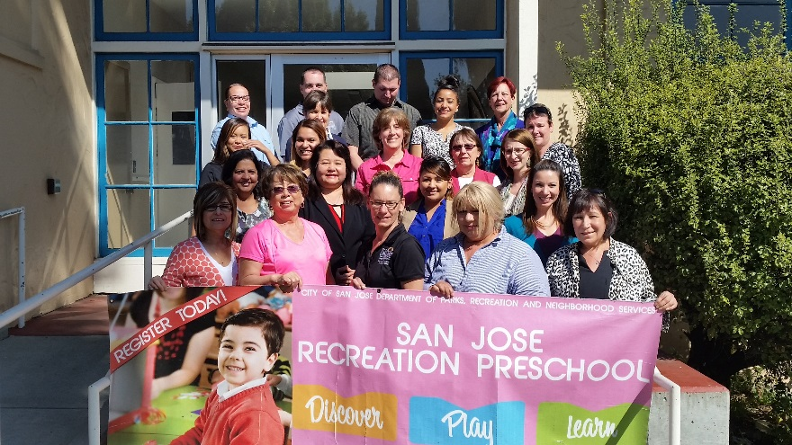
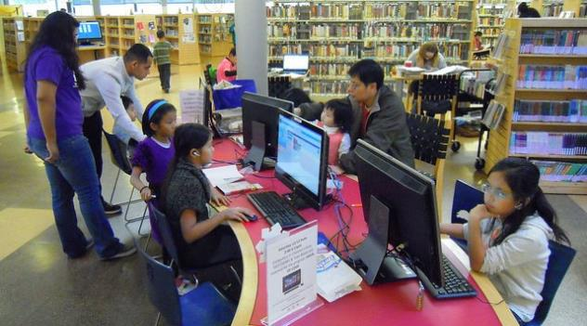
CSA Workplan Highlights
Increase community access to services
Focus on health and safety
Enhance public technology
Maintain responsive services to community priorities
NEIGHBORHOOD SERVICES 12
2016-2017 Budget Study Sessions
Notes:
For the Neighborhood Services CSA as a whole, all of our staff are committed to providing high quality services that strengthen the community and preserve healthy neighborhoods. We continue to focus on increasing community access to programs and services, the health, safety, and well-being of our community, on enhancing access to community services and technology, and responding to community priorities. And I want to note that each department works collaboratively with supporters, government partners, non-profit organizations, and corporate sponsors who all help ensure that San Jose delivers services that positively impact the community. We are fortunate and grateful for all of our supporters.
12

Slide 13
NEIGHBORHOOD SERVICES 2016-2017 Proposed Operating Budget OUTCOMES:
Safe and Clean Parks, Facilities, and Attractions
Vibrant Cultural, Learning, Recreation, and Leisure Opportunities
Healthy Neighborhoods and Capable Communities
2016-2017 Budget Study Sessions

Slide 14
Branch Library Schedules
01 Martin Luther King Library
LIBRARY BRANCHES
02 Almaden
03 Cruz-Alum Rock
04 Alviso
05 Bascom
06 Berryessa
07 Biblioteca Latinoamericana
08 Calabazas
09 Cambrian
10 East Carnegie
11 Edenvale
12 Educational Park
13 Evergreen
14 Hillview
15 Joyce Ellington
16 Pearl Avenue
17 Rose Garden
18 Santa Teresa
19 Seven Trees
20 Tully Community
21 Village Square (spring 2016)
22 Vineland
23 West Valley
24 Willow Glen
04
M 1-6
T- Th 10-7
F 12-6
Sat 10-6
06
12
03
15
10
17
01
14
07
13
20
21
08
23
05
24
19
09
16
11
22
18
02
Notes:
BACK UP

Slide 15
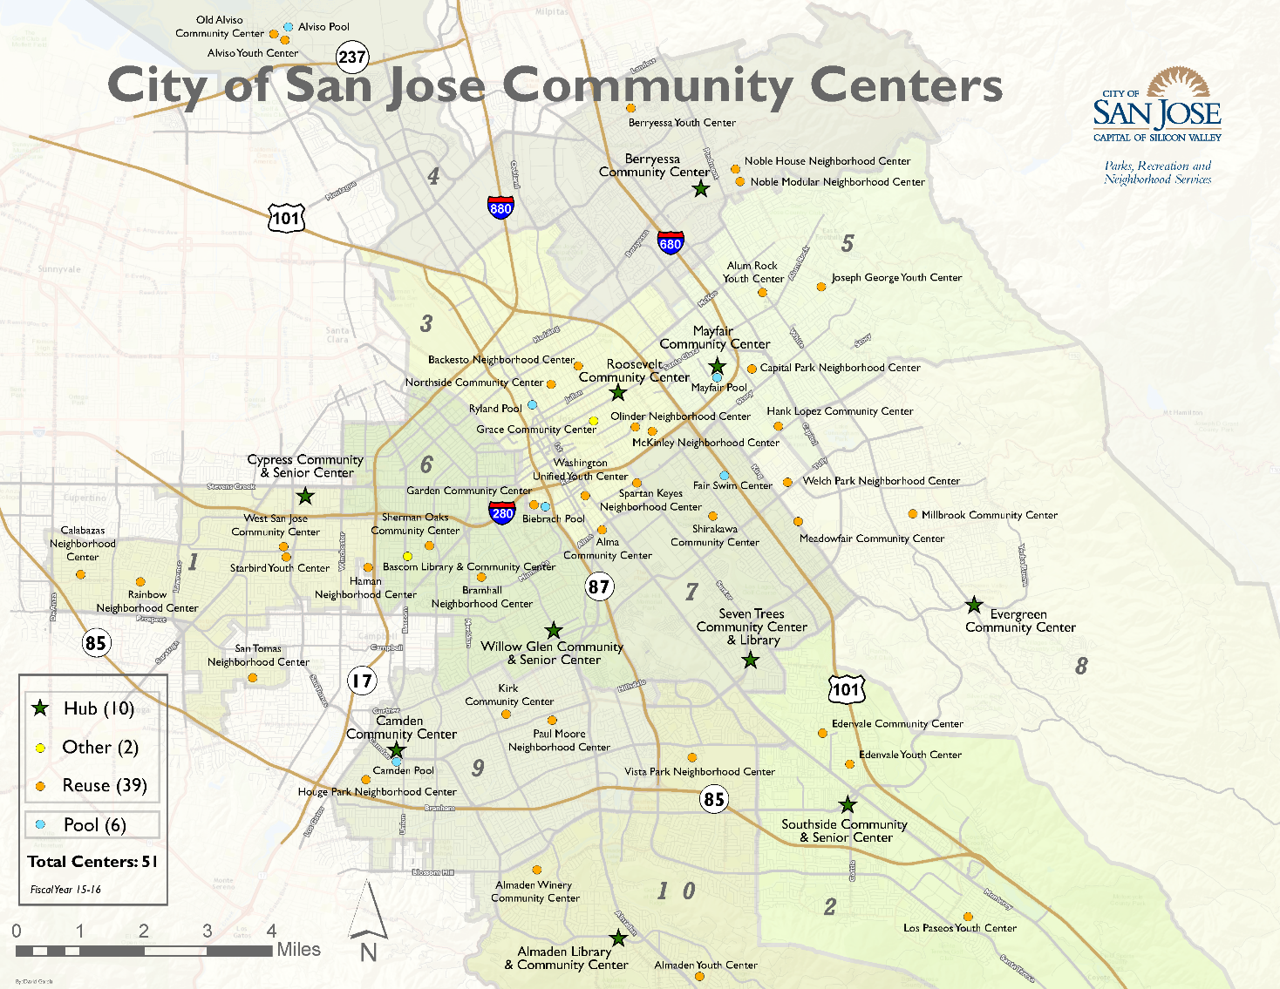
Community Centers
Notes:
BACK UP

Slide 16
PRNS Master Map

