Slide 1
Participatory Budgeting
Notes:
Lee

Slide 2
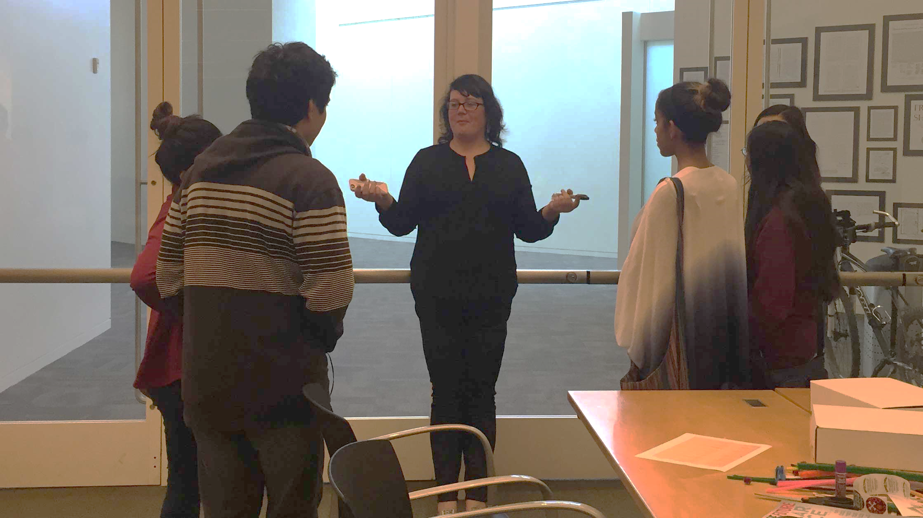
What is Participatory Budgeting?
Democratic: Community members decide how to spend part of a public budget.
Direct: Taxpayers work with government to make the budget decisions that affect their neighborhoods, communities and lives.
Empowering: Residents in low-income neighborhoods learn about the government and how they can make a difference.
Notes:
Lee

Slide 3
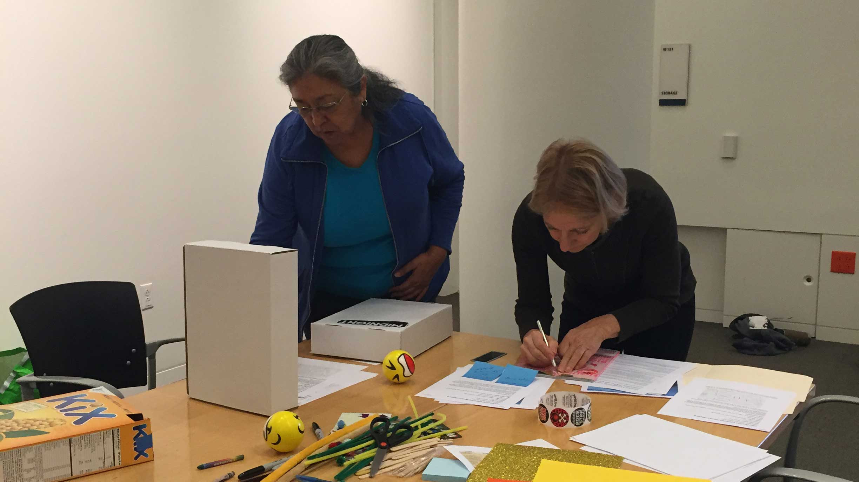
History
Spring 2015 - Mayor’s March Budget Message announced the priority
Summer 2015 – Mayor’s June Budget Message set aside $100K for pilot
Fall 2015 - Mayor Liccardo and Councilmember Peralez officially launched the City’s first pilot process with hundreds of engaged residents.
Notes:
Lee

Slide 4
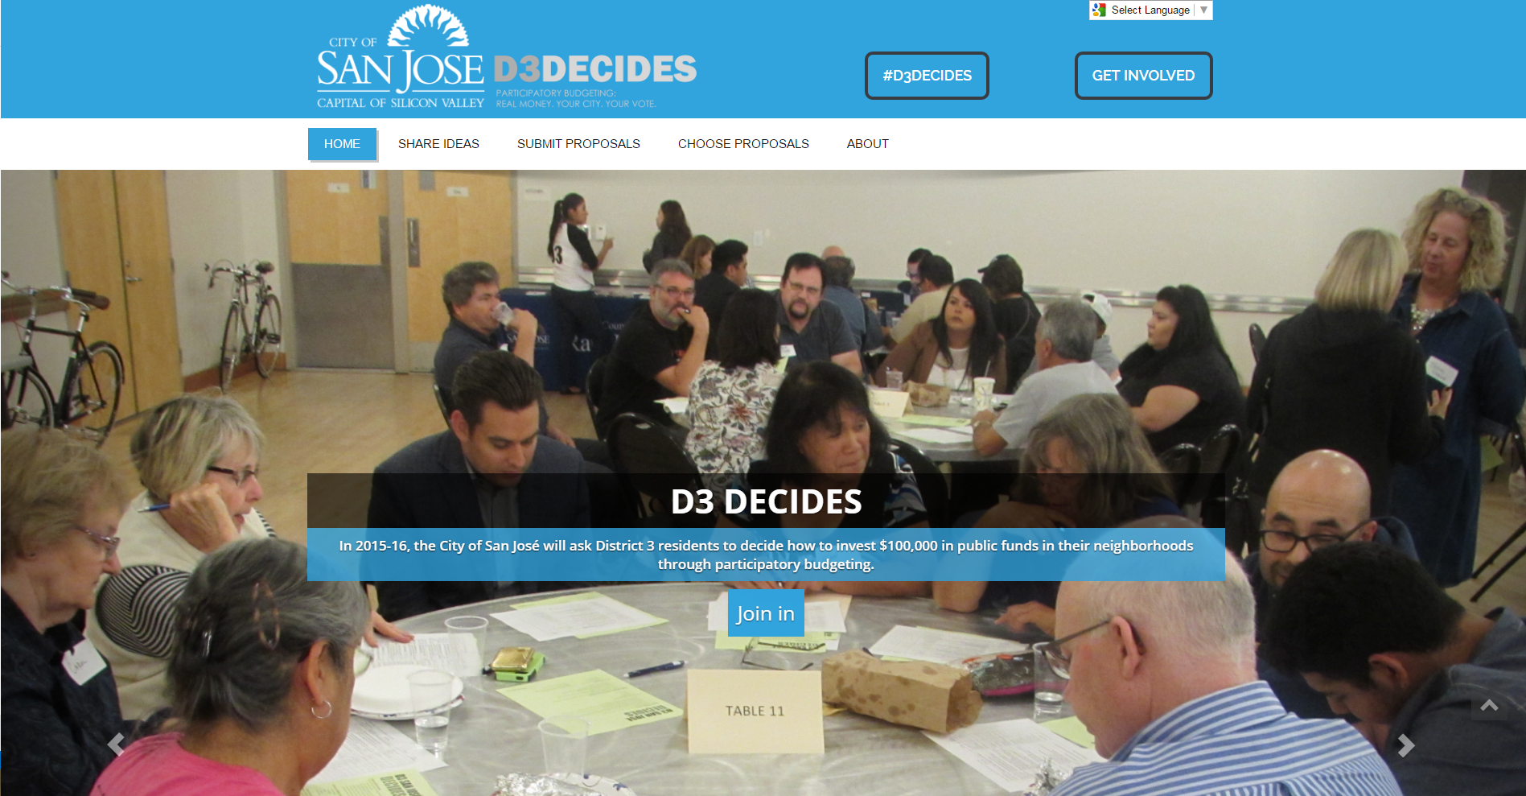

Slide 5
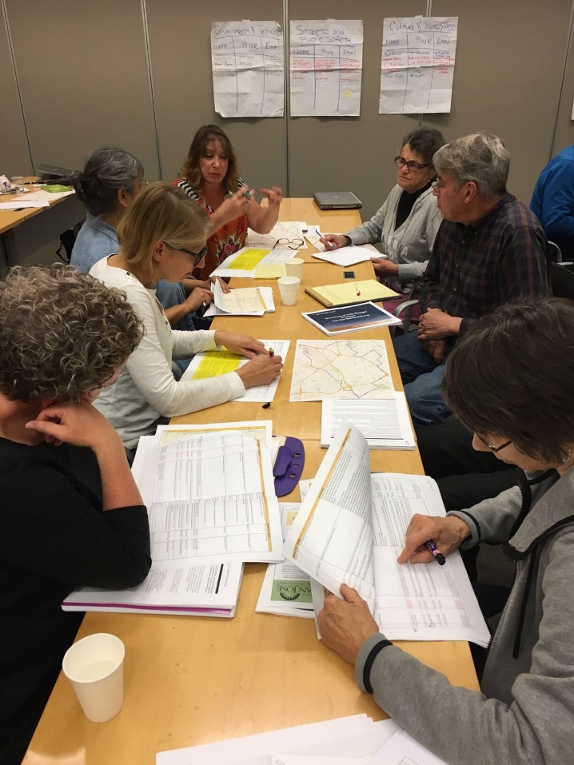
Developing PB Pilot
Setting Goals
Outreach
Idea Collection
Project Expos & Voting
Project Winner & Announce
Proposal Development
Evaluation & Monitor
Notes:
Raul

Slide 6
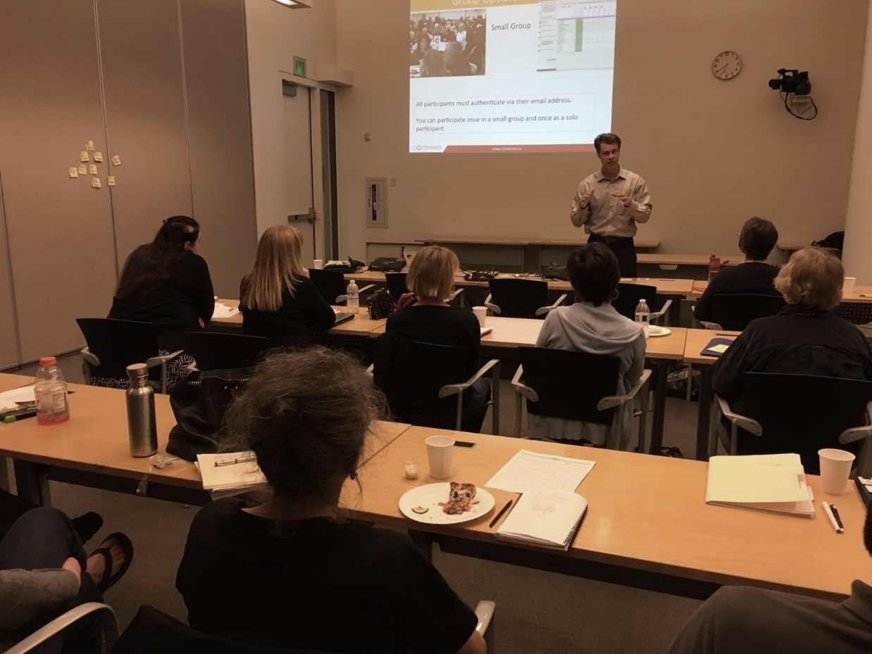
D3Decides Process
Steering Committee
Develop Process and Measure Success
Educate / Communicate
Engage as many residents as possible
Idea Share
Ideation
Decision-making
Budget Delegates
Project Eligibility
Formal Submission
Online Voting
Ballot (In-Person) Voting
Community Meetings
Social Media
Word of Mouth
Product Boxes/Video Submissions
Notes:
Raul

Slide 7
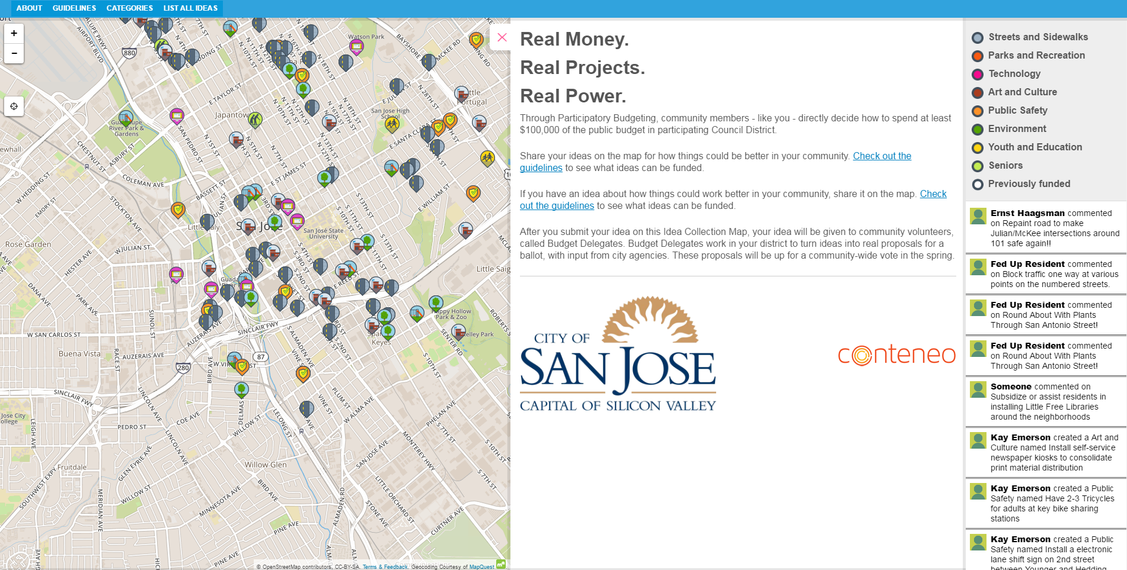
Notes:
Raul

Slide 8
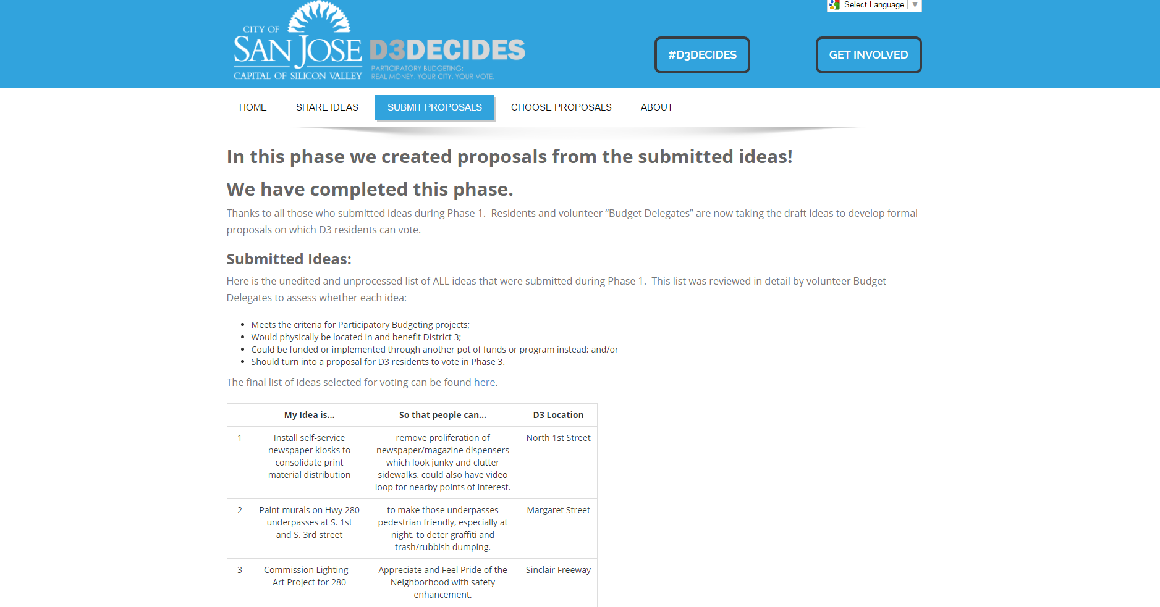
Notes:
Raul

Slide 9
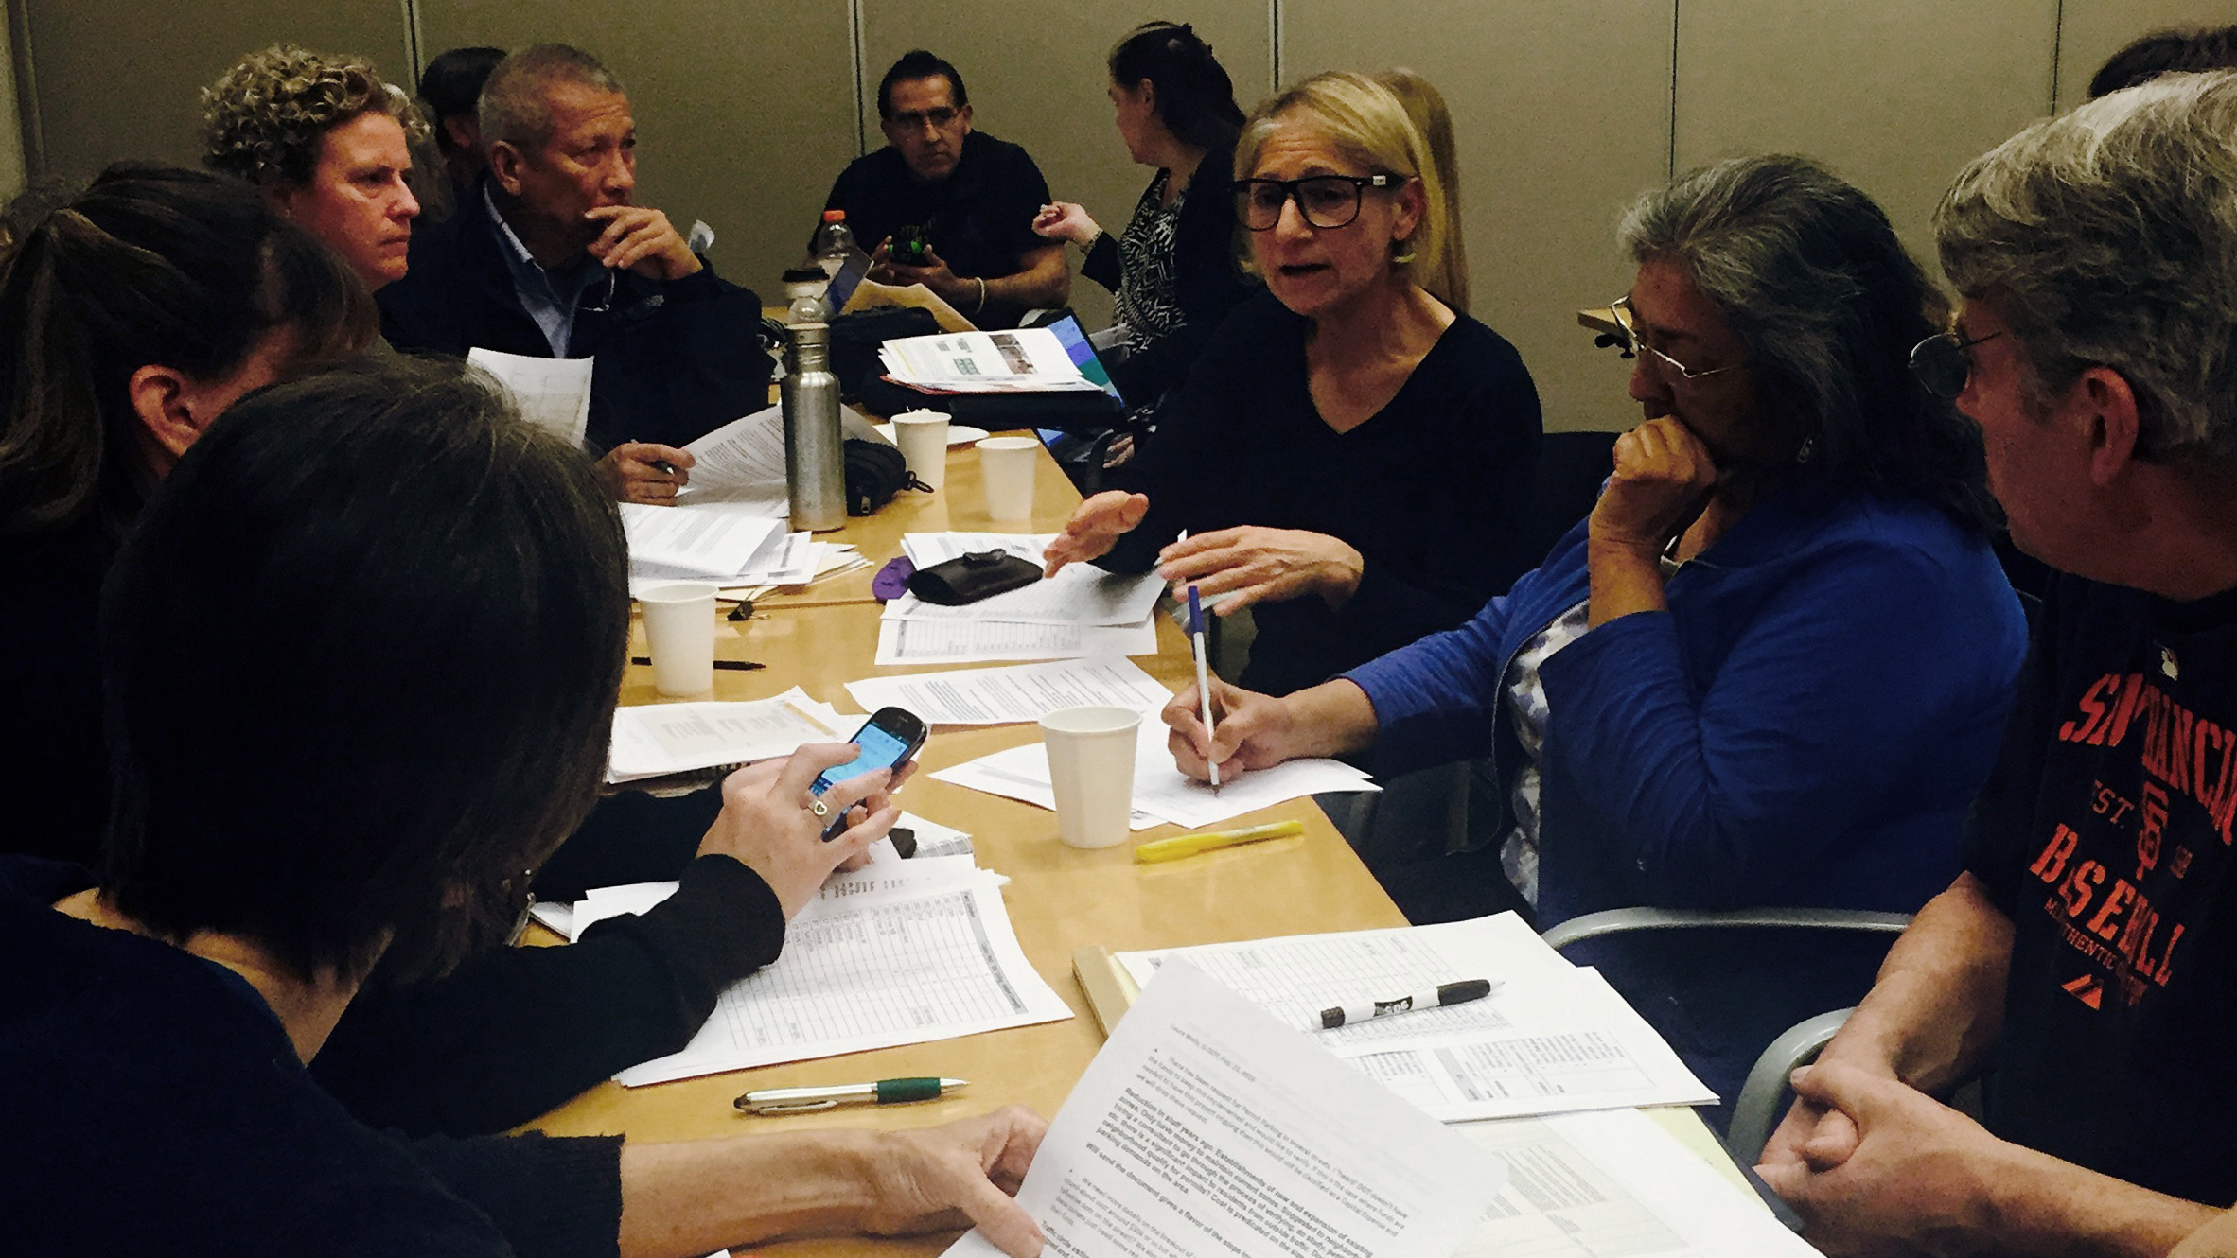
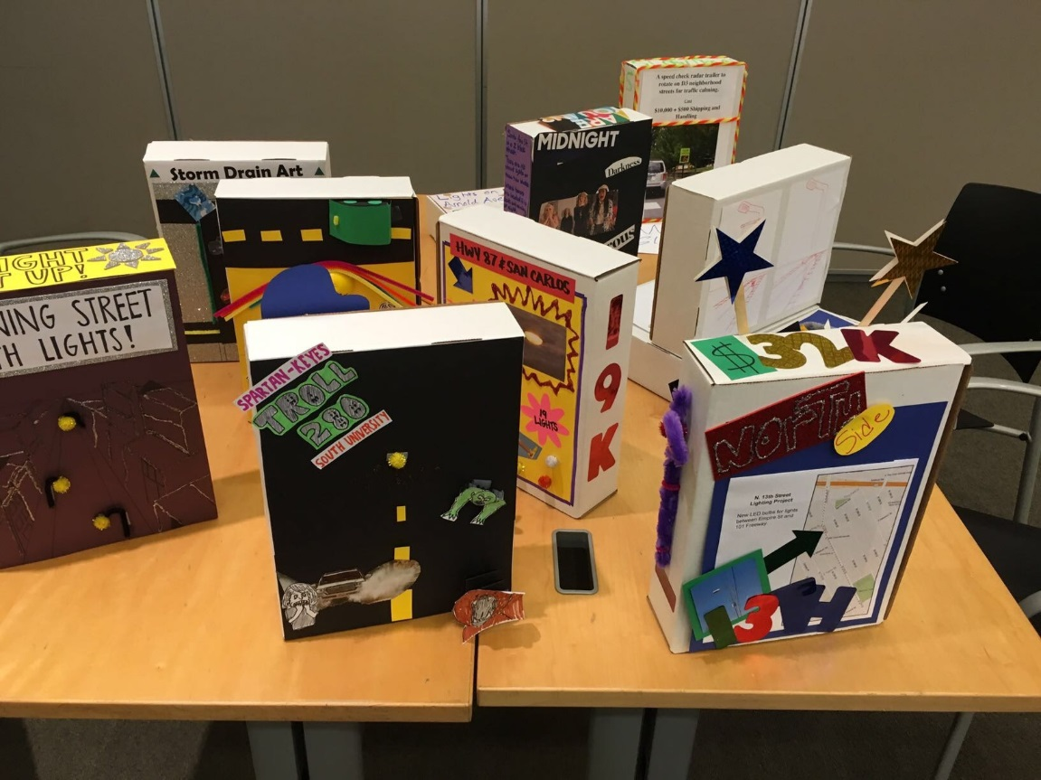
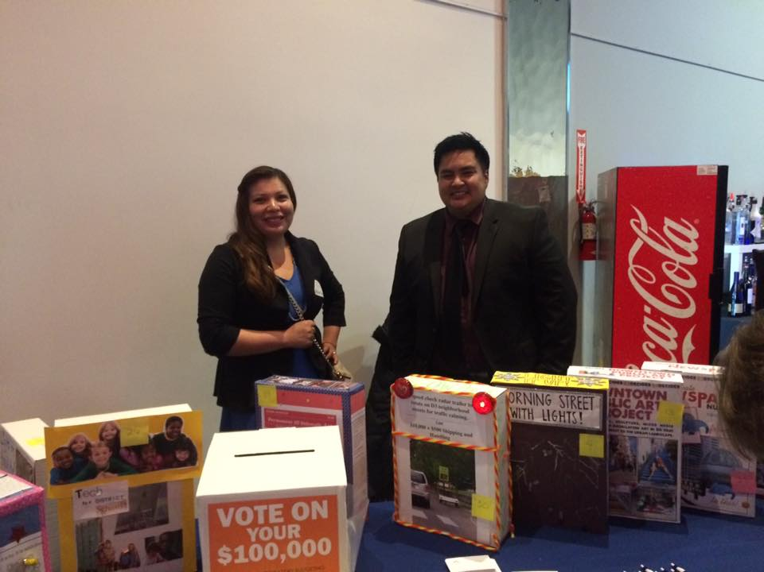
From Ideas to Projects
Notes:
Raul

Slide 10
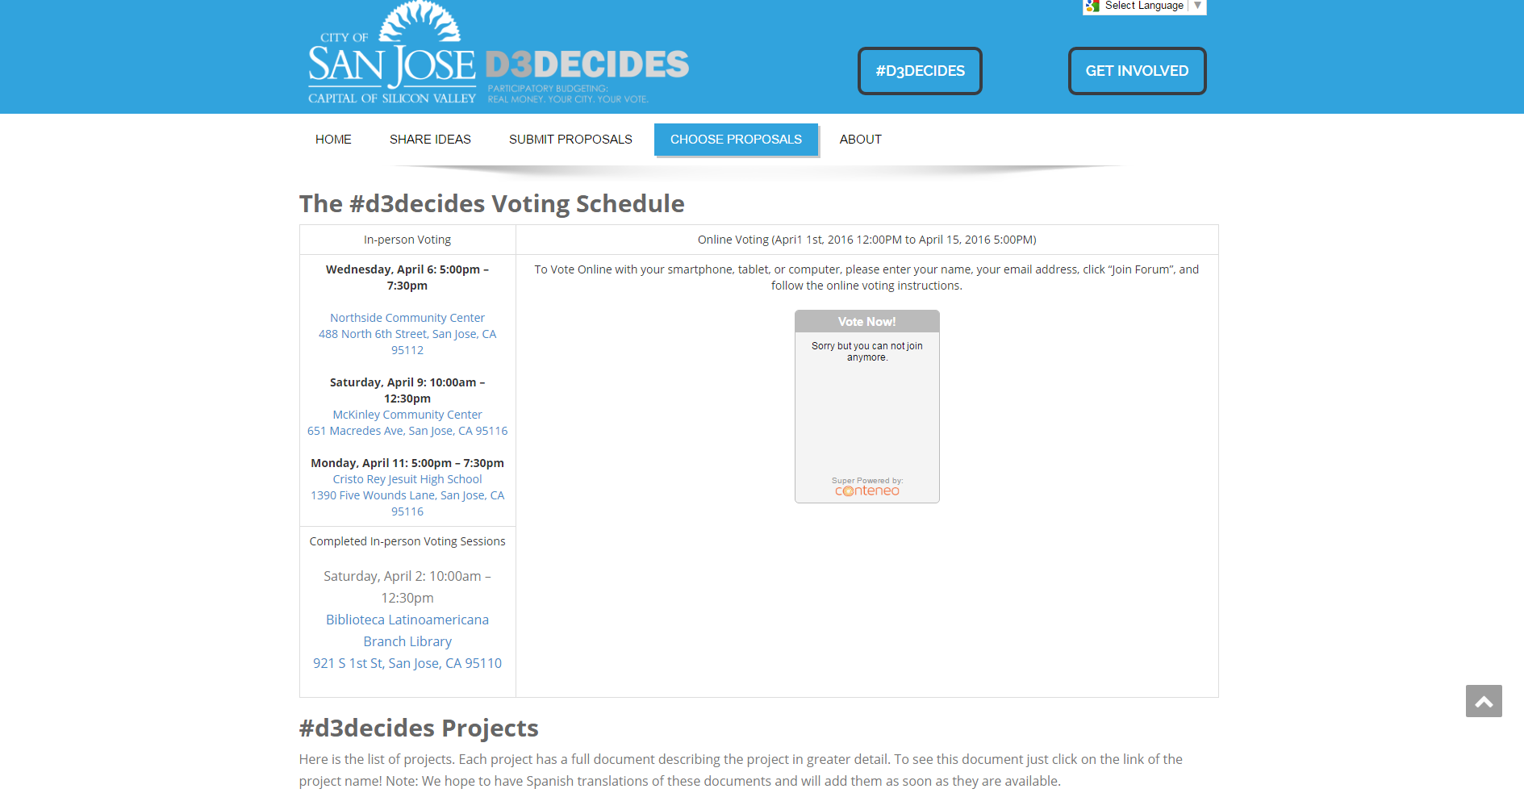
Notes:
Raul

Slide 11
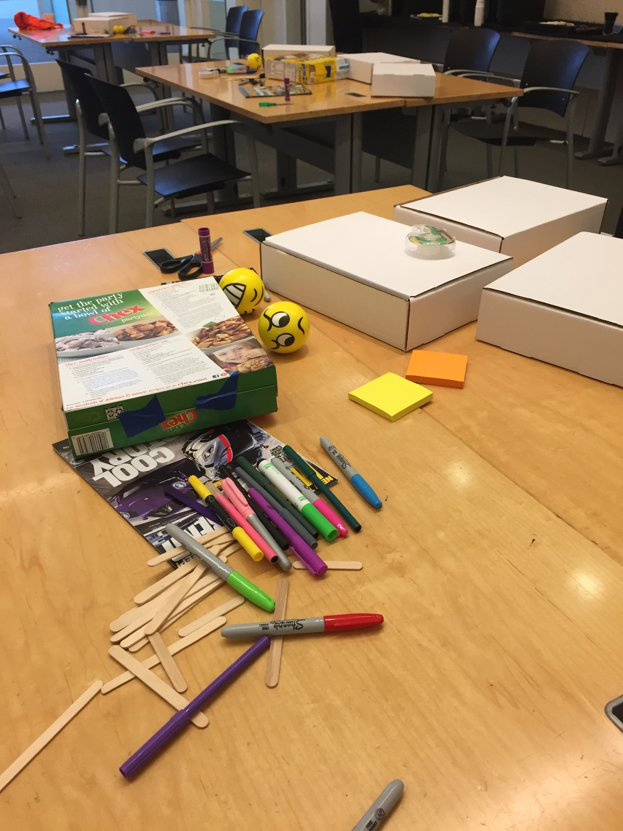
D3Decides - $100K
Notes:
Raul

Slide 12
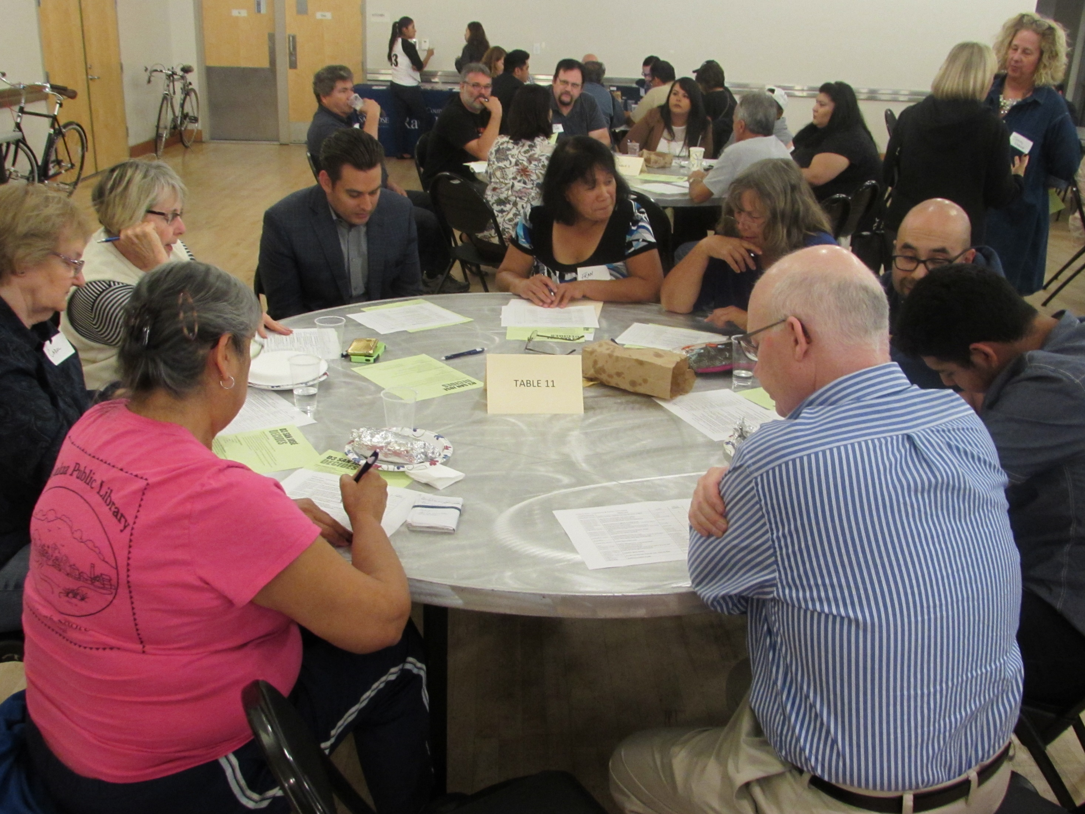
D3Decides Review
Goals
Goal 1: Receive 1% = 1,000 resident votes
Goal 2: Increase and Diversify participation in local government
Goal 3: Inform and Engage 20 D3 residents who want to be Budget Delegates.
Outcomes
Outcome 1: Received 485 Validated Votes and over 500 Votes
Outcome 2: Held 3 expos in predominately underrepresented neighborhoods.
Outcome 3: Trained 18 D3 residents as Budget Delegates
Notes:
Raul

Slide 13
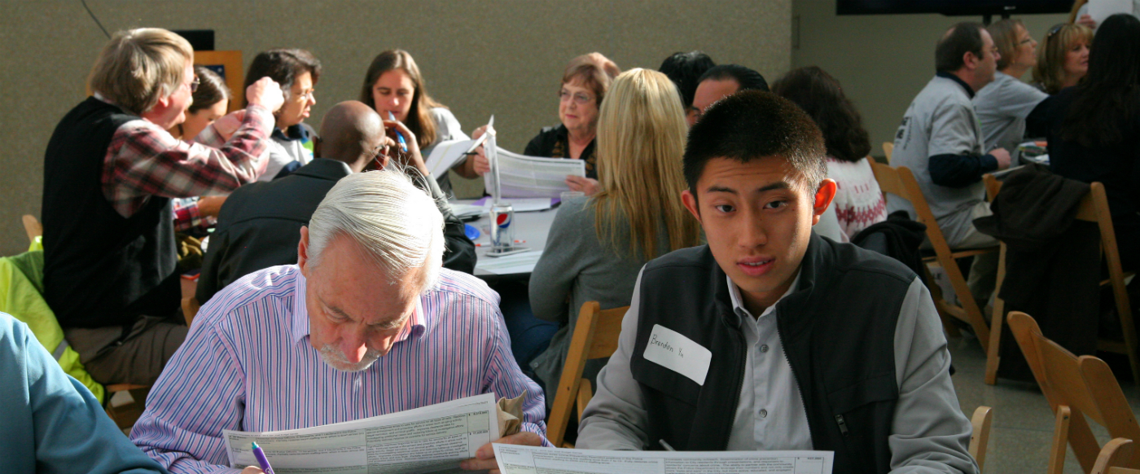
Advantages
Community Building
Improve accountability and transparency
Empower Citizens
One-time expense items to be implemented
Understanding Constituent Needs/Wants
Creating accessibility (online vs. ballot voting)
Notes:
Lee

Slide 14
Lessons Learned
Important to allocate funding for Administrative Costs
Online options reduced in-person attendance
Online voting was difficult to develop
Language/Communication Barriers
Notes:
Lee

