Slide 1
PUBLIC SAFETY 2016-2017 Proposed Operating Budget OUTCOMES:
The Public Feels Safe Anywhere, Anytime in San José
Residents Share the Responsibility for Public Safety
2016-2017 Budget Study Sessions
Notes:
Chief Garcia:
Good morning, I’m Police Chief Eddie Garcia and this is the 2016-2017 Proposed Operating Budget presentation for the Public Safety City Service Area. This CSA includes the Police and Fire Departments , and the Office of the Independent Police Auditor. With me today are Assistant Police Chief Dave Knopf, Fire Chief Curtis Jacobson, Assistant Fire Chief Johnny Dellinger, and Walter Katz. Our collective mission is to provide prevention and emergency response services for crime, fire, medical, hazardous, and disaster related situations.
Our CSA Outcomes are two-fold: The Public Feels Safe Anywhere, Anytime in San José, and Residents Share the Responsibility for Public Safety.

Slide 2
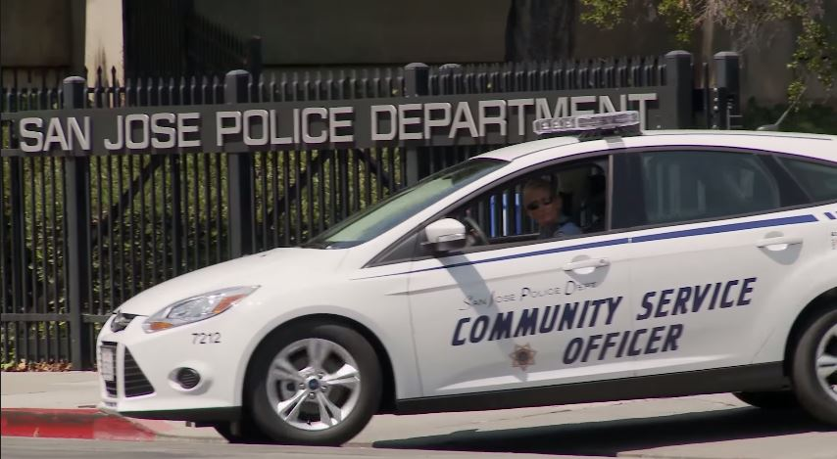
PUBLIC SAFETY
Police
Crime Prevention and Community Education
Respond to Calls for Service
Investigative Services
Regulatory Services
Special Events Services
Notes:
Chief Garcia:
For the Police Department, our core services are the following:
-Crime Prevention and Community Education
-Respond to Calls for Service
-Investigative Services
-Regulatory Services, and
-Special Events Services.

Slide 3
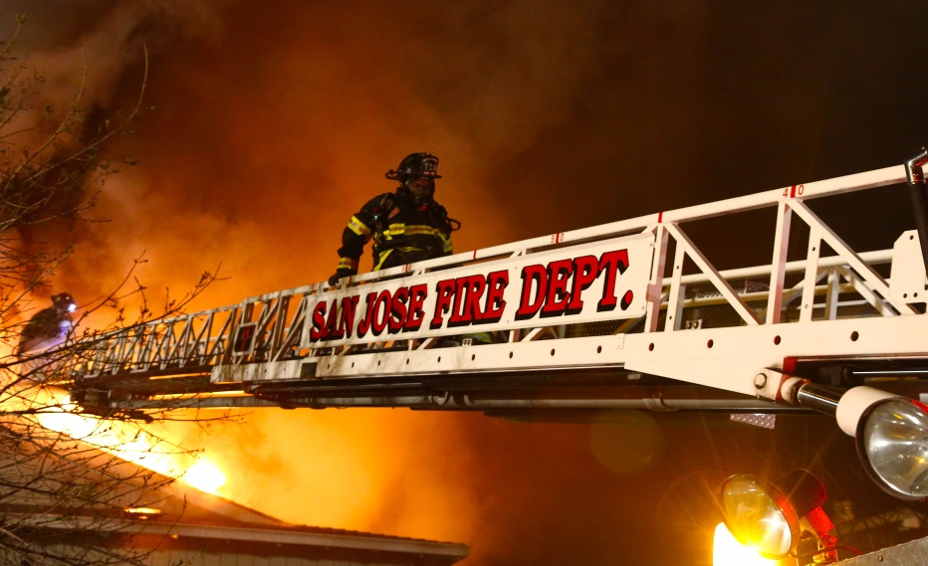
PUBLIC SAFETY
Fire Department
Emergency Response
Fire Prevention
Independent Police Auditor (IPA)
Independent Police Oversight
Notes:
Chief Jacobson:
For the Fire Department, our core services are the following:
-Emergency Response which includes fire suppression, EMS, EOC and dispatch, and
-Fire Prevention.
Our third core service, Fire Safety Code Compliance was discussed in the Community and Economic Development CSA.
Walter Katz:
For the Independent Police Auditor Department, our core service is independent police oversight.

Slide 4
CSA Expected Service Delivery
Provide essential emergency services in a timely and effective manner
Effectively investigate crimes and seek successful prosecution of suspects with a focus on gang crimes
Continue to improve response time performance
Continue regional all-risk emergency management
Provide a thorough and objective police misconduct complaint process
Continue crime and fire prevention efforts
Notes:
Chief Garcia:
The expected service delivery for this CSA is as follows:
-Provide essential emergency services, which includes patrol, fire suppression, and emergency medical services, in a timely and effective manner
-Effectively investigate crimes and seek successful prosecution of suspects with a focus on gang crimes
-Continue to improve response time performance
-Continue regional all-risk emergency management
-Provide a thorough and fair police misconduct complaint process, and
-Continue crime and fire prevention efforts

Slide 5
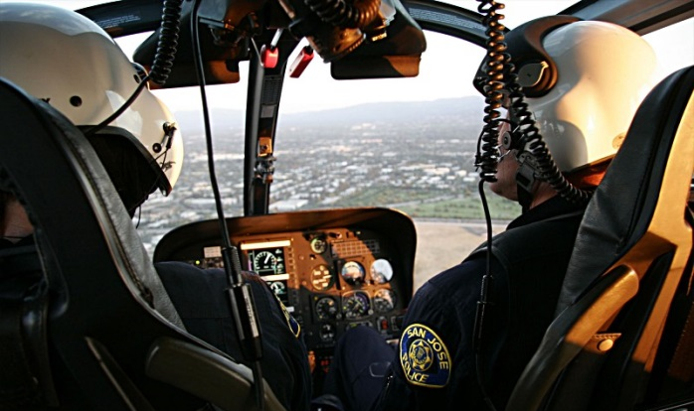
Proposed Budget Actions
Police
Increase Police Overtime
Implement a Body Worn Camera Program
AIR2 Maintenance Needs
Business Permit and Licensing System
Continue Police Recruiting Resources
Civilian Manager Position
Notes:
Chief Garcia: For 2016-2017, the Police Department is proposing the following budget actions
Increase Police Overtime – this action has set aside additional overtime resources that will be used to backfill for vacant patrol positions; maintain targeted enforcement of high crime activity through suppression cars specifically related to gang enforcement, prostitution, and graffiti; and maintain the Downtown Foot Patrol program.
Implement a Body Worn Camera Program – this action authorizes the ongoing resources necessary to implement a successful Body Worn Camera Program. The Body Worn Cameras will provide added oversight for both Department members as well as members of the community who come in contact with officers wearing a body camera. The Department plans phasing in the issuance of a body camera as part of their regular required uniform for sworn positions. This budget action provides the appropriate staffing to administer the program as well as the non-personal and contractual allocations required.
AIR2 Maintenance Needs – this action provides one-time funding from the State Drug Forfeiture Fund in order to provide required maintenance to the Department's helicopter in order to keep it air worthy until it can be replaced.
Business Permit and Licensing System – this action provides funding to replace the Department’s antiquated Business Permit and Licensing software to increase efficiency and accuracy for the Permit Unit’s operation
Recruiting resources – this action maintains appropriate resources that will allow Recruiting to continue the high volume of marketing necessary for upcoming Police Recruit Academies as well as critical civilian positions, such as Community Service Officer and Communications/9-1-1 Dispatchers
Civilian Manager Position – the addition of a Deputy Director position is part of a Department structure review and re-organization.

Slide 6
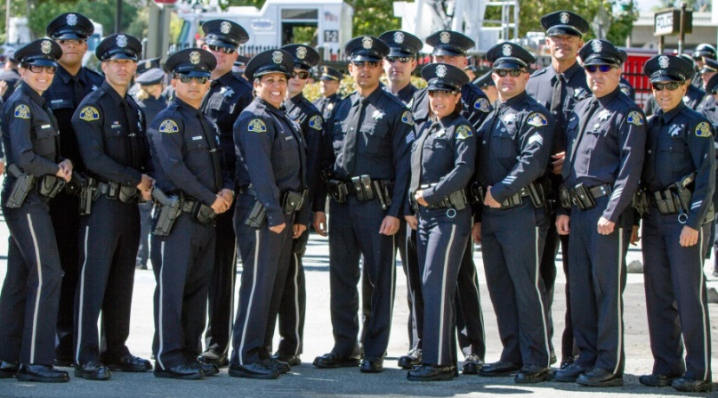
Proposed Budget Actions
Police (Cont’d.)
Medical Marijuana Control Division Staffing
Anti-Human Trafficking Program
Intelligence Technology Enhancements
Gang Investigations Technology Enhancements
Background Investigator Positions
Crime Prevention Program Meeting Space
Notes:
Chief Garcia:
Medical Marijuana Control Division Staffing – this action provides resources to establish a new Division within the Police Department in order to regulate the approved collectives with costs offset by the annual regulatory fee.
Anti-Human Trafficking – this action continues prior one-time funding ongoing in order to support the South Bay Coalition to End Human Trafficking.
Intelligence Technology Enhancements – this action supports the Department’s investigative resources by acquiring technology that will increase efficiency in location-based social media intelligence gathering in order to deter criminal activity.
Gang Investigations Technology Enhancements – this action provides one-time funding that will increase efficiencies by utilizing bridge software that will electronically connect between the Police Department’s records management system and the statewide shared gang database to help identify possible gang related entries.
Background Investigator Positions – this action adds positions to the Backgrounds Unit but is subject to final meet and confer. These positions are being set aside to support the background function pending the determination of the final service delivery approach.
Crime Prevention Program Meeting Space – this action provides one-time support to help offset rental costs for facilities in order to host neighborhood watch meetings.

Slide 7
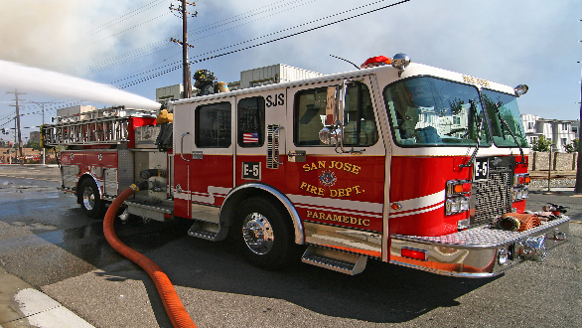
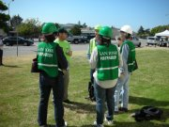
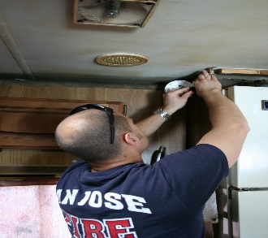
Proposed Budget Actions
Fire
Fire Engines 30 and 34/ Squad Units Staffing Realignment
Additional Resources for the Office of Emergency Services
Administrative Staffing Realignment to Support Technology Systems and Employee Relations
Increase Number of Fire Safety Inspections
Increase Diversity in Recruitment Efforts
Notes:
Chief Jacobson: In the Public Safety CSA, the Fire Department’s major budget actions are:
Permanent staffing for Engine companies 30 and 34. This action would realign staffing from four squad companies: Squads 4, 18, 5 and 26 Realignment of staffing at Squads 4 and 18 will provide appropriate staffing to keep Engine 34 in operation 24/7. Staffing at Squads 5 and 26 will staff Engine 30 24/7. This proposed action will improve response time from a 3-year average of 67% in the Las Plumas area and 72% in Azurerais.
Additional resources for the Office of Emergency Services will support the Emergency Operations Center and provide resources for OES to deliver programs and manage grants. {approx. $700k in 16-17 for OES}
Realignment of administrative personnel to support priority department initiatives including development of Fire Department Information Technology master plan.
Overtime funding in 2016-2017 {$57k} will enable staff to increase inspection of state-mandated occupancies and assemblies.

Slide 8
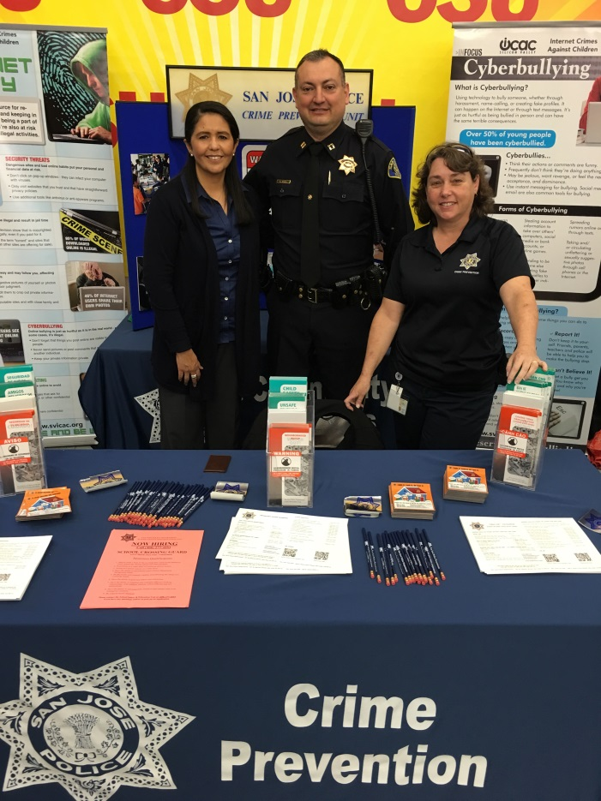
CSA Workplan Highlights - Police
Deliver high quality police services in order to maintain a vibrant and safe community
Provide effective and timely response to calls for service
Effectively investigate crimes and seek successful prosecution of suspects
Maintain a positive relationship with the community
Invest in technology to gain efficiencies
Notes:
Chief Garcia:
The Police Department’s workplan continues to:
- Provide effective and timely response to calls for service by delivering high quality police services in order to maintain a vibrant and safe community
- Effectively investigate crimes and seek successful prosecution of suspects
- Maintain a positive relationship with the community, and
- Make investments in technology in order to gain efficiencies.

Slide 9
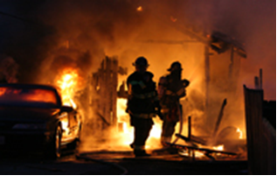
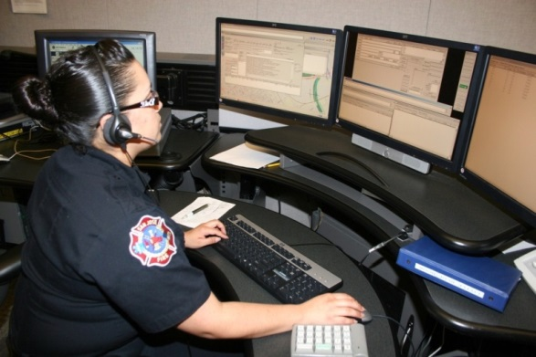
CSA Workplan Highlights - Fire
Improve response time performance (Goal of Fire unit arriving at the scene within eight minutes 80% of the time and County of Santa Clara EMS goal of 90%)
Continue dialogue with the County on delivery of EMS services
Continue to work on study of Regional Fire/EMS Communications Center
Continue with technological innovations to support improvements in response times
Notes:
Chief Jacobson: The Fire Department’s workplan continues to:
Work on achieving the City performance target of arriving at the scene of a Priority 1 incident within 8 minutes 80% of the time.
Under the leadership of the Santa Clara Fire Chief’s Association, the Fire Department continues work with other local agencies on fire and emergency regional deployment models. Current efforts include the establishment of a consolidated 9-1-1 call and emergency command center
The Department continues to work on innovations to support improvements in response times. Included in the Proposed Capital Budget is funding for an IP-based alert system. This system will allow broadcast of an event to happen immediately upon unit assignment, which should decrease dispatch time.

Slide 10
CSA Workplan Highlights - IPA
Continue to identify new ways to inform San José residents about the IPA office and the services it provides.
Develop and publish the 5th edition of the Student’s Guide to Police Practices.
Incorporate the lessons learned through the Teen Leadership Council (IPA-TLC) to identify new ways to reach young adult San José residents.
Utilize location-based analysis of complaint data to assist in directing outreach services.
Notes:
Walter Katz: The Independent Police Auditor’s workplan continues to:
Identify new ways to inform San José residents about the IPA office and the services it provides.
Develop and publish the 5th edition of the Student’s Guide to Police Practices.
Incorporate the lessons learned through the Teen Leadership Council (IPA-TLC) to identify new ways to reach young adult San Jose residents.
- Utilize location-based analysis of complaint data to assist in directing outreach services.

Slide 11
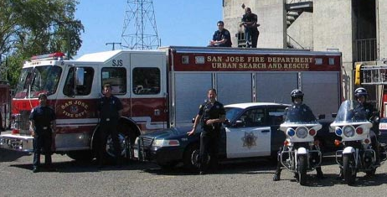
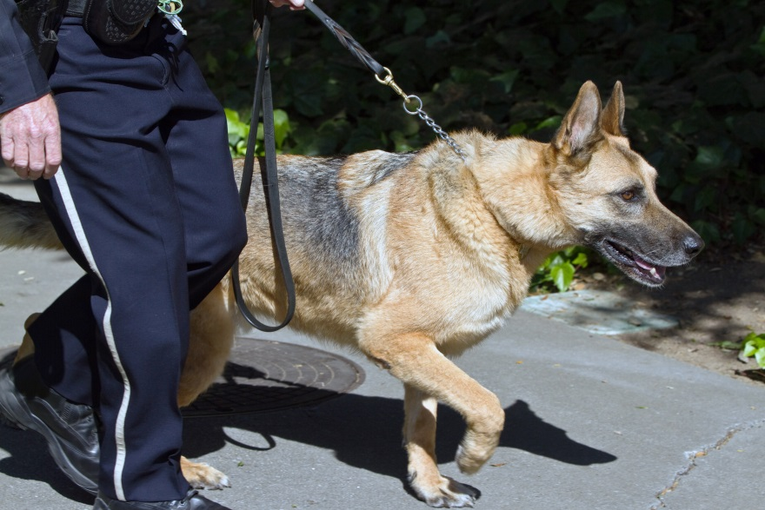
Summary
Resources will continue to focus on providing essential emergency services in a timely manner in order to protect life, property, and the environment
CSA Partners will continue to look for efficiencies, technology, revenue, grant opportunities and data analytics.
Notes:
Chief Garcia:
In summary, preserving emergency response capacity remains the highest priority of the CSA. Resources will continue to focus on providing essential emergency services in a timely manner in order to protect life, property, and the environment.
We will continue to look for efficiencies, technology, revenue, grant opportunities and data analytics in order to improve service levels and address crime, medical, or fire related situations successfully.

Slide 12
PUBLIC SAFETY 2016-2017 Proposed Operating Budget OUTCOMES:
The Public Feels Safe Anywhere, Anytime in San José
Residents Share the Responsibility for Public Safety
2016-2017 Budget Study Sessions
Notes:
Chief Garcia:
That concludes our presentation and staff are available for questions.

