Slide 1

STRATEGIC SUPPORT
2016-2017 Proposed Operating Budget
OUTCOMES:
Sound Fiscal Management that Facilitates Meeting the Needs of the Community
A High Performing Workforce that is Committed to Exceeding Internal and External Customer Expectations
Effective Use of Technology
Safe and Functional Public Infrastructure, Facilities, and Equipment
2016-2017 Budget Study Sessions
Notes:
[JULIA]
I would like to introduce you to the Strategic Support City Service Area. Our group provides support to all of the other CSAs and ensures our organization is equipped with the tools to do their jobs.
Vijay Sammeta – IT
Joe Angelo – HR
Barry Ng – Public Works
(Julia Cooper – Finance)

Slide 2
STRATEGIC SUPPORT
Human Resources
  Employee Benefits
  Employment Services
  Workers’ Compensation, Health and Safety
Finance
  Disbursements
  Financial Reporting
  Revenue Management
  Treasury Management
  Purchasing and Risk Management
Information Technology
  Information Technical Infrastructure
  Enterprise Technology Systems and Solutions
  Customer Contact Center
Public Works
  Plan, Design and Construct Public Facilities and Infrastructure
  Facilities Management
  Fleet and Equipment Services
  Equality Assurance
Notes:
[JULIA]
These are the departments and core services represented by our CSA. Public Works is represented in multiple CSAs, with approximately 50% of Public Works activity in the Strategic Support CSA.

Slide 3

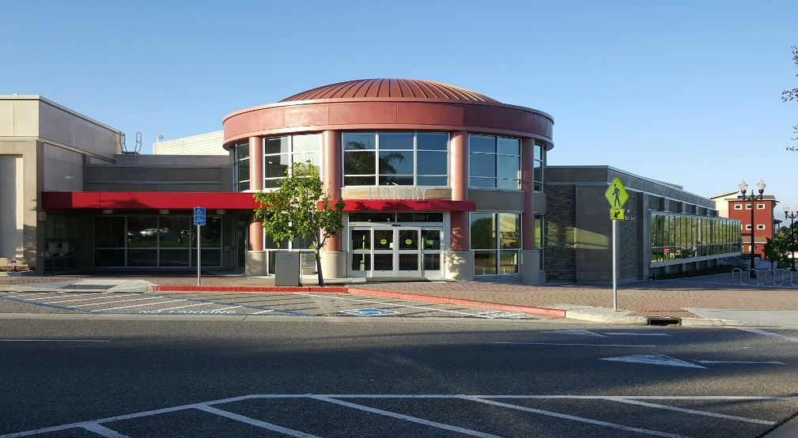
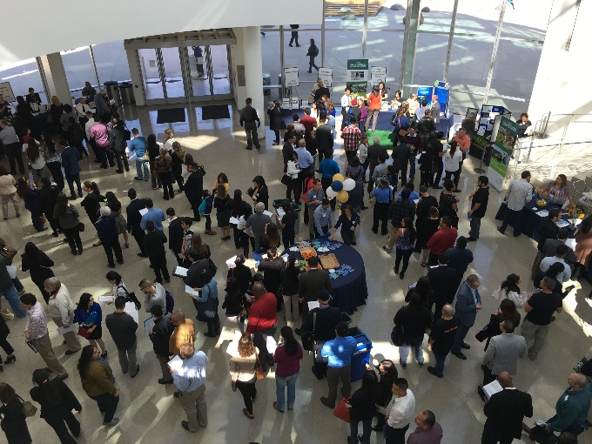
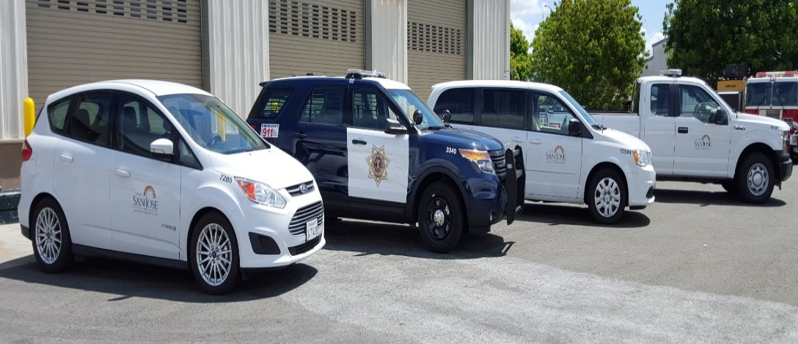
CSA Expected Service Delivery
STRATEGIC SUPPORT 3
2016-2017 Budget Study Sessions
Notes:
3
[JULIA]
The Strategic Support CSA provides infrastructure and support to the City’s organization. Investment in Strategic Support results is a direct investment into our City’s assets
Some examples of the support we provide to departments include:
Managing critical procurements throughout the City
Maintaining the City’s technology systems
Developing a safe and healthy work environment
Increased productivity and support for IT systems and tools
Implementing preventive maintenance programs for City facilities
Strategic Support provides the support necessary to make all other services possible.

Slide 4
Proposed Budget Actions
Information Technology
Funding for virtual and cloud technologies to streamline service delivery to the desktops
Begin to rebuild management framework to safeguard City data and ensure the timely completion of projects
Funding for critical infrastructure replacement to enhance network security and minimize downtime from system failures
Extension of limit-dated Customer Service Reps for the Customer Contact Center to manage caller wait times during the implementation of self-service options
STRATEGIC SUPPORT 4
2016-2017 Budget Study Sessions
Notes:
[VIJAY]
Enhancing end-user experience and strengthening the infrastructure by providing technical staff with resources such as virtualization to perform their jobs more efficiently and effectively.
As the City modernizes much of its core technologies, dedicated management is necessary to safeguard data and systems from failure or security breach.
Although core systems are being modernized, it is also important to replace the basic infrastructure that supports the business models of all departments.
While ITD does system implementation and support of those systems, its Customer Contact Center serves as the front door to the City and oftentimes the public’s first interaction with the organization. This year’s proposals address the extension of temporary positions to maintain caller wait times while we analyze business process for opportunities to reduce the need to call the City.

Slide 5
Proposed Budget Actions
Human Resources
Add an Assistant Director to provide operational oversight allowing the Director more capacity for strategic initiatives
Continue one-time funds to analyze business processes and develop metrics for measuring success
Continue one-time funds to address the backlog of recruitments and hiring and address critical job spec updates
Add staffing for extended leaves management for protected / unprotected leaves
One-time funds to implement new medical plans for 2017
One-time funds to Workers’ Compensation Division to address backlog of claims
STRATEGIC SUPPORT 5
2016-2017 Budget Study Sessions
Notes:
[JOE]
Human Resources Budget proposals for this years budget include:
Strategic Support
Add ongoing funding for an Assistant Director
Continue funding for Service Delivery and Strategic Analysis position
Employment
Continue funding to review critical job specifications
Continue funding to address the backlog of Recruitments/Hiring
Additionally, HR has proposed to:
Continue funding to continue the Career Fair for another year
One-time funding for management succession planning (Division Manager)
Benefits
Add ongoing funding for extended absence management staffing
One time funding for help with medical plans RFP
Workers’ Compensation, Health and Safety
Add one time funding to transfer additional cases to the Third Party Administrator
Add funding to add temporary services in house to continue to decrease the backlog in claims

Slide 6
Proposed Budget Actions
Public Works
Building Improvements
  City Hall HVAC
  Condition Assessments
  Muni Stadium
  Cultural Facilities
Safety Improvements
  City Hall Campus
  Employee Garage
Technology / Innovation
  Fleet Management
  Energy Program Staffing
  Master Address Database
STRATEGIC SUPPORT 6
2016-2017 Budget Study Sessions
Notes:
[BARRY]
Insert talking points

Slide 7
Proposed Budget Actions
Finance
Funding to complete the Human Resources/Payroll/Budget System upgrade
Funding to complete the Cayenta Financial Management System
One-time funding for a study of the City’s Self-Insurance Program
One-Time Funding to augment the General Liability Claims budget to address existing and anticipated claims
Notes:
[JULIA]
System implementations continue to be a top priority for the Finance Department and CSA partners.
One-time funding of $500,000 for the Human Resources/Payroll/Budget Systems upgrade to provide sufficient contingency to help ensure that the project remains on schedule and meets anticipated “go-live” dates.
One-time funding of $60,000 to continue and complete the Cayenta Financial Management System upgrade, from version 7.5 to 7.8. The $60,000 will provide funding for additional costs identified, increased technical support costs, new features and modules, and hardware requirements not previously included but necessary to support the new version.
The Finance Department and CSA partners are also focusing on the City’s Risk Management program.
One-time funding of $80,000 to obtain consulting services to perform actuarial studies to evaluate whether the city should continue to maintain a self-insurance program for liability claims by appropriating funds to cover losses or whether to obtain insurance through a third party insurer.
One-time funding of $5.0 million to increase the General Liability Claims appropriation to offset a large settlement anticipated to be paid in 2016-2017.

Slide 8
CSA Workplan Highlights
Core Technology System Implementations
“Go-live” of Community- and Organization-Facing Technologies
Business Tax Modernization
Recruitment and Retention Focus
New City Medical Plan Options Analysis
Reducing Workers’ Compensation Claims Backlog/
Workers’ Compensation Final Service Delivery Model Implementation
Continued Focus on Appropriate Preventive Maintenance Cycles for Fleet and Facilities
Effective Delivery of the Capital Improvement Program
Notes:
[JULIA]
The Strategic Support CSA will focus on the following key areas in the coming fiscal year:
The CSA continues core system implementations including “go-live” of HR/Payroll, Budget, and Business Tax in 2016-17. In addition, community-facing technology such as the Customer Relationship/Service Request Management (CRM/SRM) System and new community center networks serving the public will also go-live.
Staff will be bringing a recommendation to the City Council in June to consider ballot language changing the structure of the business tax, potentially doubling the current tax revenue of $12 million annually in future years.

Slide 9
Summary
Streamline Technology Service Delivery
Provide Sound Financial Services to the Organization
Promote Active Engagement in the Health, Well-Being and Training of Employees
Continue Effective Recruitment Strategies, and Manage Hiring Processes to Attract and Retain Qualified Employees
Improve the Condition and Extend the Life of City Fleet and Facilities
Notes:
[JULIA]
The 2016-2017 Budget proposed protection of the City’s assets in the coming year, whether they are people, places or things. Our team is focused on our customers inside and outside of the organization and seek to provide the services needed to meet their needs.

Slide 10
STRATEGIC SUPPORT
2016-2017 Proposed Operating Budget
OUTCOMES:
Sound Fiscal Management that Facilitates Meeting the Needs of the Community
A High Performing Workforce that is Committed to Exceeding Internal and External Customer Expectations
Effective Use of Technology
Safe and Functional Public Infrastructure, Facilities, and Equipment
2016-2017 Budget Study Sessions

