Slide 1

TRANSPORTATION AND AVIATION SERVICES
2016-2017 Proposed Operating Budget
OUTCOMES:
Provide Safe and Secure Transportation Systems
Provide Viable Transportation Choices that Promote a Strong Economy
Travelers Have a Positive, Reliable, and Efficient Experience
Preserve and Improve Transportation Assets and Facilities
Provide a Transportation System that Enhances Community Livability
2016-2017 Budget Study Sessions
Notes:
Presenter: Kim Becker – Director of Aviation

Slide 2
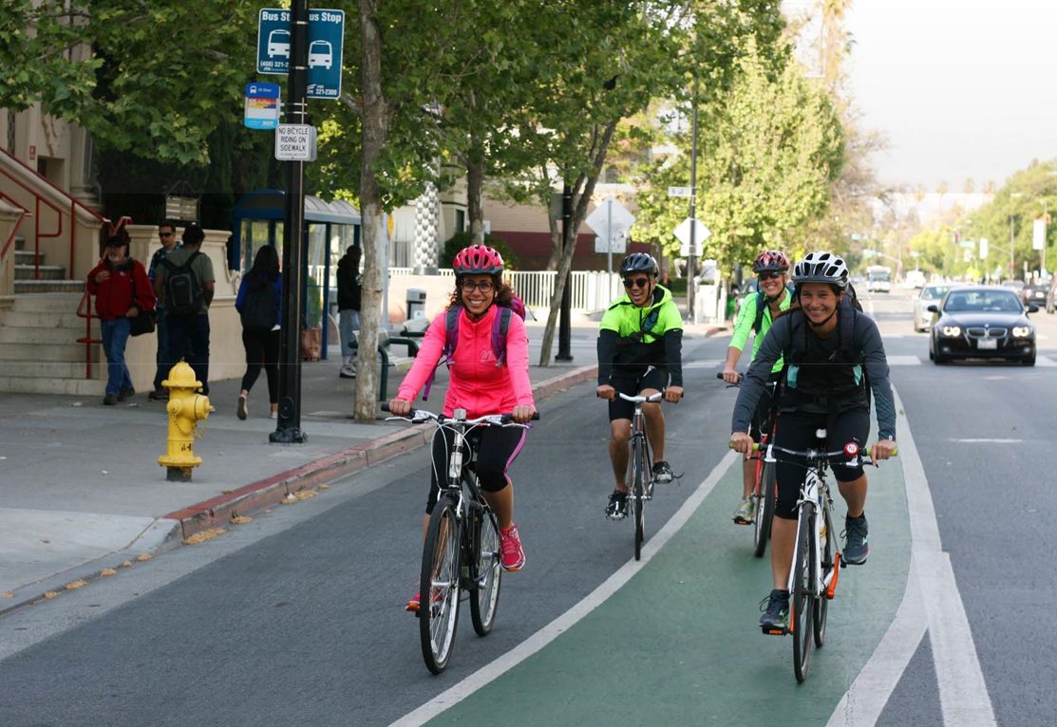
TRANSPORTATION AND AVIATION SERVICES
Transportation
  Parking Services
  Pavement Maintenance
  Street Landscape Maintenance
  Traffic Maintenance
  Transportation Operations
  Transportation Planning and Project Delivery
Police
  Traffic Safety Services
Airport
  Airport Business Development
  Airport Facilities Maintenance
  Airport Operations
  Airport Planning & Capital Development
Notes:
Presenter: Kim Becker - Airport

Slide 3
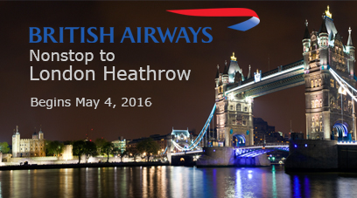
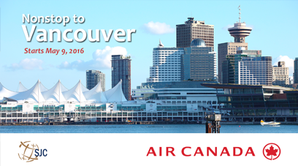
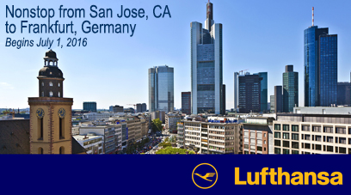
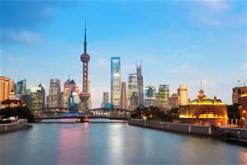

CSA Expected Service Delivery
Air Transportation
2015-2016 Outstanding!
Financial Sustainability
Safety and Security
Air Service and Passenger Growth to Support Economic Vitality
Reliable, Convenient Air Traveler Amenities
Preserve Infrastructure
  SJC Strategic Plan
Nonstop to Shanghai
Starts June 2016
Notes:
Presenter: Kim Becker - Airport

Slide 4
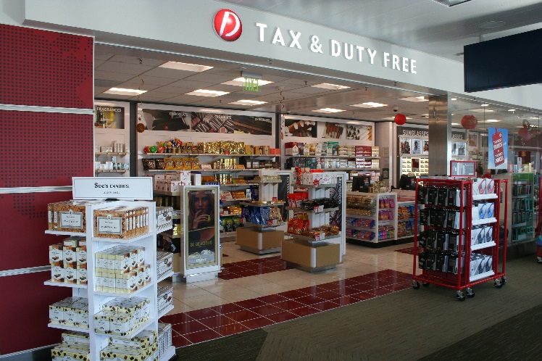
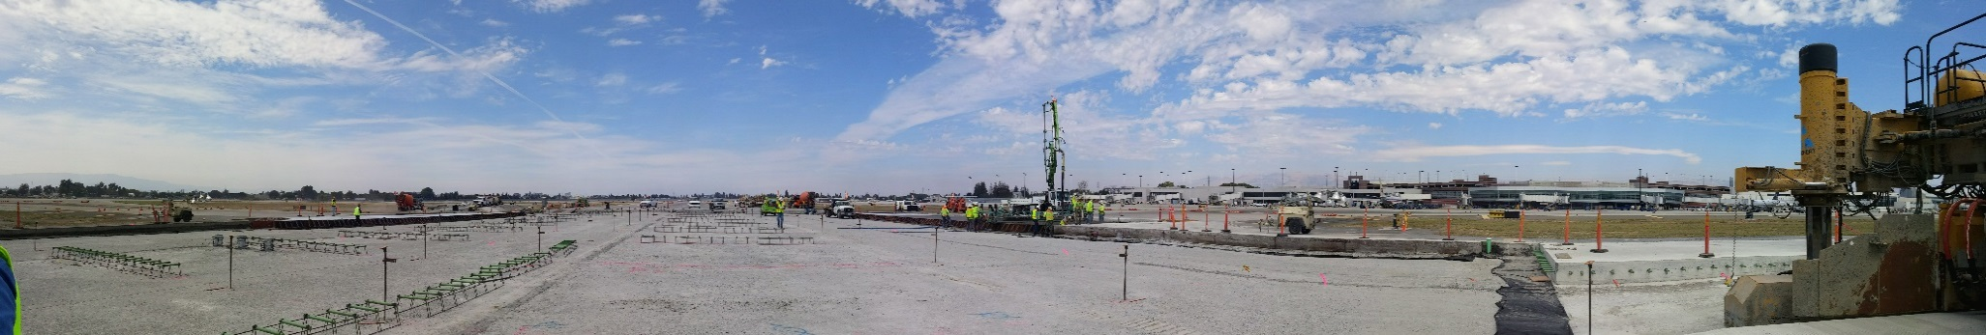
Proposed Budget Actions
Air Transportation
  Concession Plan Consultant
    Develop non-airline revenue
    Enhance financial stability
  Project Management Training
    Successfully deliver projects with increased efficiency
    Staff development
Notes:
Presenter: Kim Becker - Airport

Slide 5
CSA Workplan Highlights
Air Transportation
Passenger Growth
  Facility Impacts
  Staff Capacity
Complete Bond Funded Projects
  Summer 2017
  Maximum impact – quick turnaround
Plan for Growth
  12.2 million passengers
  217 daily departures
Notes:
Presenter: Kim Becker - Airport

Slide 6
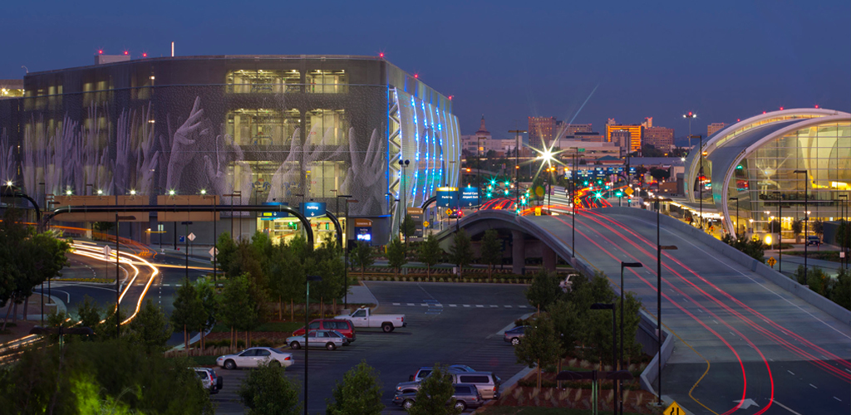
Summary
Air Transportation
Financial gap 2018-2019
Passenger growth
Tactical assessment of operations
Cautiously optimistic
Notes:
Presenter: Kim Becker – Airport

Slide 7
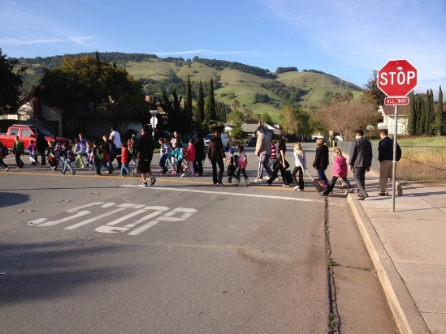
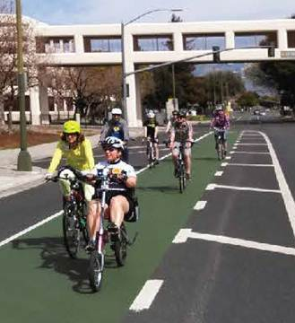
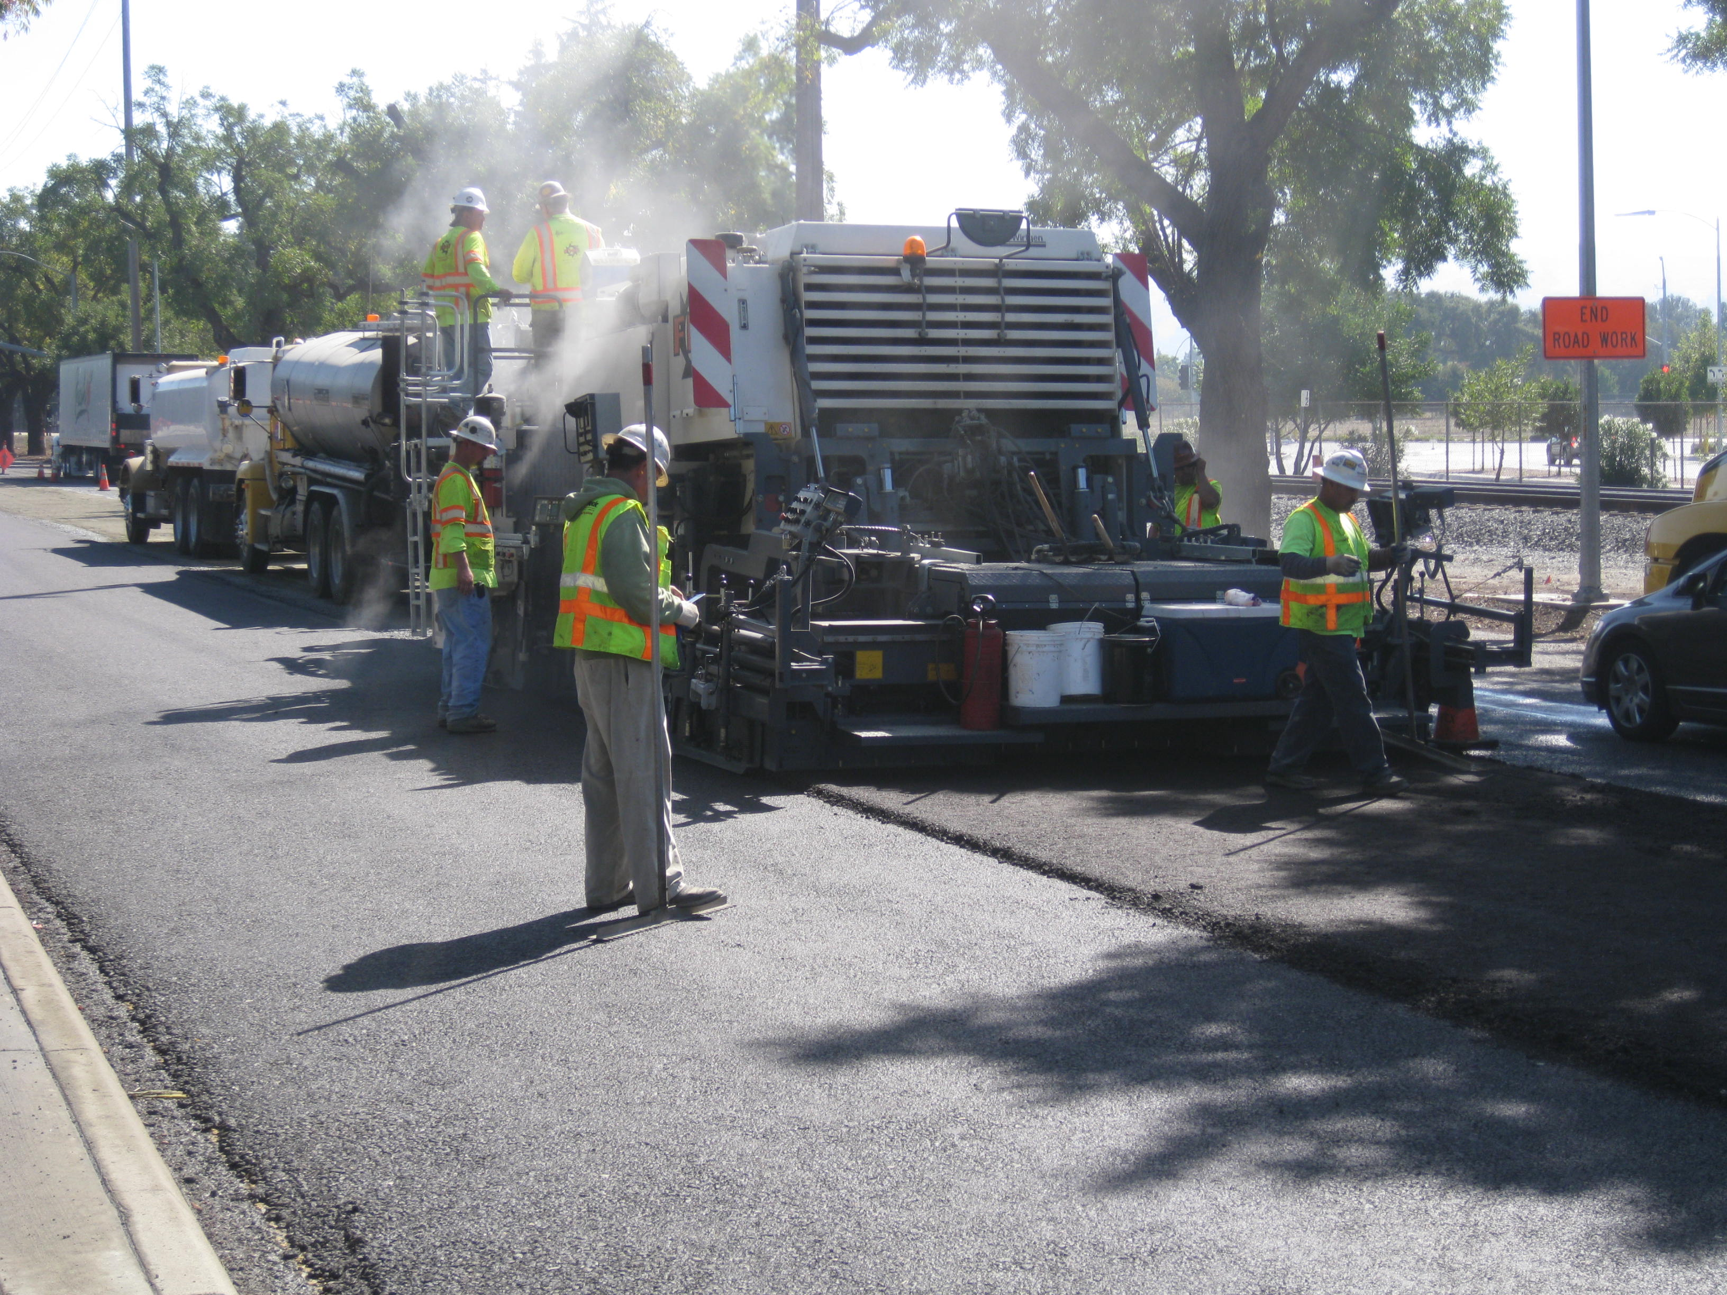

CSA Expected Service Delivery
Surface Transportation
Safe Streets
Balanced Transportation
Quality Infrastructure
Innovation & Technology
Notes:
Get photos of Walk & Roll, TiMN (this one is ok), and Paving

Slide 8
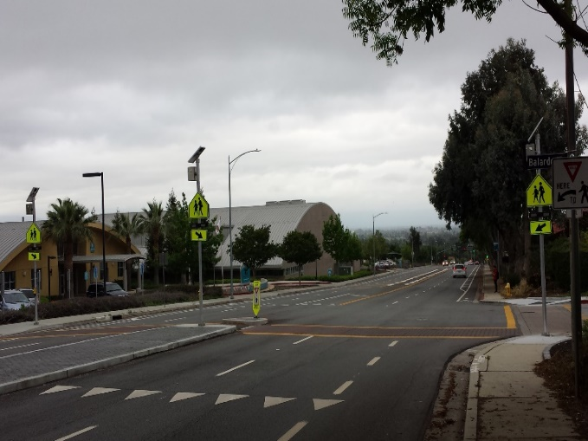
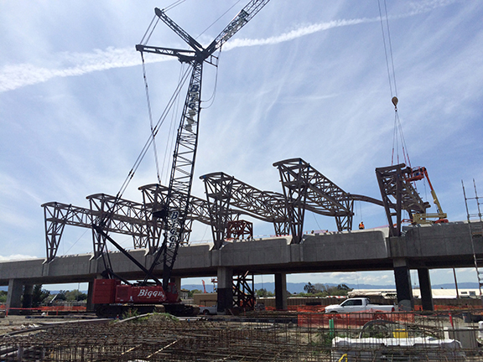
Proposed Budget Actions
Surface Transportation
Pedestrian Safety Projects
Regional Rail Expansion
  BART, HSR, Caltrain, Diridon
Long Term Pavement Funding
Transportation Technology
  Support Smart City Vision
Maintain Smart Parking Meters
Special District Retrofits

Slide 9
CSA Workplan Highlights
Surface Transportation
Safety Initiatives
  Build Vision Zero Foundation
Grant-Funded Local Street Projects
Area Development Plans & Project Delivery
Regional Highway Engineering
Regional Rail Planning & Expansion
Pavement & Infrastructure Maintenance

Slide 10
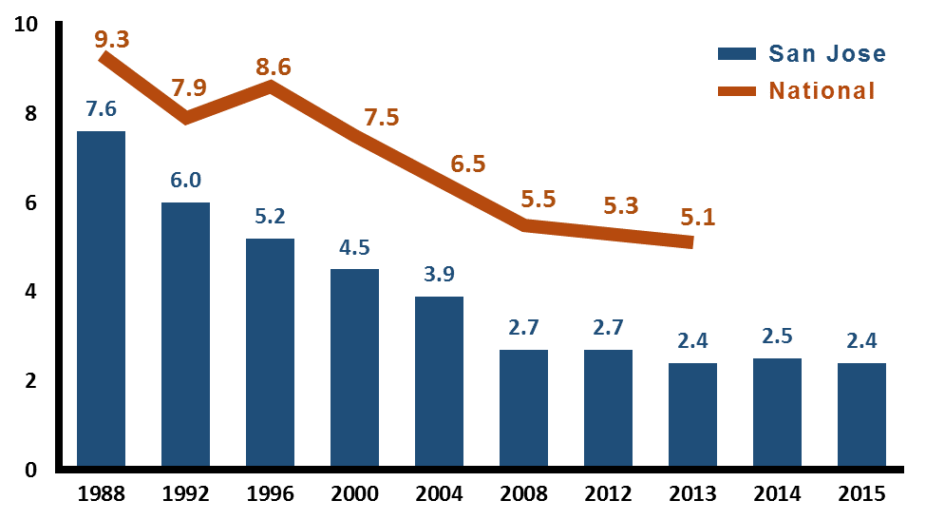
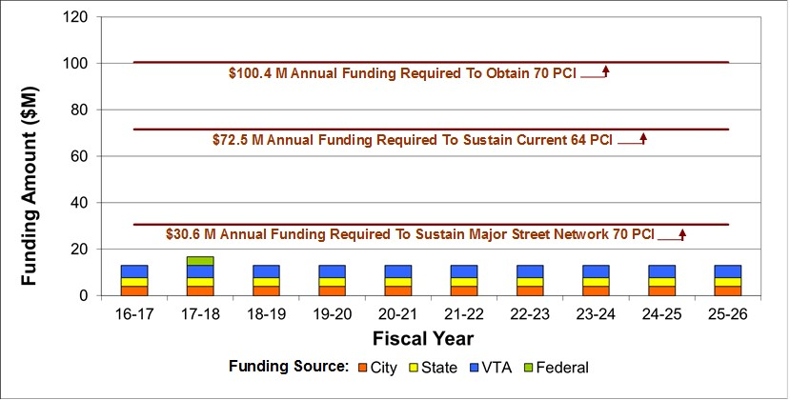
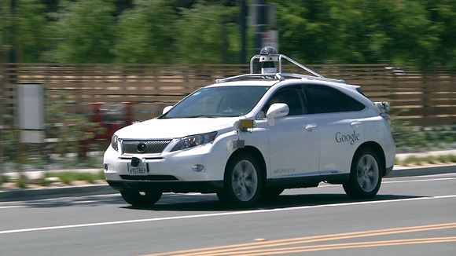
Summary
Surface Transportation
San Jose Injury Crash Rate (per 1,000 population)
Pavement Maintenance Funding Status

Slide 11

TRANSPORTATION AND AVIATION SERVICES
2016-2017 Proposed Operating Budget
OUTCOMES:
Provide Safe and Secure Transportation Systems
Provide Viable Transportation Choices that Promote a Strong Economy
Travelers Have a Positive, Reliable, and Efficient Experience
Preserve and Improve Transportation Assets and Facilities
Provide a Transportation System that Enhances Community Livability
2016-2017 Budget Study Sessions
Notes:
Presentation Panel Airport: Kim Becker and Kim Hawk; DOT: Hans Larsen and Jim Ortbal

