Slide 1
Audit of Development Noticing
Presentation to the Neighborhoods Commission
Wednesday, April 10, 2019
San José City Auditor’s Office

Slide 2
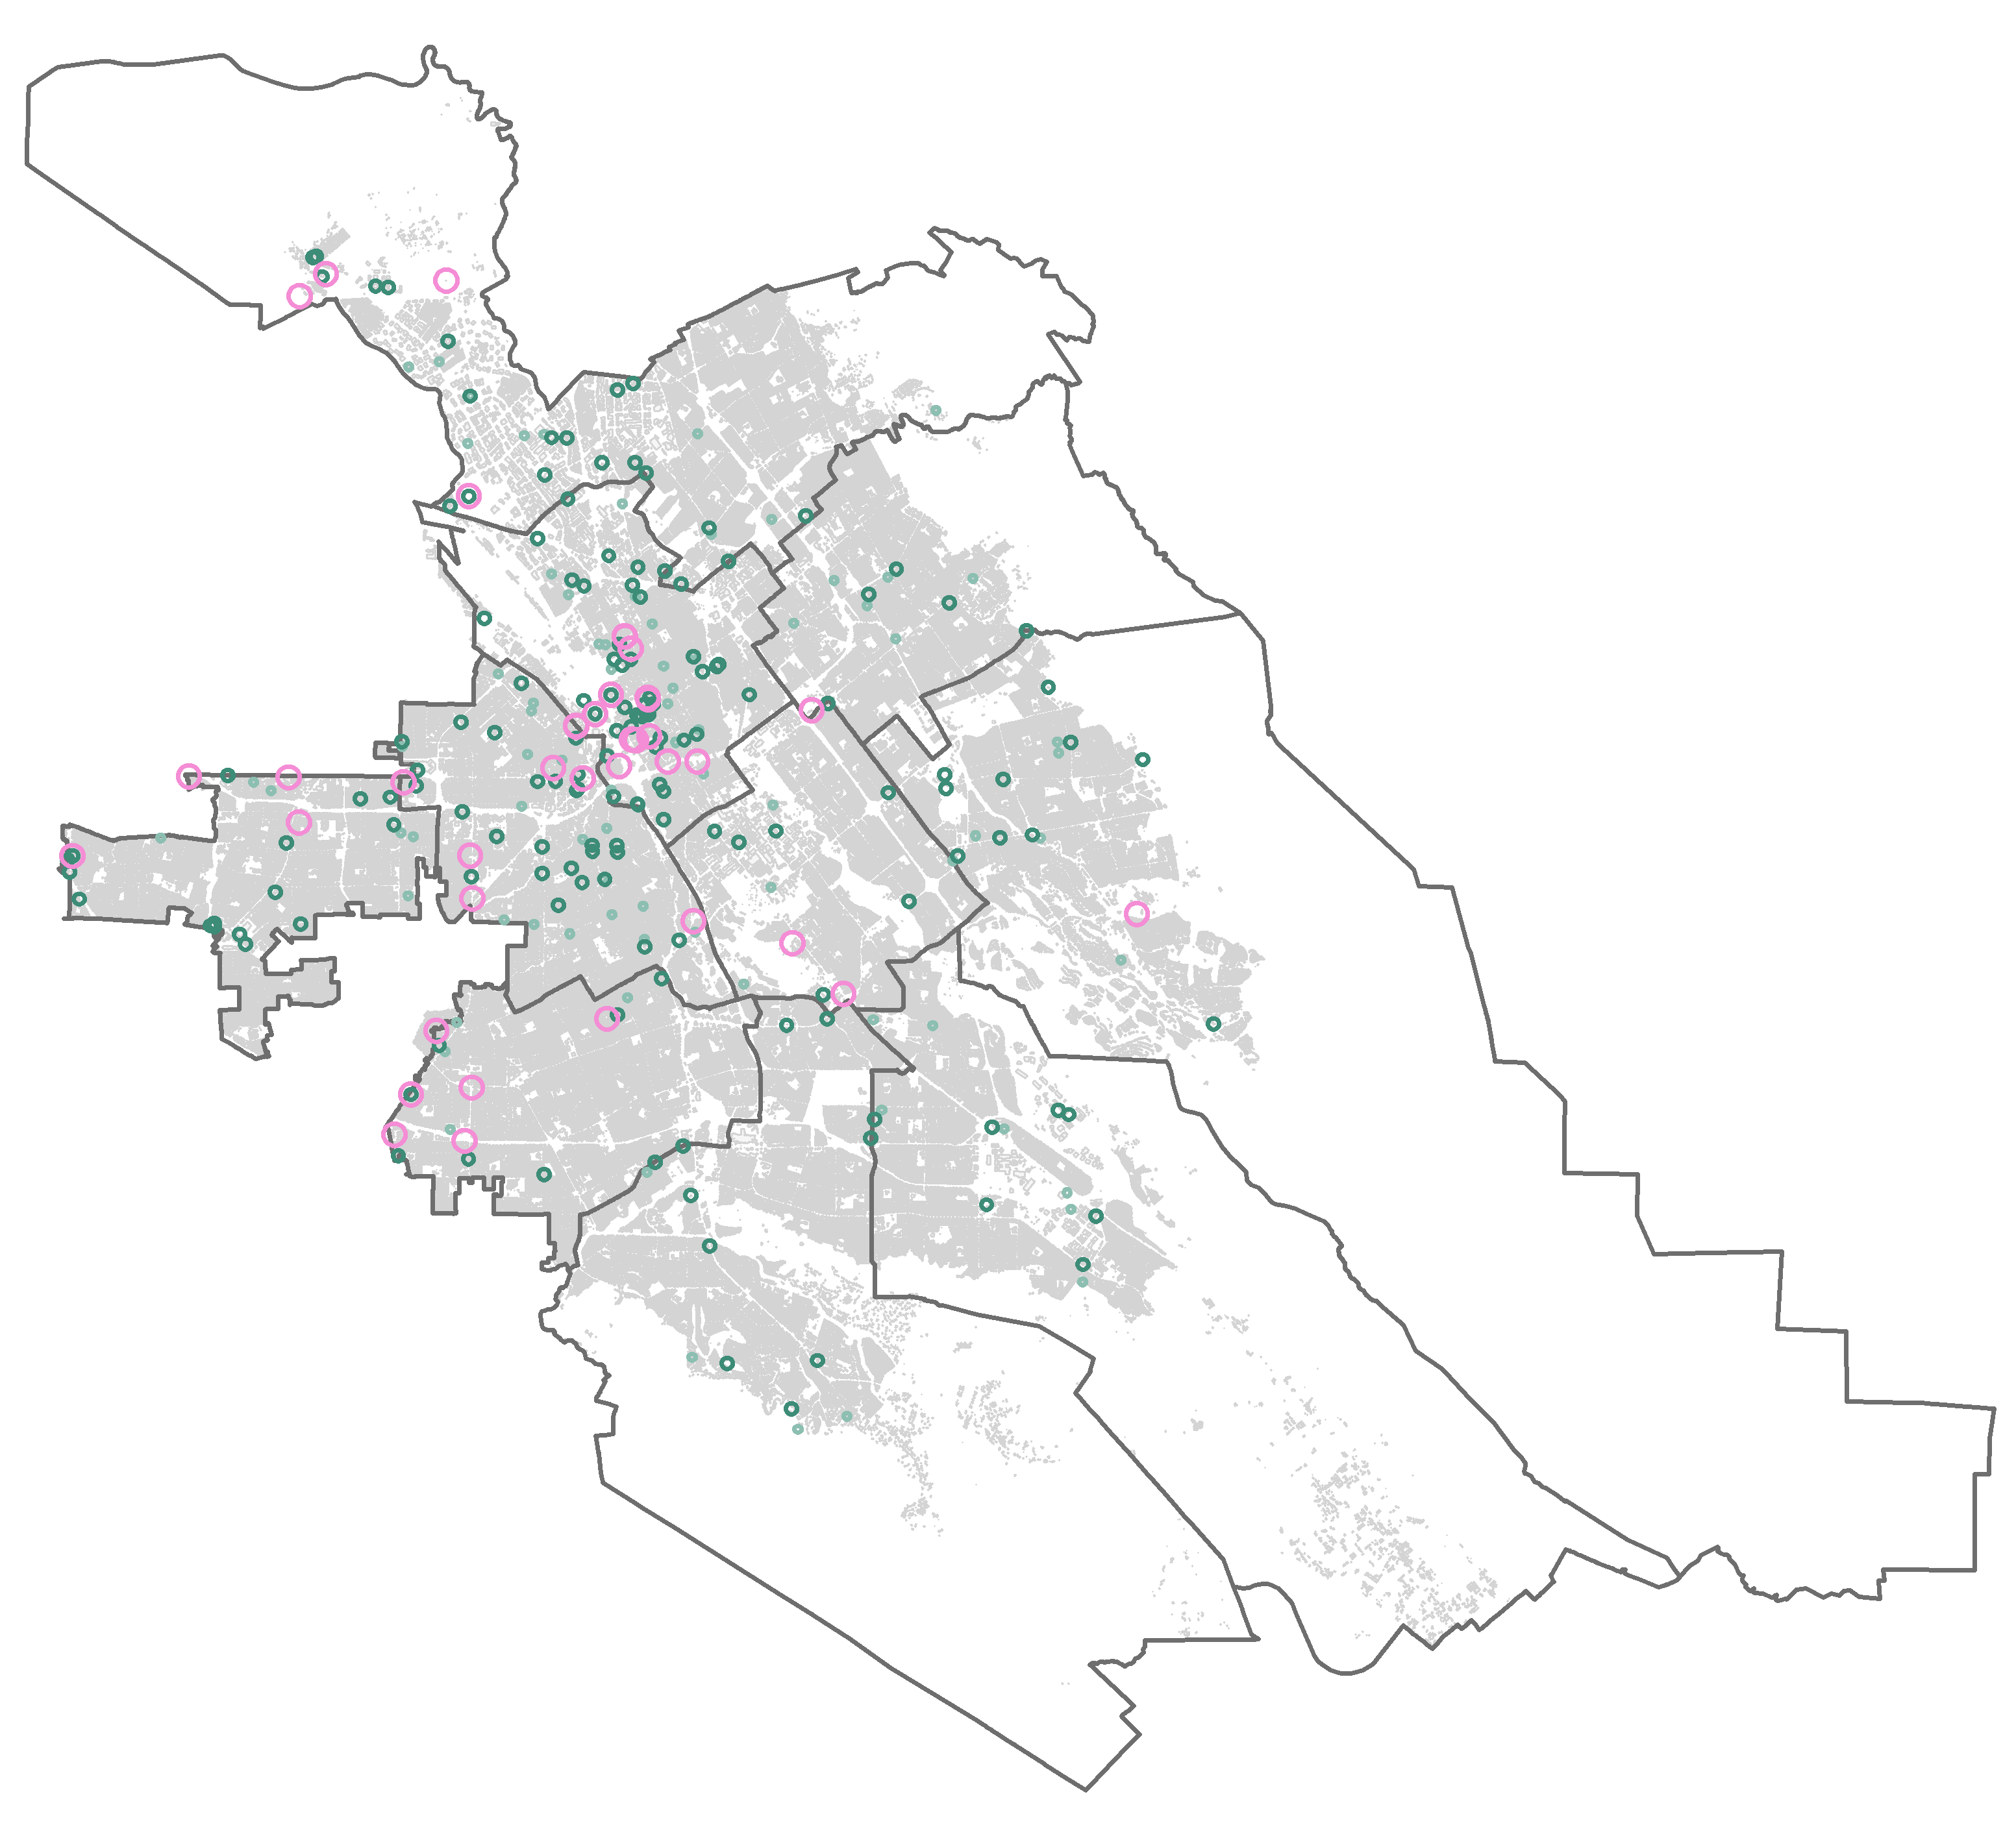
Background
Exhibit 5: Location of Development Proposals and Mailing Radii for Hearing and Community Meeting Notices in FY 2017-18
State requirements
  Property owners
  300-foot radius
  10 days’ notice
  Newspaper notices (zoning)
City requirements (6-30)
  Tenants and property owners
  1,000-foot + radius
  14 days’ notice (minimum)
  On-site notice
  Online information
Key
1000-foot radius
500-foot radius
300-foot radius
Council district boundaries
Building footprint

Slide 3
Scope & Methodology
The objective of our audit was to assess the effectiveness of outreach for new development including notice radius, timing, and language accessibility. To this end, we:
  Reviewed noticing requirements
  Observed processes for mailed notices
  Surveyed tenants and property owners
  Surveyed members of neighborhood and homeowners associations
  Benchmarked public noticing requirements against 11 other jurisdictions

Slide 4
Finding 1
Finding 1: Planning Prepares and Mails Tens of Thousands of Hearing Notices
Exhibit 2: Three Support Staff Centrally Manage Development Noticing

Slide 5
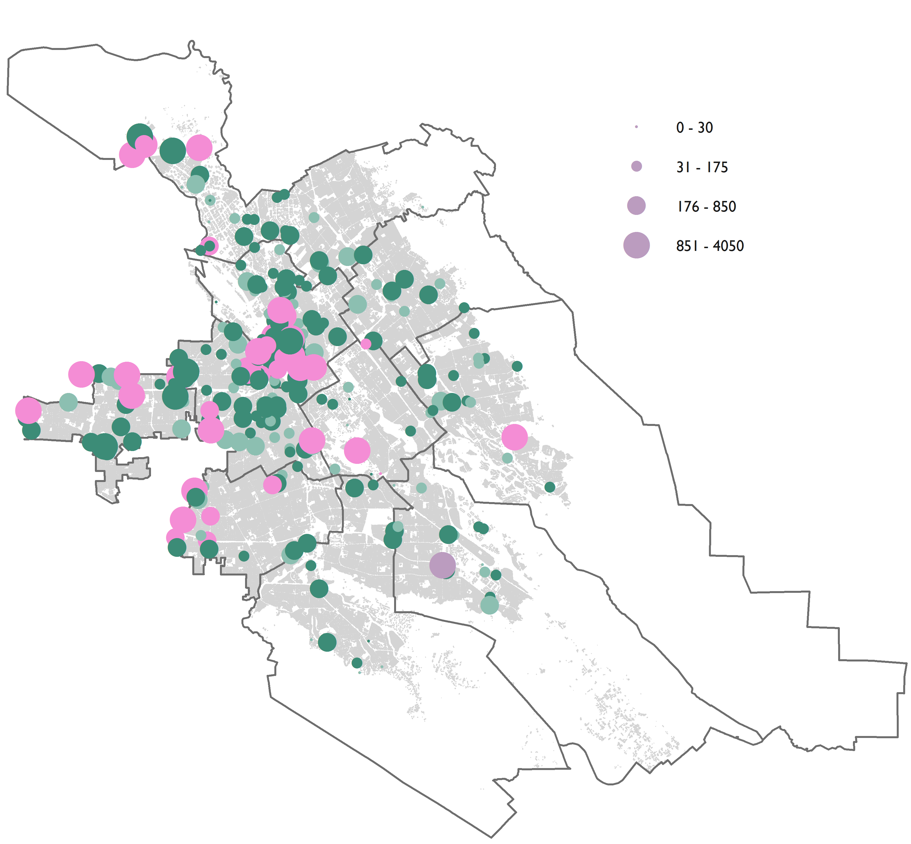
Finding 1
Exhibit 6: Number of Mailing Sent for Hearings and Community Meetings Held in FY 2017-18
Hearing notices
  374 projects
  109,741 mailings
  $276,300 in public notice fees
Community meeting notices
  44 projects
  39,515 mailings
  $68,900 in public notice fees
Number of mailings sent

Slide 6
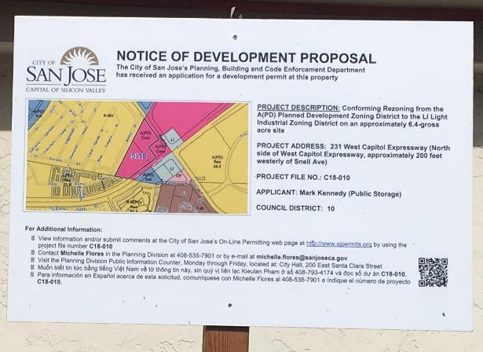
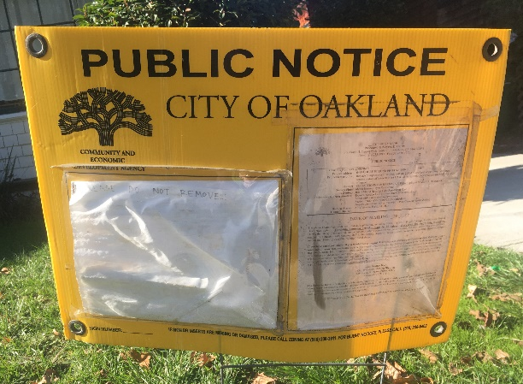
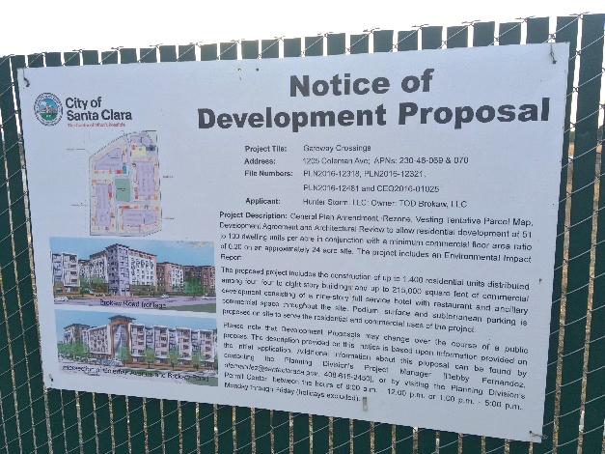
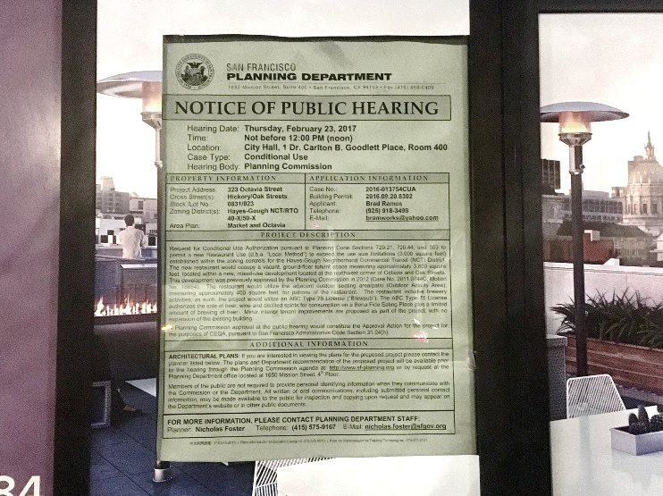
Finding 1
Exhibit 7: Example On-Site Notices in San José, Santa Clara County, Oakland, and San Francisco
San José |  | Oakland
Santa Clara |  | San Francisco

Slide 7
Finding 2
Finding 2: The City Should Improve Mechanisms for Reaching Neighborhood Associations and Limited English Speaking Communities
We found:
The City does not have a comprehensive list of contact information for neighborhood associations.
Notices do not appear to be fully translated.

Slide 8
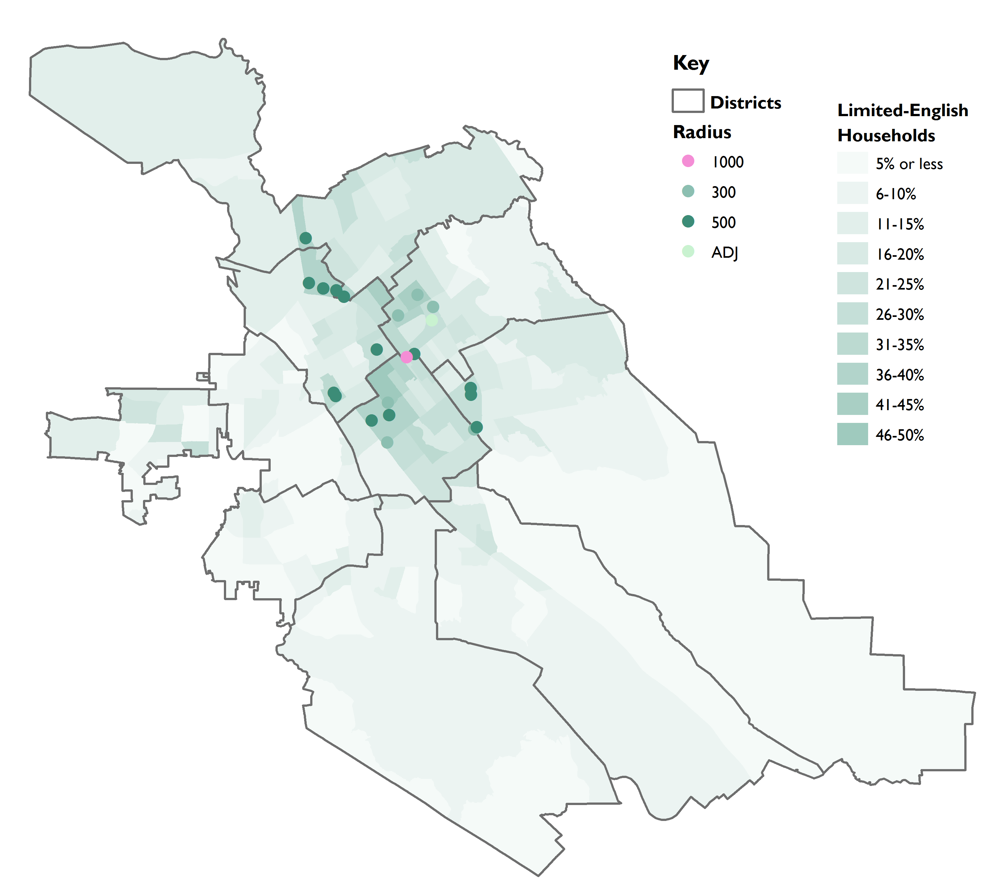
Finding 2
Exhibit 8: In FY 2017-18, Just 28 Development Projects Occurred in Census Tracts Where at Least a Quarter of Households Were Limited English Speaking

Slide 9
Finding 3
Finding 3: Further Improvements Can Enhance Public Outreach
We found:
Policy 6-30 should be updated to account for changes to the Municipal Code.
Matrix B of Policy 6-30 does not offer clear guidance.
Policy 6-30 emphasizes outmoded communications.
Hearing notices can incorporate more plain language.

Slide 10
Conclusion
Our audit report includes a total of 8 recommendations to ensure outreach policies meet community expectation.
We would like to thank Planning, PRNS, Public Works, the Office of Immigrant Affairs, the City Attorney’s Office, and San José residents for their time and insight.
The audit report is available at: www.sanjoseca.gov/auditor

