Slide 1
2018-2019 Proposed City Budget
Community Input Budget Meeting

Slide 2
Looking Back: Balancing $664M of Shortfalls
Notes:
Done

Slide 3
Economic and Fiscal Outlook
2019-2023 General Fund Forecast
Incremental General Fund Surplus/(Shortfall)
2018-2019 | 2019-2020 | 2020-2021 | 2021-2022 | 2022-2023
($4.3 M)* | ($15.5 M) | ($8.9 M) | ($10.5 M) | $10.8 M
*The shortfall amount has been addressed in the 2018-2019 Proposed Budget.
Notes:
*Updated*

Slide 4
Restoring Services (Since 2015)
Police
Added 200+ new Police Officers
Doubled Community Service Officers
Crime prevention and analysis
Gang prevention: Project Hope, SJWorks, etc.
Fire/Emergency Medical Response
Eliminated “Brown Outs”
Squad Cars
Technology: Traffic Signal Preemption,
Community centers
Libraries: Open 6 days/ wk
Homeless Rehousing
Streets: Measure B & SB1
Park Maintenance
School Crossing Guards

Slide 5
Increasing Police Staffing Levels
Street-ready positions are officers working
Notes:
Annual Report on City Services 2016-17 - Resident Survey page 21: http://www.sanjoseca.gov/DocumentCenter/View/73885

Slide 6
San Jose Police Academy Status
Academy Recruiting & Hiring | Academy 26 February 2016 | Academy 27 June 2016 | Academy 28 October 2016 (Start date 10/26/16) | Academy 29 Feb. 2017 (Start date 2/13/17) | Academy 30 June 2017 (Start date 6/15/17) | Academy 31 Oct. 2017 (Start date 10/24/17) | Academy 32 Feb. 2018 (Start date 2/8/18) | Academy 33 June 2018 (Start date 6/14/18)
Applied | 1893 | 1888 | 2822 | 2290 | 4017 | 2217 | 1910 | 3025
Proceeded to Backgrounds | 167 | 147 | 215 | 204 | 318 | 221 | 190 | 284
Hired | 7 | 17 | 34* | 29* | 53 | 47 | 57 | Not yet available
Graduating from Academy | 8/12/2016 | 12/2/2016 | 4/27/2017 | 8/11/2017 | 12/15/2017 | 04/27/18 | 8/17/18 | 12/14/18
*Includes lateral transfers
Notes:
*Updated*

Slide 7
2018-2019 Proposed Budget Overview
2018-2019 PROPOSED CITY BUDGET: | $3.5 billion
TOTAL NUMBER OF FUNDS: | 120
TOTAL NUMBER OF EMPLOYEES: | 6,392 (vs. 7400)
Notes:
*Updated*
Pie chart data: http://www.sanjoseca.gov/DocumentCenter/View/77157, Page 3

Slide 8
2018-2019 Proposed Budget Highlights

Slide 9
Homelessness and Housing
$3M —homelessness prevention & rehousing
15-point Housing Plan: 25,000 homes
Mapping Opportunity Sites w/ GIS
Rental Registry & Renter Protection
2019: $104 million Affordable Housing RFP
All the Way Home: >1,000 Vets Housed

Slide 10
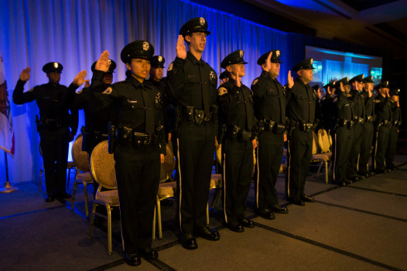
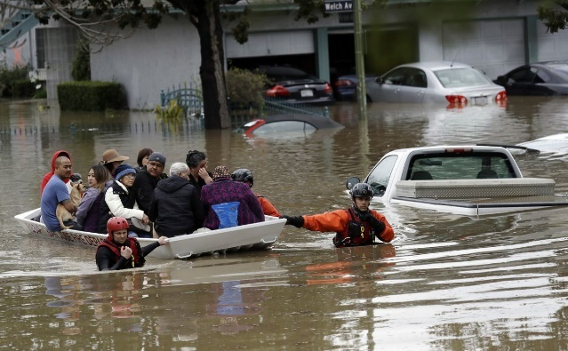
Public Safety
Increase Budget Cap to 1151 SJPD Officers
Domestic Violence: Housing Families in Crisis
Office Of Emergency Management Launch & Staffing
Massage Parlor Enforcement
Notes:
ADD Parks Irrigation Technology

Slide 11
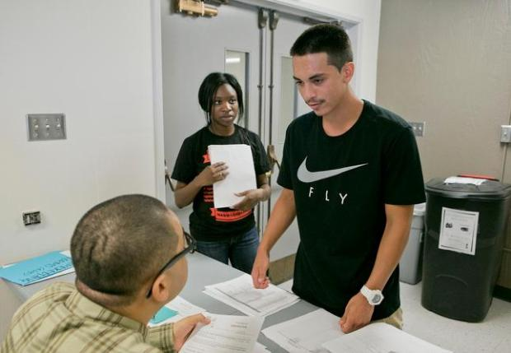
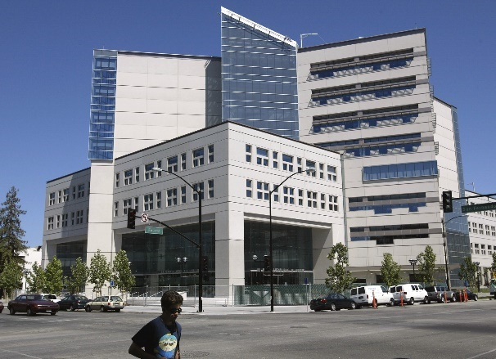
Education and Our Youth
SJ Works 4.0
SJ Learns 3.0
Summer learning program
Service Year

Slide 12
Environment
Climate Smart SJ
SJ Clean Energy Launch
EV Charging
Treatment Plant
Notes:
ADD Parks Irrigation Technology

Slide 13
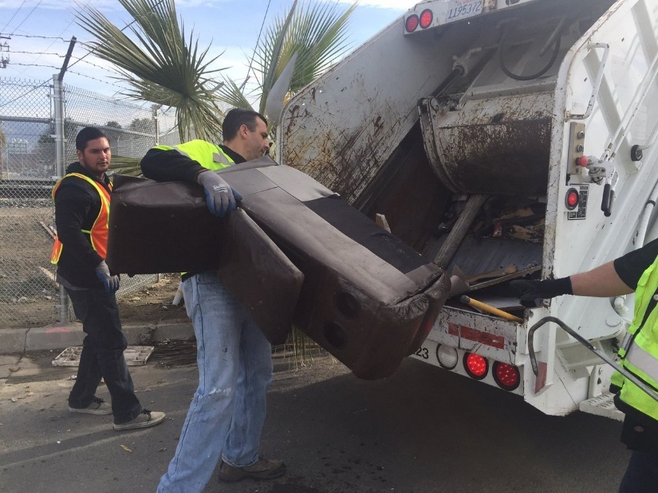
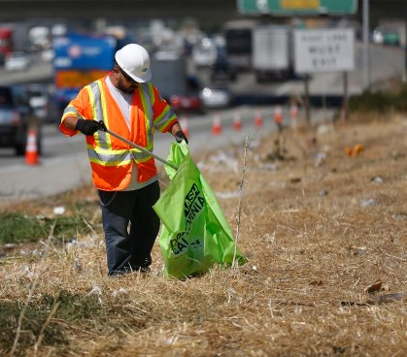
#BeautifySJ
MySanJose 2.0
Free Junk Pickup
Support/Coordinate Volunteers
San Jose Streets Team
BeautifySJ Grants
Vehicle Abatement
Median Island & Street Maintenance
Dumpster/ Neighborhood Cleanups

Slide 14
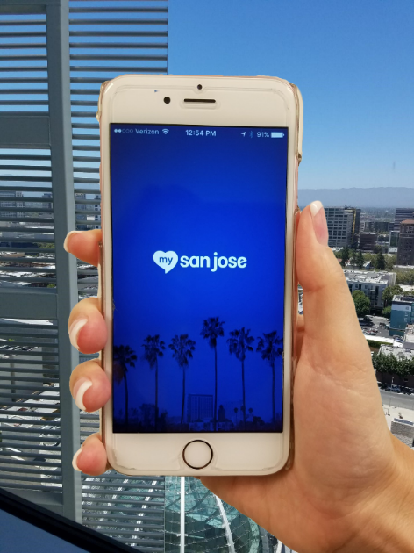
Innovation and Tech
My San Jose 2.0
Data
Digital Inclusion Fund/
Community Wi-Fi
Privacy & Data Security

Slide 15
Saving / Improving Fiscal Sustainability
$15.5M Deficit Reserve Fund
Refinanced Redevelopment Bonds
Negotiating Sales of Hayes Mansion & Other Properties

Slide 16
Budget Process 2018:
www.sanjoseca.gov
May 10th through 23rd Community Budget Meetings
May 9th through 14th City Council Budget Study Sessions
May 15th/June 11th Public Budget Hearings
June 1st Mayor’s June Budget Message Released
June 12th Council Review/Approval of Mayor’s June Budget Message and Budget
June 19th Adoption of the 2018-2019 Budget and Fees and Charges
Notes:
*Updated*

Slide 17
Get Involved!
#BeautifySJ
5K Coding Challenge
SJ Works
SJ College Promise
Gen-2-Gen Campaign

Slide 18
Share Your Input
How should you and the community be part of solutions?
Which services do you think are most critical to enhance or restore?
What is your best advice on the budget?
Spanish
Vietnamese
English

Slide 19
Questions?

