Slide 1
MGPTF –
Strategic Work Plan 2018 - 2020

Slide 2

2018 – 2020 Key Sections
Overview
History: 26 years and counting! (pg. 6)
Structure and Its Collective Impact (pg. 7)
Partnerships / Hot Spots (pgs. 8-9)
MGPTF Programs and Services
BEST (pg. 10)
Youth Intervention Services (pg. 11)
MGPTF – Neighborhood Services Programs (pg. 12)
Emerging Trends
The Problem: continued crime (pg. 13)
Substance Abuse (pg. 13-14)
Achievement Gap (pg. 14)
Homelessness (pg. 15)
MGPTF Strategic Planning Process
Community Engagement Results (pg. 16)
Stakeholder and Partner Engagement (pg. 17)

Slide 3
MGPTF 2018 – 2020
Strategic Goals
Goal 1: Strengthen the Continuum of Care.
(Prevention, Intervention, Enforcement, Reentry)
Reassess and align BEST “Eligible Services” funding to support implementation of SWP goals.
Build capacity to support services for Transitional Aged Homeless Youth.
Partner with the District Attorney’s Office and Public Health Department on Gun Violence Prevention strategies.
Continue to support the implementation of Evidence Informed and Evidence Based Programming with a Trauma Informed Care approach.
Continue alignment with the Public Health Violence Prevention Framework.

Slide 4
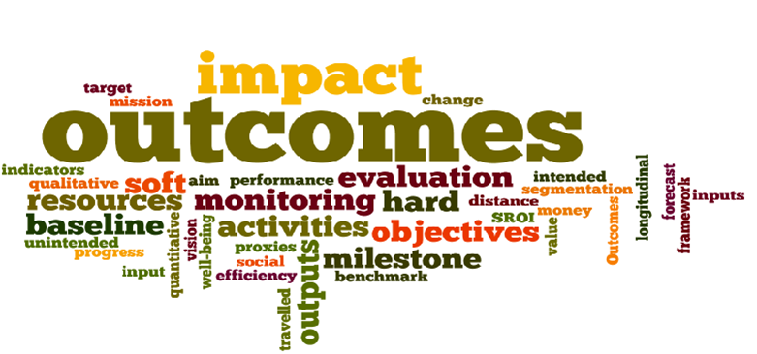
MGPTF 2018 – 2020
Strategic Goals
Goal 2: Implement outcome evaluation studies of MGPTF funded programs and services with a focus on impact of services
Work with consultants to develop new evaluation model for MGPTF Programs and services.
Strengthen data sharing agreements with MGPTF Partners (including: SJPD, SCC Probation, SCC District Attorney’s Office, SCC Public Defenders Office, SCC Office of Education)
Provide an Annual Report to the MGPTF Policy Team on Direct Impact of MGPTF Programs.

Slide 5
MGPTF 2018 – 2020
Strategic Goals
Goal 3: Develop strategies to place MGPTF youth and young adults in vocational training programs and jobs
Enhance SJ BEST contracted services to increase jobs and vocational training capacity.
Integrate Work2Future resources and services to access state and federal opportunities (funding).
Implement a SJ Works Program to provide both subsidized and unsubsidized work experience and shadowing programs.
Pilot a “Gang Impacted Construction Career Initiative” for youth and young adults
Convene a youth jobs steering committee.

Slide 6
MGPTF 2018 – 2020
Strategic Goals
Goal 4: Increase community safety through empowered neighborhoods.
Support and build community/neighborhood capacity in “Hot-Spot” communities to address issues of violence and blight.
Link existing community capacity building initiatives in San Jose to leverage resources and share best practices (i.e. MGPTF Project Hope, SCC Probation NSU, District Attorney’s Office)
Seek local, state, and federal funding opportunities to support this effort
Conduct and evaluation of Project Hope after implementation at two sites

Slide 7

MGPTF 2018 – 2020
Strategic Goals
Goal 5: Enhance linkage and leverage of all youth violence prevention initiatives
Inventory current community and youth violence prevention strategies (i.e. MGPTF, East Side Peace Project, School Linked Services, MBK, Opportunity Youth, others TBD).
Develop an Action Plan to leverage resources and increase community and youth outcomes.
Convene quarterly meetings with Violence Prevention Initiative stakeholders.
Provide an Annual Report to the MGPTF Policy Team on the impact of this goal.

Slide 8
QUESTIONS
Notes:
That concludes our presentation and we are open to questions

