Slide 1
ENVIRONMENTAL & UTILITY SERVICES 2015-2016 Proposed Operating Budget OUTCOMES: - Reliable Utility Infrastructure - Healthy Streams, Rivers, Marsh, and Bay - “Clean and Sustainable” Air, Land, and Energy - Safe, Reliable, and Sufficient Water Supply
2015-2016 Budget Study Sessions

Slide 2
ENVIRONMENTAL & UTILITY SERVICES
Environmental Services
Natural and Energy Resources Protection
Potable Water Delivery
Recycled Water Management
Recycling and Garbage Services
Stormwater Management
Wastewater Management
Transportation
Sanitary Sewer Maintenance
Storm Sewer Management
Public Works
Sewer Condition, Capacity and Asset Management

Slide 3
CSA Expected Service Delivery
Build, Operate, and Maintain the City’s Utilities Reliably and Safely
Promote Pollution Prevention, Water Quality, and Habitat Protection
Oversee Programs to Maximize Solid Waste Diversion from Landfills

Slide 4
Proposed Budget Actions
Proposed Residential Rate Changes
 | % Change | Monthly $ Change | Proposed Rate
Muni Water | 29.0% | $17.47* | $78.06
Recycle Plus | SFD: 3.0% MFD: 5.0% | SFD: $0.92 MFD: $10.58 | SFD: $31.76 MFD: $222.19
Sewer Service and Use Charge | 5.5% | SFD: -$0.08** MFD: $3.27** MHP: $6.09** | SFD: $33.75 MFD: $25.89 MHP: $31.57
Storm Sewer Service Charge | 0.0% | $0.00 | $7.87
*Average increase, which varies by volume
**Includes changes based on Sanitary Sewer Flow Study Update

Slide 5
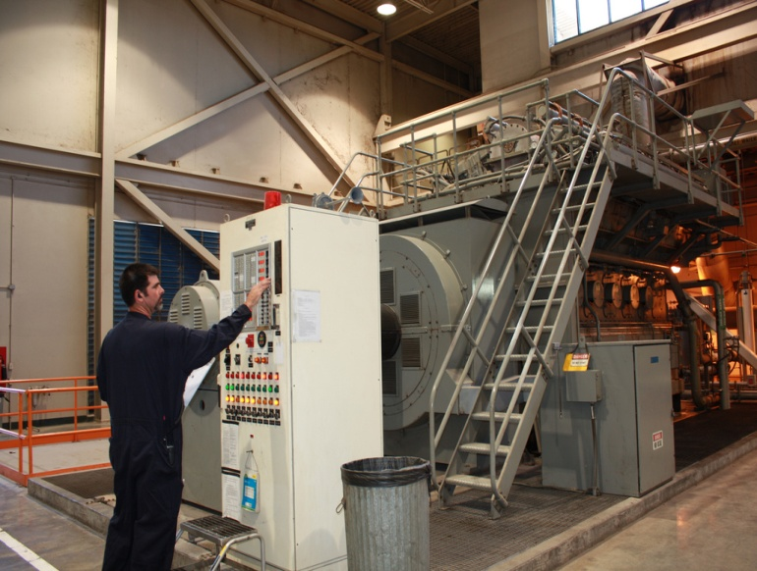
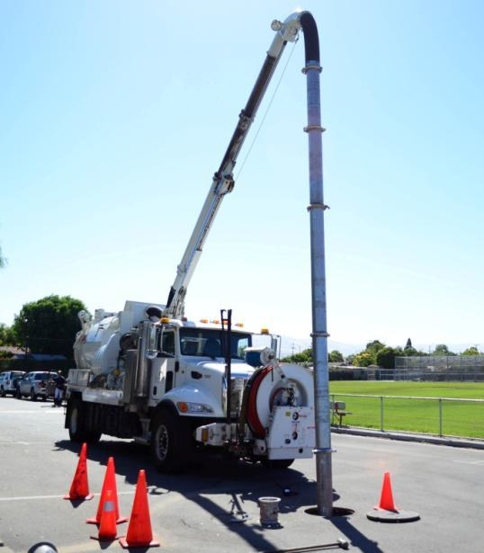
Proposed Budget Actions
Wastewater Facility CIP Staffing
Sorting of Residential Solid Waste (additional 20%)
Water Conservation
Stormwater Permit Compliance
Bioretention Facility Maintenance
Sanitary Sewer Maintenance Staffing

Slide 6
CSA Workplan Highlights
Sanitary Sewer Program
- Sanitary Sewer Overflows Reduction, CIP Improvements
Storm Sewer Program
- Master Plan, Long-Term Trash Load Reduction
Solid Waste Management
- Advance Zero Waste Goals
Wastewater Management
- Recycled Water Program, Plant CIP Delivery
Water Conservation
- Water Supply Planning, City-Wide Outreach

Slide 7
Summary
Rebuild and Revitalize the Plant
Address Sanitary Sewer System Capital Investment Needs
Continue to Focus on Reducing Sanitary Sewer Overflows
Evaluate Short- and Long-Term Opportunities and Strategies for the Recycled Water Program
Support City-Wide Water Conservation Efforts

Slide 8
ENVIRONMENTAL & UTILITY SERVICES 2015-2016 Proposed Operating Budget OUTCOMES: - Reliable Utility Infrastructure - Healthy Streams, Rivers, Marsh, and Bay - “Clean and Sustainable” Air, Land, and Energy - Safe, Reliable, and Sufficient Water Supply
2015-2016 Budget Study Sessions
Notes:
8

