Slide 1
NEIGHBORHOOD SERVICES 2015-2016 Proposed Operating Budget OUTCOMES: - Safe and Clean Parks, Facilities and Attractions - Vibrant Cultural, Learning, Recreation, and Leisure Opportunities - Healthy Neighborhoods and Capable Communities
2015-2016 Budget Study Sessions
Notes:
Good afternoon (Morning?). I am Jill Bourne Director of the Library and I am joined with and Jon Cicerelli Director of Animal Care and Services, Diane Buchanan Deputy Director for Code Enforcement, and Angeil Rios Jr., Acting Director of the Parks Recreation and Neighborhood Services Department.

Slide 2
NEIGHBORHOOD SERVICES
Library
Formal and Lifelong Self-Directed Education
Access to Information, Library Materials & Digital Resources
PBCE
Community Code Enforcement
PRNS
Parks Maintenance and Operations
Recreation and Community Services
Public Works
Animal Care and Services
Notes:
Library Core Services
Library Core Services
Formal and Lifelong Self-Directed Education
Access to Information, Library Materials & Digital Resources
Parks, Recreation & Neighborhood Services Core Services
Parks Maintenance and Operations
Recreation and Community Services
Public Works Core Services
Animal Care and Services
Planning, Building & Code Enforcement Core Services
Community Code Enforcement
No need to read the core service -

Slide 3
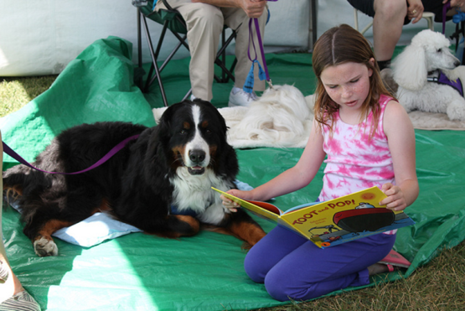
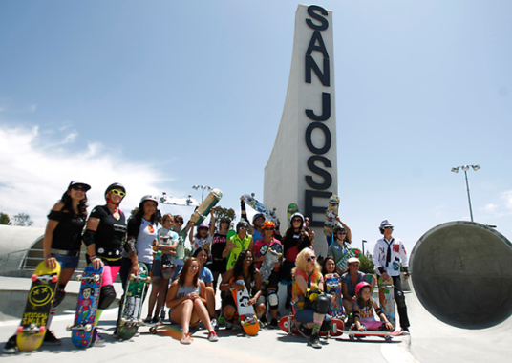
Neighborhood Services CSA
Cultivate Healthy Neighborhoods;
Support an Engaged and Informed Citizenry;
Activate a Thriving Community;
Steward Well-Managed, Effective, and Sustainable Assets
NEIGHBORHOOD SERVICES 3
2015-2016 Budget Study Sessions
Notes:
3

Slide 4
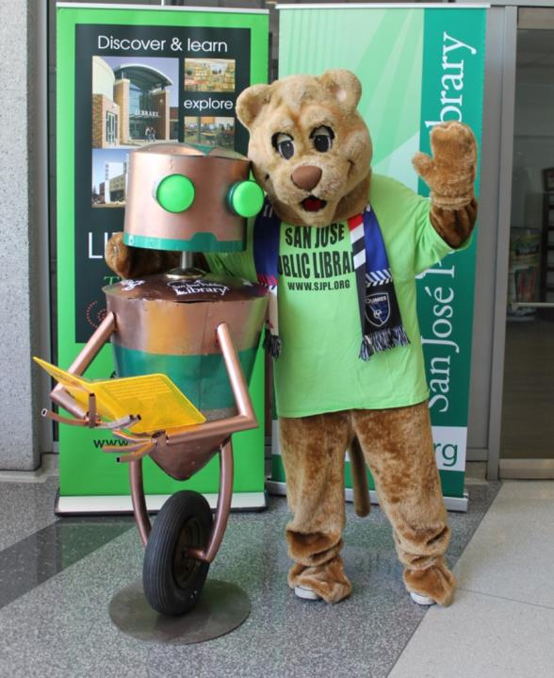
Library Accomplishments and Expected Service Delivery
Libraries open 6 Days/47 Hours per Week, Monday-Saturday
Village Square Branch Open Spring 2016
Engage Volunteers
Increase Public Access to Technology
Notes:
Accomplishments
Passage of Parcel Tax
Working through Audit
Focused on STEAM, partnerships with Small Business
Upgrading technology
Expected Service Delivery
Expand Branch Library hours
Opening Village Square in Spring (Last of major bond projects programmed)
Actively engage adult and teen volunteers to support and enhance Library operations
Design Maker[Space]ship
RFID
Literacy, Partnership and Early Education initiatives

Slide 5
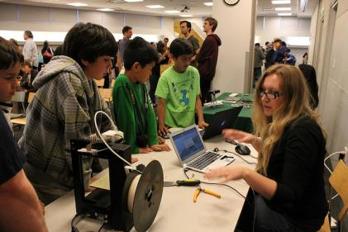
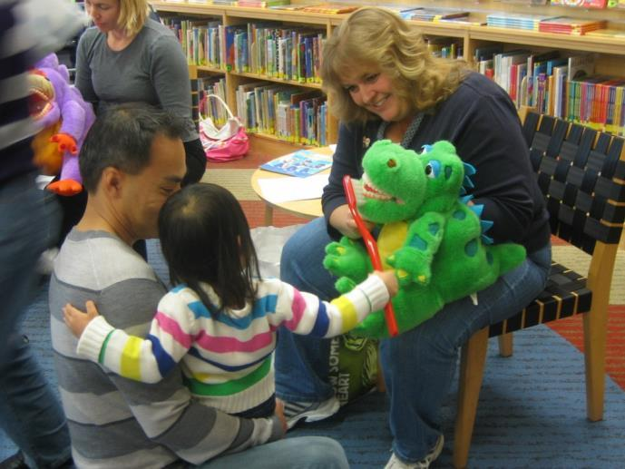
Library Proposed Budget Actions
Expand Library Branch Services from 4 Days/33-34 Hours to 6 Days/47 Hours per Week
Renewal of Library Parcel Tax Continues Support of Library Operating and Capital Programs

Slide 6
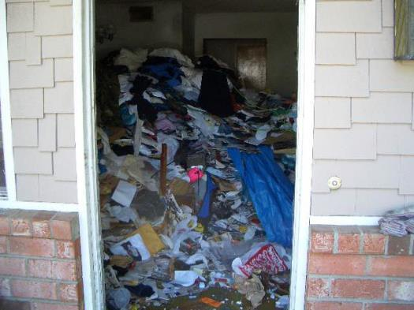
PBCE – Code Enforcement Accomplishments and Expected Service Delivery
Respond to Life Safety Complaints Within 24 to 72 Hours
Successfully Implemented the Redesigned Multiple Housing Program
Notes:
Respond to life safety complaints within 24 to 72 hours
Restore field inspection services to routine complaints
Implement the redesigned Multiple Housing Program

Slide 7
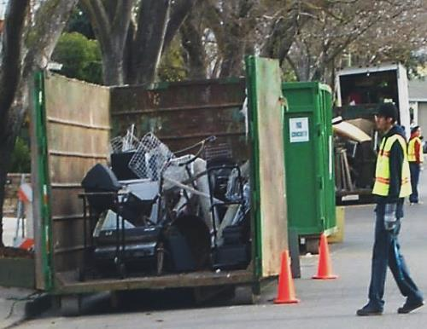
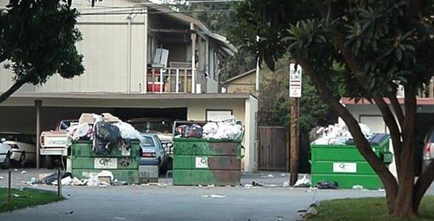
PBCE – Code Enforcement Proposed Budget Actions
Coordination of City-Wide Illegal Dumping Program
Targeted Remediation Actions and Implementation of Best Practices

Slide 8
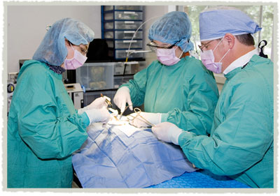
Public Works – Animal Care Accomplishments and Expected Service Delivery
Exceeded Live Release Rate
Celebrated 10 Year Anniversary
Health and Safety Calls
Low Cost Spay and Neuter
Notes:
Focus on health and safety related Animal Care and Services calls; grant opportunities; low cost spay and neuter services; and improve outcomes for sheltered animals.
Increase live release rate for animals in shelter
Increase Grant funding and revenues

Slide 9
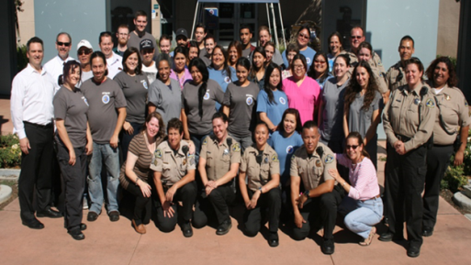
Public Works - Animal Care Proposed Budget Actions
Funds Critical Facility Upgrades
Adds Revenue Supported Staff in Facility
Focus on Improving Cost Recovery

Slide 10
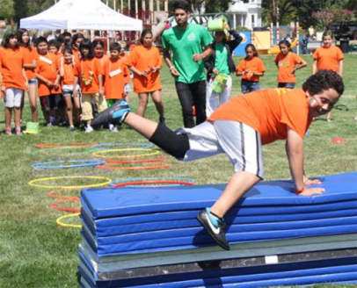
PRNS Accomplishments and Expected Service Delivery
Building Community through placemaking
Fun Recreational Options for All Ages
Safe Neighborhoods
Access to Services and Financial Sustainability
Notes:
Thank you, Diane. (or Jon, depending on the order of speakers)
Mayor and Councilmembers, thank you for having us here today. I’m Angel Rios, Jr., Interim Director of Parks, Recreation and Neighborhood Services. I’m honored and proud to share our accomplishments and expectations. We are such a large, diverse department, it can be challenging to sum us up sometimes. I’ll take a shot in four words: Building Community Through #Fun. Let me tell you what that means.
As I mentioned at the April NSE Committee meeting, we have made placemaking a priority. Placemaking is creating quality places, wherein people want to live, work, play, and learn. It’s all about building community by through places that have been thoughtfully designed and programmed to engage people all across the City from all walks of life. Our places and programs serve the entire community, not just one segment. Whether it is our award-winning San Jose Recreation Preschool, afterschool programs, leisure classes, active adult events, community gardens, or our parks and facilities, like the recently opened (???) Rotary PlayGarden at Guadelupe River Park and Gardens, we make fun and meaningful contributions to the lives of children, youth, adults, seniors, and people with disabilities.
One of our many contributions is to the safety of our neighborhoods and youth. Through the efforts of the Mayor’s Gang Prevention Task Force we help address youth-related violence through prevention and intervention efforts, especially in gang-impacted areas within the City. (this is not a great talking point, needs work)
Finally, we have made great strides in the area of financial sustainability, reaching our goal of 40% cost recovery for our General Fund operating budget in 2013-2014. Looking to the coming year, we will continue to explore ways to increase our cost recovery through revenue generation, balanced with ensuring all customers have access. Our redesign of the Citywide Scholarship Program enhances resident access to programs and services.

Slide 11
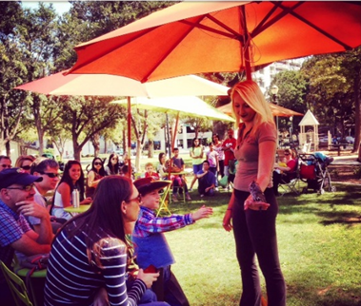
PRNS Proposed Budget Actions
Increase Resources at Regional Parks, Including the Planned Lake Cunningham Bike Park
St. James Park Activation
Youth Violence Prevention Efforts
SJ Learns
Enhanced Park and Community Center Rentals and Reservations
Notes:
To support our efforts, this Proposed Operating Budget helps us build forward into next year and beyond. I can’t go through all our proposals, but want to highlight a few. The addition of 5.75 FTE staff for Lake Cunningham helps us builds towards an adventure sports park. Our Lake Cunningham Regional Skate Park will continue to be a mainstay attraction as the largest skate park in California. And I’m excited to talk with you about the adventure sports park’s five-acre bike element. It will offer riders of all ages and abilities access to trails, tracks, skills challenge courses, dual slalom, free ride area, and pump tracks that embrace a variety of bike disciplines, such as mountain biking, free-style, slope-style, and cycle-cross. To get ready to open in July 2016, hiring will occur in the second half of next year.
This budget also proposes ongoing funding for many items included as one time funded in 2014-2015, including our innovative and successful St. James Park activation. We have also secured grant funding from the Santa Clara County Public Health Department for our Viva Parks program to activate Hillview, Emma Prusch, Mayfair and Roosevelt parks during the summer.
Also made ongoing is BEST and Mayor’s Gang Prevention Task Force funding, including the Safe School Campus Initiative and Safe Summer Initiative. SSCI is a partnership between PRNS, School Districts, and the Police Department to create safer high schools, middle schools, and communities by addressing youth-related violence through prevention and intervention efforts, especially in gang-impacted areas within the City. The Safe Summer Initiative Program provides funding for pro-social recreational activities during the summer months for at-risk, high-risk, gang-impacted and gang-intentional youth. We have also brought forward (or will bring forward) an MBA on the value, results, and positive impacts of the Female Gang Intervention Unit, MGPTF capacity building programs, and the Digital Arts Program (talk about the award we won?).
Continuing our efforts to provide community access to our sites and facilities while achieving financial sustainability, this budget proposes the addition of staff who can help individual, non-profits, and for-profit organizations host special events in our parks and along our trails, and rent space in community centers. And, this budget adds some parks maintenance staff to help ensure our new and existing parks and landscapes are well-maintained, attractive, and a source of pride for all of San Jose.

Slide 12
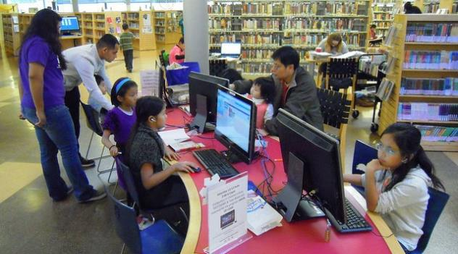
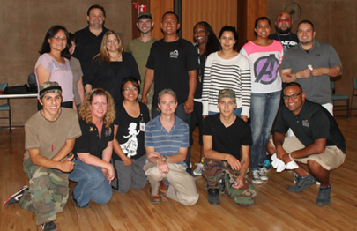
CSA Workplan Highlights
Increase Community Access to Services
Focus on Health and Safety
Enhance Public Access to Technology
Maintain Responsive Services to Community Priorities
NEIGHBORHOOD SERVICES 12
2015-2016 Budget Study Sessions
Notes:
For the Neighborhood Services CSA as a whole, all of our staff are committed to providing high quality services that strengthen the community and preserve healthy neighborhoods. We continue to focus on increasing community access to programs and services, the health, safety, and well-being of our community, on enhancing access to community services and technology, and responding to community priorities. And I want to note that each department works collaboratively with supporters, government partners, non-profit organizations, and corporate sponsors who all help ensure that San Jose delivers services that positively impact the community. We are fortunate and grateful for all of our supporters.
12

Slide 13
NEIGHBORHOOD SERVICES CSA 2015-2016 Proposed Operating Budget OUTCOMES: - Safe and Clean Parks, Facilities and Attractions - Vibrant Cultural, Learning, - Recreation, and Leisure Opportunities - Healthy Neighborhoods and Capable Communities
2015-2016 Budget Study Sessions

Slide 14
Branch Libraries
01 Martin Luther King Library
LIBRARY BRANCHES
02 Almaden
03 Cruz-Alum Rock
04 Alviso
05 Bascom
06 Berryessa
07 Biblioteca Latinoamericana
08 Calabazas
09 Cambrian
10 East Carnegie
11 Edenvale
12 Educational Park
13 Evergreen
14 Hillview
15 Joyce Ellington
16 Pearl Avenue
17 Rose Garden
18 Santa Teresa
19 Seven Trees
20 Tully Community
21 Village Square (spring 2016)
22 Vineland
23 West Valley
24 Willow Glen
04
M 1-6
T- Th 10-7
F 12-6
Sat 10-6
06
12
03
15
10
17
01
14
07
13
20
21
08
23
05
24
19
09
16
11
22
18
02

Slide 15
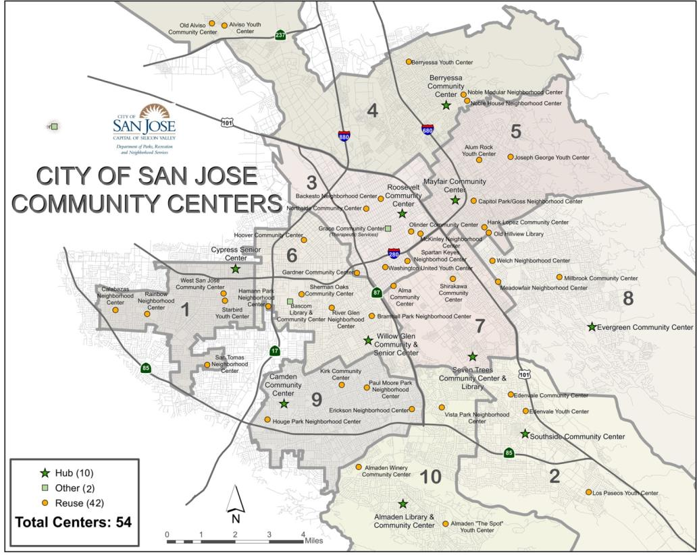
Community Centers

