Slide 1
PUBLIC SAFETY 2015-2016 Proposed Operating Budget OUTCOMES: - The Public Feels Safe Anywhere, Anytime in San José - Residents Share the Responsibility for Public Safety
2015-2016 Budget Study Sessions
Notes:
Chief Esquivel:
This is the 2015-2016 Proposed Operating Budget presentation for the Public Safety City Service Area. This CSA includes the Police, Fire, and Independent Police Auditor Departments. With me today are [Introduce members of the presentation panel]. Our collective mission is to provide prevention and emergency response services for crime, fire, medical, hazardous, and disaster related situations.
Our CSA Outcomes are two-fold: The Public Feels Safe Anywhere, Anytime in San José, and Residents Share the Responsibility for Public Safety.

Slide 2
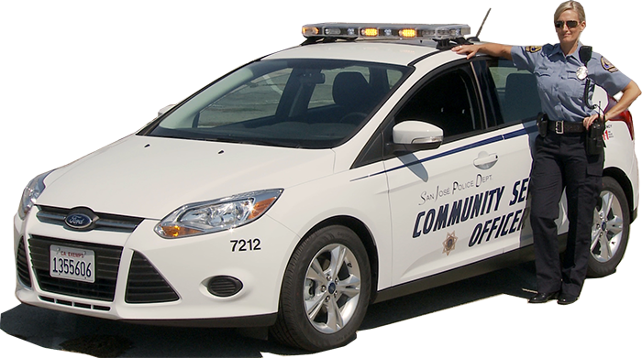
PUBLIC SAFETY
Police Department
Crime Prevention and Community Education
Respond to Calls for Service
Investigative Services
Regulatory Services
Special Events Services
Notes:
Chief Esquivel:
For the Police Department, our core services are the following:
-Crime Prevention and Community Education
-Respond to Calls for Service
-Investigative Services
-Regulatory Services, and
-Special Events Services.

Slide 3
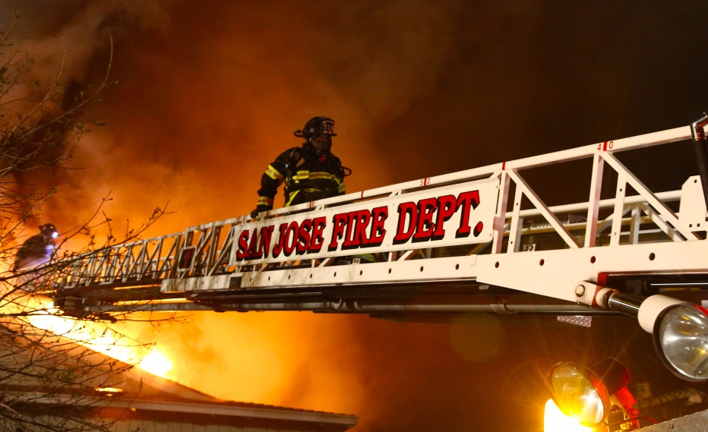
PUBLIC SAFETY
Fire Department
Emergency Response
Fire Prevention
Independent Police Auditor
Independent Police Oversight
Notes:
Chief Jacobson:
Fire Department is an all hazard department. Core services in the Public Safety CSA are emergency response and fire prevention.
Operational services under Emergency Response include fire suppression, EMS, readiness of Emergency Operations Center, dispatch, HIT, USAR, ARFF
In Fire Prevention, services include fire cause investigation, regulatory enforcement of fire and hazardous materials codes; public education on fire and life safety
The Fire Department’s Fire Safety Code Compliance core service was discussed at the CED CSA presentation yesterday. Fire Safety Code Compliance includes code plan review and inspection services. Fire staff works closely with Planning, Building, and Public Works to meet customer service needs on a timely basis.
Judge Cordell:
For the Independent Police Auditor Department, our core service is independent police oversight.

Slide 4
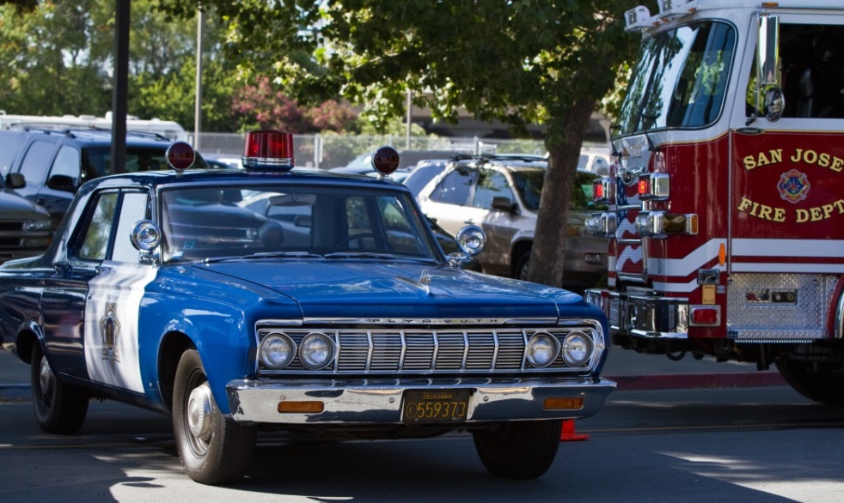
CSA Expected Service Delivery
Provide Essential Emergency Services in a Timely and Effective Manner
Effectively Investigate Crimes and Seek Successful Prosecution of Suspects
Continue Efforts to Deter Gang Violence
Continue Regional All-Hazard Emergency Management
Continue a Police misconduct complaint process that is thorough, objective, and fair
Notes:
Chief Esquivel:
The expected service delivery for this CSA is as follows:
-Provide essential emergency services, which includes patrol, fire suppression, and emergency medical services, in a timely and effective manner
-Effectively investigate crimes and seek successful prosecution of suspects
-Continue efforts to deter gang violence
-Continue regional all-hazard emergency management
-Provide a police misconduct complaint process that is thorough, objective, and fair

Slide 5
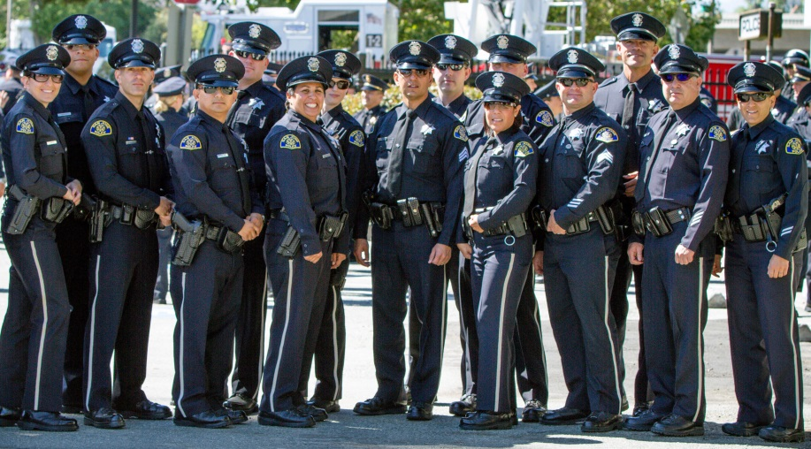
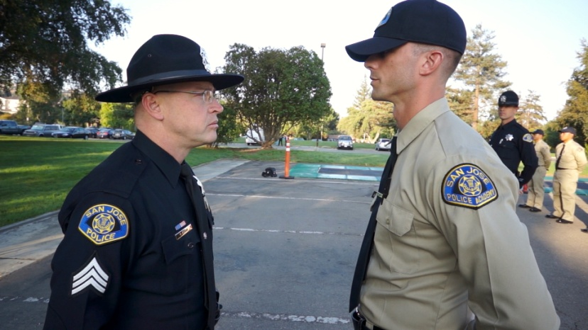
Proposed Budget Actions - Police
Increase Police Overtime
Expand Community Service Officer Program
Expand Crime Prevention
Continue Police Recruiting and Background Resources
Provide Protective Equipment
Continue Central ID Staffing
Field Training Officer Program Staffing
Notes:
Chief Esquivel: For 2015-2016, the Police Department is proposing the following budget actions
Increases Police Overtime – this action has set aside additional overtime resources that will be used to backfill for vacant patrol positions; maintain targeted enforcement of high crime activity through suppression cars specifically related to gang enforcement, prostitution, and graffiti; and maintain the Downtown Foot Patrol program.
Expand Community Service Officer Program - Police Patrol staffing will be further augmented by the addition of 22.0 Community Service Officers and 4.0 Senior CSOs in spring 2016. Recruitment is currently is progress for these positions.
The Crime Prevention Unit will add four staff in order to increase community education services
Recruiting and Background resources – this action adds appropriate resources that will allow these units to continue the high volume of recruiting, hiring, and backgrounding necessary for upcoming Police Recruit Academies as well as critical civilian positions, such as Community Service Officer and Communications/9-1-1 Dispatchers.
Protective Equipment - investments in protective equipment such as ballistic panels, plates and vests will help protect the existing workforce.
The Central Identification Unit will extend two positions to accommodate an increased case load
The FTO program will add a civilian position to assist with clerical duties which will allow a Police Officer position to be redeployed

Slide 6
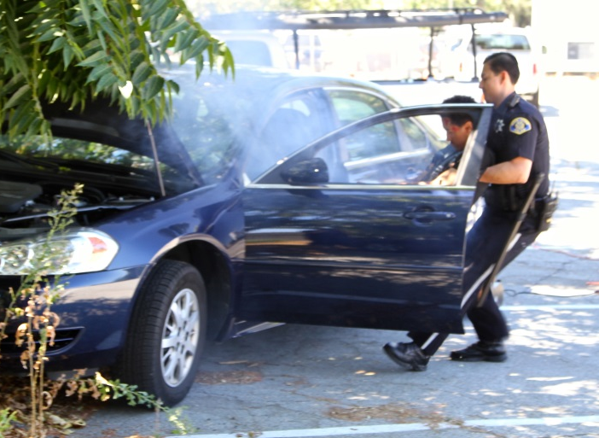
Proposed Budget Actions – Police
Technology Investments
Field Patrol Mobile Data Computers
Computer Aided Dispatch Business Intelligence
Communications 9-1-1 Phone System
Crime Analysis Program Manager
Video Unit Training Resources
Bureau of Investigations Video Evidence
Gang Investigations Unit Staffing
Silicon Valley Regional Communications System Reserve
Notes:
Chief Esquivel:
Technology investments within the Police Department will allow for greater efficiencies to be realized. Investments include new Mobile Data Computers for Field Patrol, Business Intelligence software for data analytics, and a Program Manager position for the Crime Analysis Unit to leverage and expand the use of data analytics.
Video resources in the form of contractual services for video training and a Senior Crime & Intelligence Analyst position for forensic video evidence analysis will support the increasing demand in this media field.
Gang Investigations – this action will add a Crime & Intelligence Analyst to assist with increasing workload demands
Silicon Valley Regional Communications System Reserve $3.0 million

Slide 7
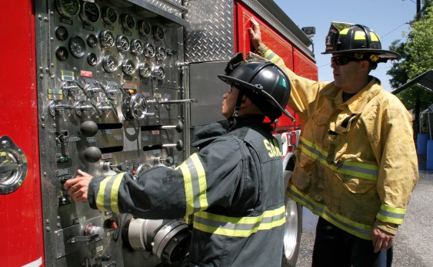
Proposed Budget Actions - Fire
Staffing for Adequate Fire and Emergency Response (SAFER) 2014 Grant Reserve
Fire Engineer Academy Training
Firefighter Recruit Academy Training
Information Technology Staffing
Notes:
Chief Jacobson:
Staffing for Adequate Fire and Emergency Response (SAFER) 2014 Grant Reserve of $1.95 million
Fire Engineer Academy and Training ($115,000 for 15-16; $0 ongoing) would expand Fire Engineer training from one to two weeks to meet NFPA 1002 training mandates.
Firefighter Recruit Academy and Training ($70,00 for 15-16; $35,000 ongoing) would meet new training criteria set by the California State Fire Marshal’s Office. This new requirement must be implemented for any academy that ends Dec. 31, 2015.
A limit-dated Information Systems Analyst position is added to assist with implementation of the ePCR systems and to work on more efficient technical applications to provide timely information for service analysis and improvements. Ongoing need for this position will be evaluated as part of the current organizational review study.

Slide 8
CSA Workplan Highlights - Police
Provide Effective and Timely Response to Calls for Service by Delivering High Quality Police Services in Order to Maintain a Vibrant and Safe Community
Effectively Investigate Crimes and Seek Successful Prosecution of Suspects
Maintain a Positive Relationship With the Community
Invest in Technology to Gain Efficiencies
Notes:
Chief Esquivel:
The Police Department’s workplan continues to:
- Provide effective and timely response to calls for service by delivering high quality police services in order to maintain a vibrant and safe community
- Effectively investigate crimes and seek successful prosecution of suspects
- Maintain a positive relationship with the community, and
- Make investments in technology in order to gain efficiencies.

Slide 9
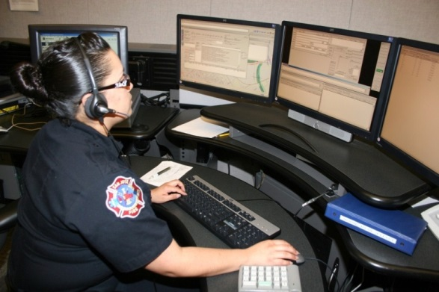
CSA Workplan Highlights - Fire
Achieve City Performance Goal of Fire Unit Arriving at the Scene Within 8 Minutes 80% of the Time and County of Santa Clara EMS Goal of 90%
Complete Fire Department Organizational Review Study
Provide Leadership in Completing Feasibility Study for Providing Emergency Medical Transportation
Provide Leadership in Completing Feasibility Study of Regional Fire/EMS Communications Center
Continue With Improvements in Technology
Continue Emergency Training and Preparedness
Notes:
Chief Jacobson:
With regard to performance goal: Fire Department continues to work on achieving the City performance target of arriving at the scene of a Priority 1 incident within 8 minutes 80% of the time. The Agreement the County of Santa Clara requires the City to meet the standard 90% of the time for EMS.
Consultant work has begun on the organizational review of the Fire Department. This study will include a review of current services, including evaluation of feasibility of collaborative transport services with the County analyze performance targets for services provides; and recommend improvements to the current service levels. In addition, consultant will also review the feasibility of engaging community-based organizations in large-scale emergencies, as well as in fire prevention initiatives.
San Jose has been participating with Santa Clara County, Mountain View, and Palo Alto on a combined Fire/EMS communications study. Consultant study on feasibility of regional dispatch is expected to be completed in July 2015. This study will identify advantages and disadvantages, including any associated costs, of moving out of the current dispatch configuration and into a consolidated center. Other options that could include contracting with one of the agencies to perform system wide dispatch services or creating an independent agency will also be explored.
Provide Leadership in Completing Feasibility Study of Regional Fire/EMS Communications Center add language!!!
Fire Department continues with its efforts towards improvements in technology to improve response time performance. Enhancements to CAD system will improve data related to Fire Department incidents. Department expects to complete data warehousing and business intelligence elements of the project by fall 2015.
Extension of a position to continue to collaborate with Regional Partners on Emergency Training and Preparedness

Slide 10
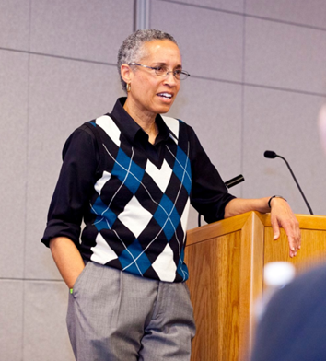
CSA Workplan Highlights - IPA
Continue Providing Mandated Police Oversight Services Including Making Recommendations to Improve SJPD Policy and Procedures
Identify New and Cost-Effective Ways to Inform San José Residents About the IPA Office and the Services It Provides
Continue to Resolve Complaints, When Appropriate, Through the IPA/SJPD Mediation Program
Notes:
Judge Cordell:

Slide 11
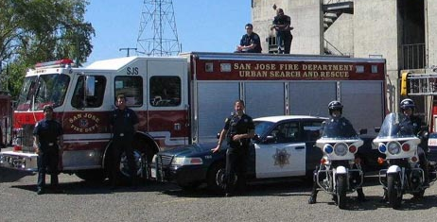
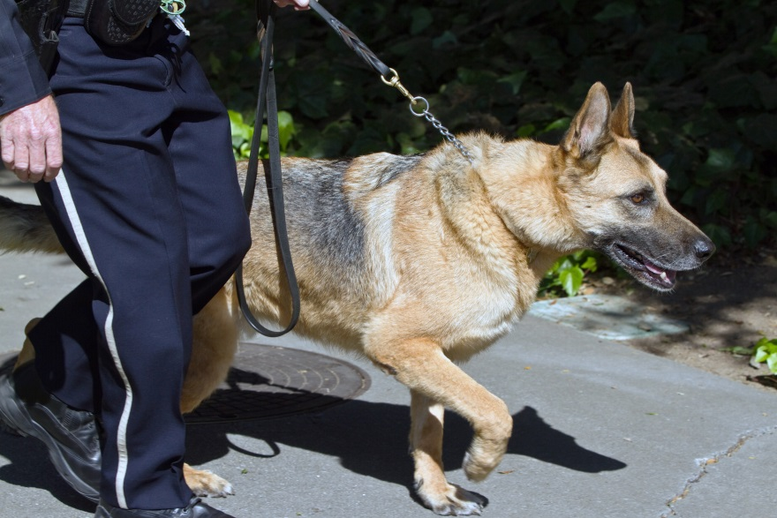
Summary
Resources Will Continue to Focus on Providing Essential Emergency Services in a Timely Manner, in Order to Protect Life, Property, and the Environment
CSA Partners Will Continue to Look for Efficiencies, Technology, Revenue, Grant Opportunities and Data Analytics
Notes:
Chief Esquivel:
In summary, preserving emergency response capacity remains the highest priority of the CSA. Resources will continue to focus on providing essential emergency services in a timely manner in order to protect life, property, and the environment.
We will continue to look for efficiencies, technology, revenue, grant opportunities and data analytics in order to improve service levels and address crime, medical, or fire related situations successfully.

Slide 12
PUBLIC SAFETY 2015-2016 Proposed Operating Budget OUTCOMES: - The Public Feels Safe Anywhere, Anytime in San José - Residents Share the Responsibility for Public Safety
2015-2016 Budget Study Sessions
Notes:
Chief Esquivel:
That concludes our presentation and staff are available for questions.

