Slide 1

Strategic Support
2015-2016 Proposed Operating Budget
OUTCOMES:
- A High Performing Workforce that is Committed to Exceeding
Internal and External Customer Expectations
- Safe and Functional Public Infrastructure, Facilities, and
Equipment
- Effective Use of Technology
- Sound Fiscal Management that Facilitates Meeting the Needs of the Community
2015-2016 Budget Study Sessions

Slide 2
STRATEGIC SUPPORT
Human Resources
  Employee Benefits
  Employment Services
  Workers’ Compensation, Health and Safety
Finance
  Disbursements
  Financial Reporting
  Revenue Management
  Treasury Management
  Purchasing and Risk
  Management
Information Technology
  Information Technical Infrastructure
  Enterprise Technology Systems
  and Solutions
  Customer Contact Center
Public Works
  Plan, Design and Construct Public
  Facilities and Infrastructure
  Facilities Management
  Fleet and Equipment Services
  Equality Assurance

Slide 3
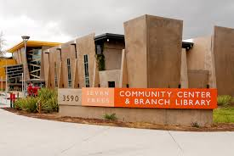
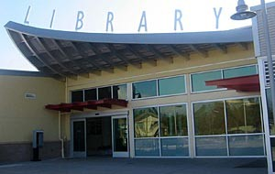
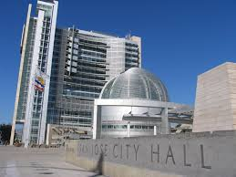
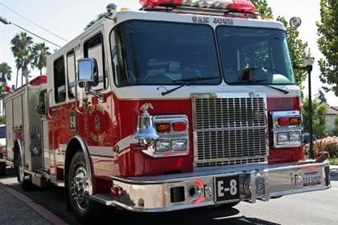
CSA Expected Service Delivery
Strategic Support
Investing in our Assets
STRATEGIC SUPPORT 3
2015-2016 Budget Study Sessions
Notes:
3

Slide 4
Proposed Budget Actions
Information Technology
Fund Network Upgrades to Improve Connectivity for Public Safety Facilities and Field Personnel
Add One-Time Funding to Address the Most Critical Cyber Security Needs
Enable Multi-Modal Communications Between the City and Residents or Businesses Through Customer Relationship Management/Service Request Management
Funding for Enhanced Licensing of Office 365 and Rebuilding Management Capacity to Protect Public Funds and Ensure Success of Technology Modernization Efforts
STRATEGIC SUPPORT 4
2015-2016 Budget Study Sessions

Slide 5
Proposed Budget Actions
Human Resources
Provide One-Time Funding to Address the Backlog of Recruitments and Hiring
Provide One-Time Funding for HR to Reduce Recruitment Steps and Update Job Specs
Continue Workers’ Compensation Service Delivery Model Pilot Program for an Additional Year and Add Funding to Address Backlog of Claims
Add One-Time Funding to Identify HR Process Improvements and Document Methodologies Through Evaluation and Review of Business Processes
One-Time Funds to Pilot a Wellness Program to Increase Employee Healthcare Participation
STRATEGIC SUPPORT 5
2015-2016 Budget Study Sessions

Slide 6
Proposed Budget Actions
Public Works
Continued Funding for Preventive Maintenance at City Facilities
Continued Staffing for the City-Building Energy Projects Program
Additional Staffing to Support the Silicon Valley Regional Communications System Upgrade
One-Time Funding to Upgrade the Enterprise Asset Management System
Staffing to Support Delivery of Capital Improvement Program
STRATEGIC SUPPORT 6
2015-2016 Budget Study Sessions

Slide 7
Proposed Budget Actions
Finance
Funding for the Purchasing Division to Manage City-Wide Technology Procurements and Planning, Building and Code Enforcement Department Procurements
One-Time Funding for Consulting Services to Develop Policies, Procedures, and Training Materials for Financial Functions Throughout the City
Funding for the Implementation of the New HR/Payroll/Budget System
Reduction of Staffing Related to the Single Family Garbage Billing System Transfer to the County in 2015-2016

Slide 8
CSA Workplan Highlights
Core Technology System Implementations
Increased Bandwidth and Network Reliability for Facilities and Public Safety Field Personnel
Workers’ Compensation Pilot Program Continuation
Workers’ Compensation / Employment Temporary Staffing
Continued Focus on Achieving Appropriate Preventive Maintenance Cycles at City Fleet and Facilities
Effective Delivery of the City’s Capital Improvement Program

Slide 9
Summary
Investing in our Assets
Begin Shift from Internal Focus to Public Facing Technologies
Provide Support to Departments in Critical Areas
Invest in the Health and Well-Being of Employees
Facilitate Effective Recruitments and Manage Hiring Processes to Attract and Retain Qualified Employees
Improve the Condition and Extend the Life of City Fleet and Facilities

Slide 10
Strategic Support
2015-2016 Proposed Operating Budget
OUTCOMES:
- A High Performing Workforce that is Committed to Exceeding
Internal and External Customer Expectations
- Safe and Functional Public Infrastructure, Facilities, and
Equipment
- Effective Use of Technology
- Sound Fiscal Management that Facilitates Meeting the Needs of the Community
2015-2016 Budget Study Sessions

