Slide 1
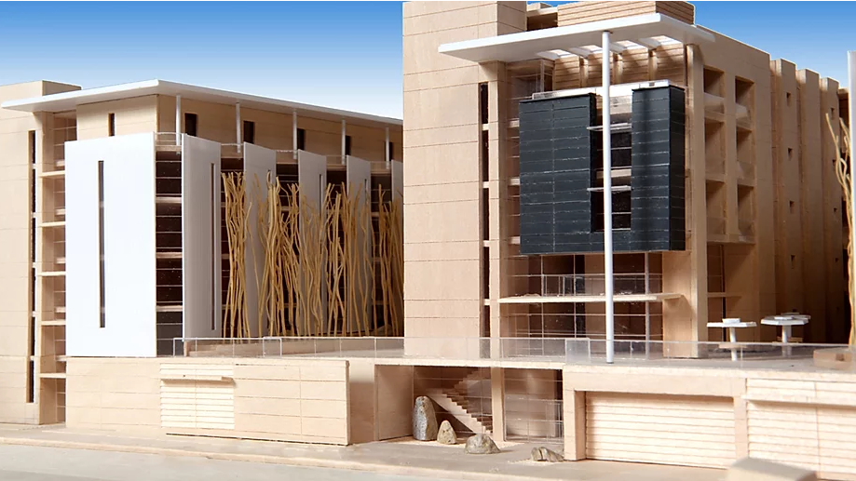
Housing Market Update
Fourth Quarter 2019
North San Pedro Studios is one of San Jose’s largest, 100-percent affordable housing projects. It will be the affordable part of the North San Pedro Residential Project, a housing master plan being developed by Intracorp Homes, Swenson and First Community Housing in partnership with San Jose’s redevelopment agency on 5.72 acres adjacent to the downtown core. North San Pedro Studios was made possible through gap funding from the Measure A affordable housing bond that Santa Clara County residents approved in 2016. It will reportedly be the first project in San Jose to set aside units specifically for chronically homeless veterans.
Source: Silicon Valley Business Journal January 2020, image from First Community Housing

Slide 2
Q4 2019 San José Housing Market
542 residential building permits issued for market rate housing and 0 for affordable housing – 2,411 permits issued for 2019, out of which 853 were for affordable housing
108 second units / ADU (Accessory Dwelling Units) permits issued – 416 permits issued in 2019 (far exceeds 190 permits issued in calendar year 2018)
Average effective rent down 0.8% Quarter-over-Quarter (QoQ); Overall Residential Vacancy is 4.9% ¹
Renters must earn $53/hour ($109,520/year) to afford the average effective monthly rent for a 2-bedroom apartment of $2,738 ²
Median single-family home price is $1,070,500, down 0.4% QoQ ³
Buyers must earn $95/hour ($197,314/year) to afford a median priced single-family home ⁴
1. Costar January 6, 2020.
2. Based on Q4 2019 Costar average rents; income calculation assumes rents are 30% of income, 40-hour work week and a single income household.
3. Santa Clara County Association of Realtors (SCCAOR) December 2019.
4. Based on SCCAOR, December 2019 median prices; income calculation assumes monthly payments are 30% of income, 20% down, 3.72% interest rate, 1.1% property tax, 40-hour work week and a single income household.

Slide 3
2019 Residential Building Permit Activity
Annual RHNA Goal is 3,987 total units permitted
SOURCE: City of San José Housing Department Q4 2019. MF Affordable includes some market rate units counted as moderate income units, without deed restrictions, per HCD guidelines for RHNA reporting

Slide 4
Second Unit / ADU Permits Far Exceed 2018 Permits
Zoning code updated in Nov 2016 and in June 2018 to conform with new State Legislation and to facilitate construction of ADUs; Not all permits result in units built.
SOURCE: City of San José Monthly Permit Reports as of December 2019.

Slide 5
San José Average Rents
Average Rents Down 0.8% QoQ* and Up 2.6% (YoY)*
$3.384
$2,738
$2,480
$2,236
$1,958
SOURCE: Costar January 6, 2020.
* QoQ = Quarter-over-Quarter; YoY = Year-over-Year.

Slide 6
Average Vacancy at 4.9%, close to“Healthy” Rate
Q4 2019 Vacancy Rates
Studio – 5.7%
1 Bdrm – 5.3%
2 Bdrm – 4.8%
3 Bdrm – 4.0%
Average – 4.9%
National Average = 6.4%
San Jose Average = 4.9%
SOURCE: Costar, January 6, 2020; National Rate – US Census Bureau Current Population Survey/ Housing Vacancy Survey January 30, 2020.

Slide 7
Average Vacancy Lower for Older Buildings* (84% of total rental stock)
Inventory | % of Rental Stock | Vacancy %
Class A | 16.4% | 7.1%
Class B | 34.3% | 3.5%
Class C | 49.1% | 3.7%
Class F | 0.2% | 4.1%
SOURCE: Costar January 6, 2020.
* Older buildings refer to Class B, C and F properties; Class A buildings are usually newly constructed properties.

Slide 8
Housing Unaffordable for Many San José Workers
SOURCE: Employment Development Department (EDD) – First Quarter 2019 Wages; Costar Q4 2019 Average Effective Rents; Income to rent calculation assumes rent at 30% of income and a single income household; Santa Clara County Association of Realtors Dec 2019 median prices; Income to mortgage calculations assume payments at 30% of income, 20% down, 3.72% interest, 1.1% Property Tax, $300 HOA dues for condos and a single-income household.

Slide 9
San José Renters Spend Higher % of Income on Rent
SOURCE: Zillow Rental Affordability Index Q3 2019 – One Quarter Lag.

Slide 10
San José Single-Family Median Home Prices
$1,232,500
$1,070,500
San José Single-family home prices Down 0.4% QoQ and Up 2% YoY
SOURCE: Santa Clara County Association of Realtors December 2019.

Slide 11
San José Condo/Townhome Median Prices
$765,000
$655,000
San José Condo/Townhome Prices Down 8% QoQ and 6% YoY
SOURCE: Santa Clara County Association of Realtors December 2019.

Slide 12
San José Metro Area Home Price to Income Ratio
San José Metro Area Median Home Prices close to 10x Median Income – More than Double the National Average
SOURCE: Zillow Price to Income Index Q3 2019, one quarter lag.

Slide 13
Percent of Income Spent on Mortgages
San José Owners Spend Over 40% their Income on Mortgages, 2.5X National Average
SOURCE: Zillow Mortgage Affordability Index Q3 2019, one quarter lag.

Slide 14
Only 21% of SJ Homes Remain Affordable to Median Income Households
Only 1 in 5 families can afford to buy a median priced home in San José
63%
21%
SOURCE: National Association of Home Builders, Housing Opportunity Index (HOI) Q4 2019.

Slide 15
Single-Family New Listings, Inventory & Sales Down QoQ (67%, 71%, 3%), Sales Up 13% YoY
358
215
152
SOURCE: Santa Clara County Association of Realtors December 2019.

Slide 16
Homes are Taking Over a Month to Sell; Condos Taking Almost Two Months
56 Days
38 Days
SOURCE: Santa Clara County Association of Realtors December 2019.

Slide 17
Interest Rates Remain Low
3.72%
3.39%
1.55%
SOURCE: Federal Reserve, Freddie Mac Primary Mortgage Market Survey, Q4 2019.

Slide 18
Data Sources and Definitions
The City of San José selected Costar to supply rental housing statistics as of July 1, 2017. The City’s previous vendor, RealAnswers, went out of business in Q4 2016
The City has restated rents and vacancy data beginning January 2000, using Costar. The revised data will be posted in the Housing Market Updates beginning in Q2 2017
The source of the quarterly rents and vacancy data will be average, effective, market-rate apartment rents for the geography encompassing the City of San José, as reported in Costar’s proprietary database
Effective rent is the average rent paid over the term by a tenant adjusted downward for concessions paid for by the landlord (such as free rent, moving expenses, or other allowances), and upward for costs that are the responsibility of the tenant (such as operating expense pass throughs)
The rents reported are average market rate rents charged by existing market-rate apartments; Costar updates rents data once a month for apartments with more than 30 units and once a quarter for apartments with less than 30 units
Moderate Market rate units in the Residential Building Permits data refers to market-rate units identified as affordable to moderate income households based on the expected rents data provided by the developer, during the building permit application process
QoQ refers to Quarter-over-Quarter and YoY refers to Year-over-Year
For questions, please call the Housing Department at 408-535-3860

