Slide 1


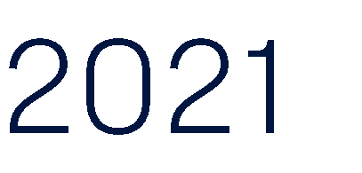

Slide 2





















⬇
⬇
⬇
⬥
⬥
⬥
⬇
⬇
⬇

Slide 3
Thoughts from the Hyas Group
Ideally you would work with other City departments to find missing DC participants
Many times the 457 participant information is outdated but other insurance or retirement (DB) information is up to date
Having a process (or even a policy) in place goes a long way
Your procedures may look similar to:
Understand that missing participants may be an issue
Have a policy in place
Work with other departments for the most up to date contact information
Consider implementing an annual data request (an email to every participant or a screen before the website’s landing page)
Leverage Voya to use outside information databases to find participants

