Slide 2
Trafficking Victim Assistance Program (TVAP)
Leah Breevoort, Program Officer
Notes:
Trafficking Victim Assistance Program working with survivors of both sex and labor trafficking. Further down we will get more into who the survivors are that are eligible for TVAP

Slide 3
About USCRI
Began in NYC in 1910 (International Institute of NY)
Mission: To protect the rights and address the needs of persons in forced or voluntary migration worldwide and support their transition to a dignified life
Immigrant children, legal services, resettlement, refugee health, policy & advocacy, and trafficking
Field offices in 7 US cities, shelter in FL, and 2 international offices

Slide 4
Trafficking Survivors
Refugees
Legal status upon U.S. arrival
Community and family ties in the U.S. can support resettlement
Social services already made available to refugees and asylees
May not have legal status when in the U.S.
May not have community or family ties – may be wary of community connections
Must learn how to navigate the social service system and advocate for access
Self-determination; can survive without us
May have experienced violence and trauma
Distrust/fear of social service agencies or immigration agencies
Notes:
For those of you with experience in refugee resettlement and associated programs, a difference you may notice about TVAP is that the program is very client-driven; we expect case managers and clients to collaborate to set goals and plan for the future, setting small milestones along the way. Another significant different is that TVAP clients will have very different immigration statuses, from none to Certified T-visa or Continued Presence recipient.

Slide 5
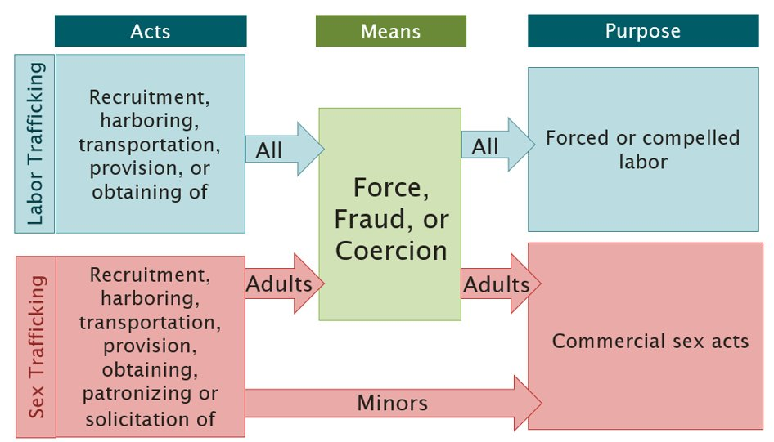
What is Human Trafficking?

Slide 6
Domestic vs. Foreign National
Domestic survivors of human trafficking are individuals who are trafficked and are either U.S. citizens (both domestic-born or foreign-born), or lawful permanent residents (i.e. green card holders).​
Foreign national survivors of human trafficking arrive from other countries; they do not have citizenship or lawful permanent resident status within the U.S.

Slide 7
Risk Factors
Unstable living situations​
Poverty​
Sexual abuse ​
Domestic violence​
Homelessness​
​Juvenile justice history​
Child welfare involvement​
Lack of legal status in U.S.​
Substance dependence​
LGBTQIA ​

Slide 8
Red Flags for Trafficking
Pressured to stay in a job ​
Debt owed to an employer or recruiter or sponsor​
Not paid agreed upon wage​
No control of passport or other identity documents​
Living and working in isolated conditions ​
Monitored by another person, “pimp” or “manager”​
Threatened by employer with deportation or other harm​
Working in dangerous conditions ​
Living in dangerous, overcrowded, or inhumane conditions provided by an employer​
Live and work in the same location​
Dependence on drugs to cope with working situation​
Work in an illicit industry – drug smuggling, brothels

Slide 9
TRAFFICKING VICTIMS PROTECTION ACT (TVPA)​
Enacted in 2000, the TVPA was the first U.S. federal legislation that addressed various ways of combatting human trafficking: ​
Protection- Created “T Nonimmigrant Visa” status for foreign-national victims & foreign victims became eligible for health and social service benefits ​
Prosecution- Strengthened the ability of law enforcement agencies to investigate and prosecute human trafficking​
Prevention- Creation of Office to Monitor & Combat Trafficking in Persons ​
Renewed in 2003,2005, 2008, 2015, and 2018/2019

Slide 10
Legal Assistance
T Non-Immigrant Status | Continued Presence
Allows applicants to remain in the United States for four years. May apply for lawful permanent residency or a “green card” after being continually present for three years or the applicant’s trafficking case has been determined closed by the U.S. Attorney General. | Temporary status that allows survivors of trafficking to remain in the U.S. for a period of 1-3 years. Granted by a law enforcement agency. Renewable as long as the investigation is ongoing.

Slide 11
Types of Letters and Benefits
Minors:
Eligibility Letter – does not expire, but some benefits are time-limited and dependent on state guidelines
Interim Assistance Letter – can be used to apply for benefits for up to 120 days
Adults:
Certification Letter – benefits are time-limited and dependent on state guidelines
Potential benefits and programs:
Non-work Social Security Number (for EL and IA holders)
Supplemental Nutritional Assistance Program (SNAP)
Temporary Assistance for Needy Families (TANF)
Refugee Cash Assistance
Medicaid
Children’s Health Insurance Program (CHIP)
Public Housing Program
Resources for Case Manager:
Monthly Webinars: Responding to Foreign National Minor Victims of Trafficking
Notes:
Interim assistance letter please remember to update us if a client receives their EL letter after having received the IA letter Please remember to follow up with OTIP

Slide 12
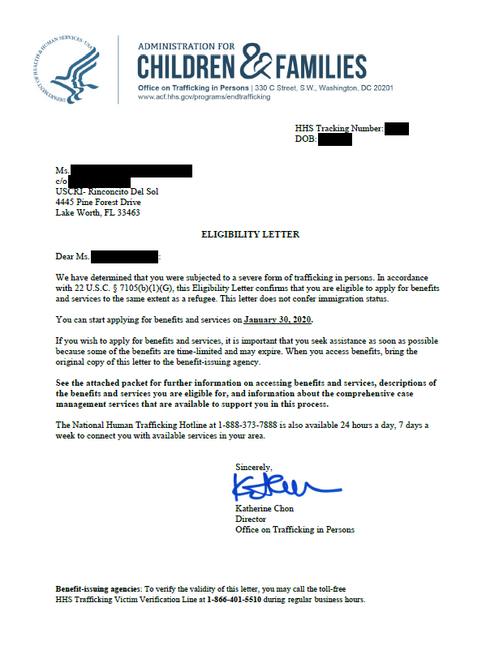
TVAP Program Goal
TVAP is here to help foreign national survivors of human trafficking:
achieve HHS certification
receive trauma-informed, person-centered, comprehensive case management services
gain timely access to vital services to stabilize and re-establish the ability to live independently.
HHS Certification/ Eligibility
Access to Public Benefits & Services
Healing & Stability

Slide 13
Regional Map

Slide 14
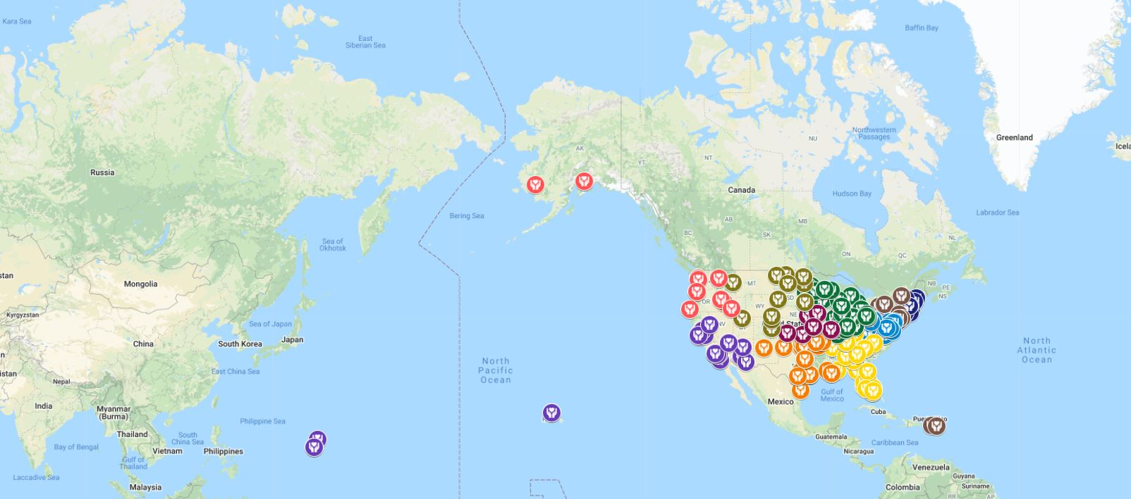
Local Provider Network

Slide 15
TVAP Administration
Local Providers
Comprehensive Case Management Services
Community Referrals
Documentation and reporting of services provided
Local Service Provider
USCRI
Technical Assistance and Support
Community and Learning Network
Program Oversight and Monitoring
Data collection and reporting of client demographics and services provided in aggregate
USCRI
TVAP
OTIP
Develops anti-trafficking strategies and policies
Funds programs to prevent human trafficking
Increases victim identification and issues Certification/ Eligibility Letters
Collaborates with federal partners and stakeholders
OTIP
Notes:
USCRI provides services to TVAP clients by partnering with local direct service providers.
The TVAP also serves as a provider community and learning network through which anti-trafficking partners and organizations can develop high quality service delivery models and best practices in serving the unique needs of trafficking victims.
USCRI – TVAP is responsible for:
Offering case consultation and guidance to assist you in managing the case;
Providing training and support to service providers on the TVAP program, including:
enrollment process
forms and reporting
Facilitating referrals to service providers throughout USCRI-TVAP’s region.
Facilitating referrals (from OTIP, or other sources) and client transfers to and from regions served by Tapestri and USCCB.
Reimbursing you for services provided to enrolled clients

Slide 16
TVAP Program Guidelines
Eligibility for Enrollment
An adult foreign national who
is a potential victim of trafficking actively pursuing T-nonimmigrant status and/or Continued Presence (CP);
is seeking a Certification Letter from HHS; or
received HHS Certification
A minor foreign national who
is a potential victim of trafficking seeking an Eligibility Letter from HHS; or
received an Eligibility Letter from HHS
Note: Lawful Permanent Residents (LPRs), U.S. citizens, asylees, and refugees are not eligible for assistance and services under this program.
Notes:
Minors do not need to be pursuing a T visa and can have received SJIS and still enroll in TVAP
Although family members and derivatives are not eligible to enroll as individual participants in TVAP, family members who live with the participant may derive benefits from the services provided to the participant (such as housing, food, and other expenses) that are deemed in the best interest of the participant and their household.
In recognition of the need for additional assistance to participants who live with an eligible family member(s), TVAP provides a higher per capita rate for these enrollees. Eligible family members include:
A family member in receipt of a derivative T visa issued by DHS;
A dependent minor child of a potential victim of trafficking seeking HHS certification; and
A dependent minor child of a victim of a severe form of trafficking who has received HHS certification.
For the T visa adults don't need law enforcement certification but for U visa you do

Slide 17
TVAp Focus on minor services
TVAP serves foreign national minors who were trafficked outside or inside the U.S.
Coordinate and connect eligible minors to services, including those
Identified at the border
In ORR shelter
Identified in the community
Notes:
we help with minor referrals and provide TTA for case managers who are assisting minors at ORR shelters to connect them to TVAP service providers. We assist with coordination between state CPS and referring agencies. For both adults and minors, when we send referrals to you, was ask that you initiate contact with the client within 48 hours.

Slide 18
Comprehensive Case management
Services Available:
Refugee Cash & Medical Assistance
Access to Federal Benefits:
Legal Assistance
Individualized Service Plans
Meeting Basic Needs
Housing
Medical & Behavioral Health
Language Access
Education and/or Employment
Reunification
Financial Literacy
Medicaid
Temporary Assistance for Needy Family
Supplemental Nutrition Assistance Program (SNAP)
Supplemental Security Income
Torture Treatment Program

Slide 19
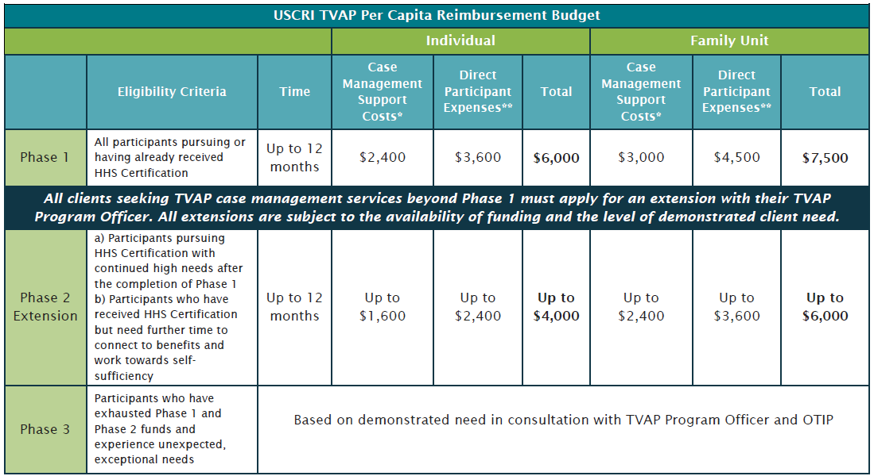
Per Capita Reimbursement
Notes:
This is the breakdown of the phases that we implented this year as you can see phase 1 is the original 12 months with $6,000 for individual and $7,500 for family.
If a client has additional money but has run out of time they can request a Phase 1A extension
Phase 2 breaks down into phase 2A and 2B
Phase 3 is case by case
The admin allowable cost stays at the 40% cap from the initial amount granted at the phase so for example if a client enrolls as an individual they are granted up to $2,400 that can be used for admin expenses but does not have to be, it can all go towards client expenses and this is for you as an org to discuss with the clients and budget with.

Slide 20
EnD-of-Year Results
All Regions
Regions 9-10

Slide 21
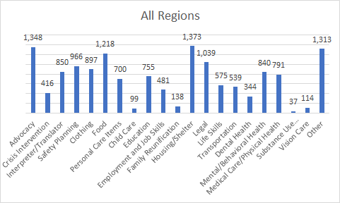
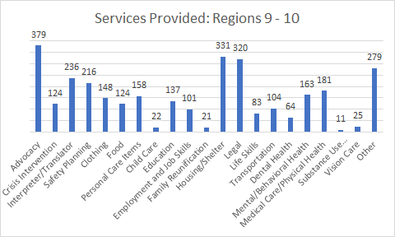
Advocacy
Crisis Intervention
Interpreter/Translator
Safety Planning
Clothing
Food
Personal Care Items
Child Care
Education
Employment and Job Skills
Family Reunification
Housing/Shelter
Legal
Life Skills
Transportation
Dental Health
Mental/Behavioral Health
Medical Care/Physical Health
Substance Use Assessment/Treatment
Vision Care
Other

Slide 22
Services | Regions 9-10 | Total Funds Spent All Regions
Housing/Shelter | $ 489,331.67 | $ 2,233,566.93
Food | $ 167,338.66 | $ 682,822.54
Personal Care Items | $ 75,575.53 | $ 390,123.26
Legal | $ 113,374.50 | $ 131,864.99
Clothing | $ 14,523.80 | $ 122,684.88
Other | $ 6,690.55 | $ 79,332.86
Transportation | $ 13,775.44 | $ 68,873.95
Mental/Behavioral Health | $ 1,350.00 | $ 60,423.27
Medical Care/Physical Health | $ 2,486.92 | $ 25,915.72
Education | $ 2,140.57 | $ 24,543.50
Dental Health | $ 3,642.01 | $ 22,578.01
Child Care | $ 2,767.16 | $ 11,838.77
Interpreter/Translator | $ 1,363.32 | $ 11,530.64
Vision Care | $ 3,657.70 | $ 4,128.80
Employment and Job Skills | $ 238.45 | $ 2,051.45
Life Skills | $ 25.00 | $ 1,107.87
Advocacy | $ - | $ -
Crisis Intervention | $ - | $ -
Family Reunification | $ - | $ -
Safety Planning | $ - | $ -
Substance Use Assessment/Treatment | $ - | $ -

Slide 23
Questions
Thank you!

Slide 25
Anti-Trafficking Programs At IRC

Slide 26
What is Human Trafficking?
carnivals
escort services
hotels
construction
restaurants
massage
parlors
strip
clubs
agriculture
elder care
Exploited Labor
cruises
hair salons
domestic
work
factories
meat
packing
child care
sex work
Vulnerability meets Opportunity
FORCE
Physical assault
Sexual assault
Isolation
Confinement
Political instability
Poverty
Racism and the legacy of colonialism
Gender inequality
Youth
Immigrants and refugees
Broken systems
Addiction
Trauma and mental health issues
Gang involvement
Barriers to Escape
COERCION
Threats against victim/family
Sense of duty
Debt bondage
Withholding legal docs and i.d.
FRAUD
Deceptive employment offers
Sham marriages
Lying about work and living conditions
Withholding wages
Confiscating documentation

Slide 27
Statistics
An estimated 40.3 million people are trapped in forced globally.
In 2019 in the U.S., between 8,375-10,168 survivors engaged in federally funded services—including those provided by the IRC in 13 community such as IRC in San Jose
The U.S. Department of Labor has identified 148 goods from 76 countries made by forced and child labor.
Visit www.slaveryfootprint.org to measure your impact as a consumer.

Slide 28
IRC Approach to Combating Trafficking
Adopted a Human Rights Approach
Focuses on empowerment
Views trafficking through multiple lenses (ie. workers rights, criminal justice, immigration)-
Addresses root causes of exploitation
Centers our clients and respects their individual autonomy

Slide 29
Human Rights Approach in Practice
Each client is an individual with unique experiences, self-expression, preferences, and needs
Relationship with clients is a partnership
Supporting client choice even when we can’t understand or don’t agree
Treating clients as the experts they are in their own lives

Slide 30
IRC Anti-Trafficking History
2003
Federal Funding Awarded
2010 Services to LPRs and U.S. Citizens
2019 Framework Created
2011
Launch of Look Beneath the Surface
(Large-Scale Public Awareness Work )
2018 THB Program in Serbia estalished (Project from Harm to Safety, Supported by JTIP)
2020 Childs Rights in Serbia - CRIS Project

Slide 31
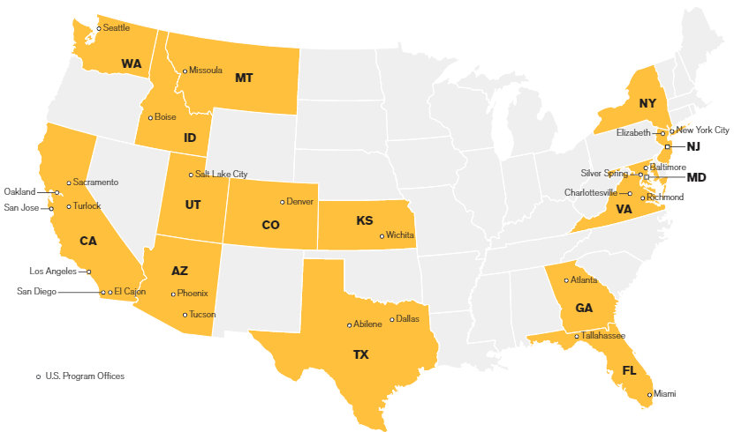
Where We Work
DOJ Funded Program
Program Funded by Other Sources

Slide 32
RAI Initiatives in the U.S.
Services
Education
CLIENT
+
IRC
Basic Needs
Housing
Medical/
Mental Health Services
Transportation
Legal
Employment
Education/Life Skills
Interpretation
Outreach and Public Awareness
Training and Local Capacity Building
TTA
National lead
Survivor- Informed
Trauma-Informed
Comprehensive

Slide 33
Who We Serve in the United States
All Survivors Served
Types of Trafficking: Sex and Labor
Countries of Origin: 48
Languages Spoken by Survivors: 30+

Slide 34
Available Support
Individual consultations
In-person training
Live webinars
Self-paced online courses
Peer-to-peer learning
Self-study materials
Blog posts
Tip Sheets
Newsletter
Resource library
Learn more on our website:
www.FrameworkTA.org

Slide 35
Ways You Can help
https://www.state.gov/20-ways-you-can-help-fight-human-trafficking/
20 Ways You Can Help Fight Human Trafficking - United States Department of State
Anyone can join in the fight against human trafficking. Here are 20 ideas to consider.

