Slide 1
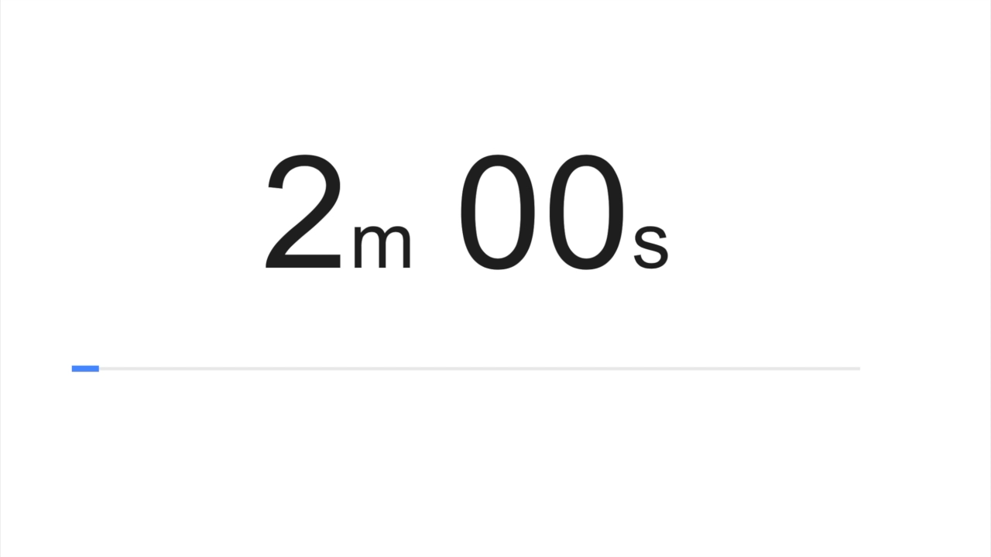
Agenda Item
Code of Conduct
Comment on the specific agenda item topic only
Speakers’ comments should be addressed to the full body. Requests to engage the Mayor, Council Members, Board Members, Commissioners or Staff in conversation will not be honored.
Abusive language is inappropriate.
Repeated failure to comply with this Code of Conduct which will disturb, disrupt or impede the orderly conduct of the meeting may result in removal from the meeting.
Please unmute your device when your name is called. Phone in callers, please press *6 to unmute.

