Slide 1
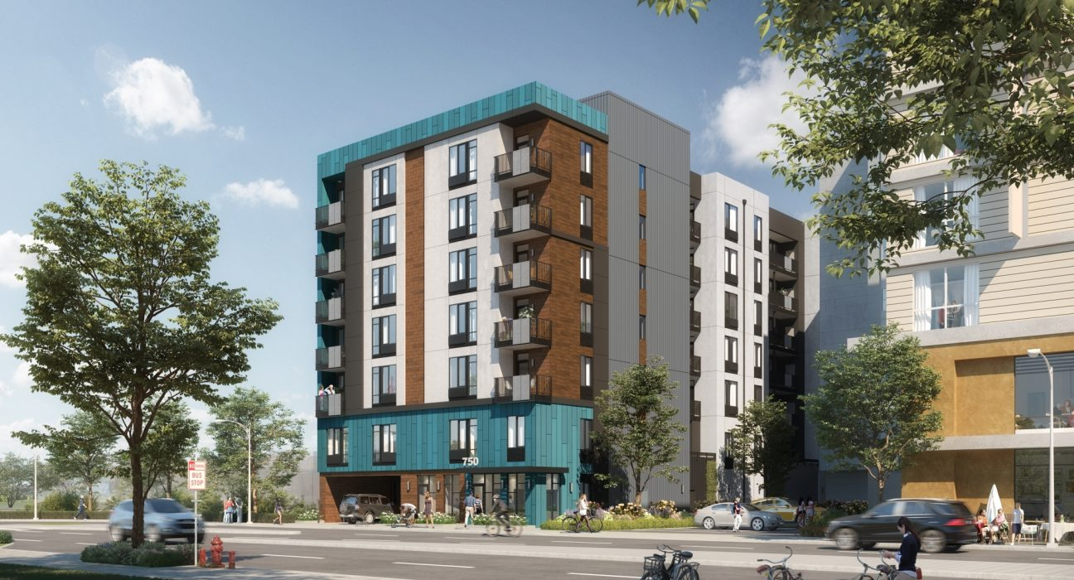
Housing Market Update
First Quarter 2023
Mariposa Place, a 100% affordable project that is under construction, will provide 80 affordable apartments for families and special needs tenants. The project is expected to create a memorable gateway for the rapidly changing West San Carlos Avenue district. The building was designed to carefully fit the unique narrow site and will add a new pedestrian path, linking a future light rail stop with the West San Carlos district.. Courtesy Danco-group.com

Slide 2
Q1 2023 San José Housing Market
Renters must earn $58/hour ($119,880/year) to afford the average effective monthly rent for a 2-bedroom apartment¹
Homebuyers must earn $166/hour ($345,678/year) to afford a median-priced single-family home²
801 residential building permits issued in Q1, 122 (15%) were for affordable apartments
111 ADU (Accessory Dwelling Units) permits issued in Q1
Rents up & vacancy down QoQ: average effective rent is $2,669³, up 1.3% QoQ⁴; overall rental vacancy rate is 5%, down 0.5 pt QoQ
For-sale market - median single family home price is $1,470,000⁵, up 13% QoQ
1. Based on Q1 2023 Costar average effective rents; income calculation assumes rents are 30% of income, 40-hour work week and a single-income household; "effective" rents include rent concessions such as free months' rent.
2. Based on SCCAOR March 2023 median prices; income calculation assumes monthly payments are 30% of income, 20% down, 6.32% interest rate, 1.1% property tax, 40-hour work week, and a single-income household.
3. Based on Costar Data April 5 , 2023.
4. QoQ – Quarter over Quarter; Yoy – Year over Year.
5. Based on Santa Clara County Association of Realtors (SCCAOR), March 2023.

Slide 3
Many Essential Workers Cannot Afford San José Housing Costs
SOURCE: Employment Development Department (EDD) – First Quarter 2022 Wages; Income to afford average rent calculation uses Costar Q1 2023 Average Effective Rents, rent at 30% of income and a single-income household; Income to afford mortgage uses SCCOAR March 2023 median home sales prices; payments at 30% of income, 20% down, March 2023 Freddie Mac 30 Year Fixed interest Rate of 6.32%, 1.1% Property Tax, $300 HOA dues for condos and a single-income household.

Slide 4
CY 2023 YTD Residential Permit Activity
SOURCE: CSJ PBCE & Housing. MF Affordable Includes some market-rate units without deed restrictions but counted as moderate-income units, per HCD guidelines for RHNA reporting. New RHNA Goal from 2023-2031

Slide 5
Strong ADU Permit Activity
Zoning code updated in Nov 2016 and in June 2018 to conform with new State Legislation and to facilitate construction of ADUs
SOURCE: City of San José ADU Dashboard & PBCE Permit Activity Reports as of March 2023.

Slide 6
Rents Up Slightly - 1.3% QoQ & 2.9% YoY
$3,715
$2,997
$2,669
$2,376
$2,072
SOURCE: Costar April 5, 2023
* QoQ = Quarter-over-Quarter; YoY = Year-over-Year.

Slide 7
Rents By Class – Class A is the most volatile
$3,209
$2,851
$2,669
$2,069
$1,604
SOURCE: Costar April 5, 2023

Slide 8
Avg Rental Vacancy 5%, Down 0.5 pt QoQ, at "Healthy” Rate of 5%
Q1 2023 Vacancy Rates
Studio – 5%
1 BR – 5.2%
2 BR – 4.9%
3 BR – 4.5%
Average – 5.0%
U.S. Average = 6.4%
SOURCE: Costar Jan 3, 2023; National Rate – US Census Bureau Current Population Survey/ Housing Vacancy Survey Q4, 2022.

Slide 9
Vacancies by Class – Class A Vacancy is 6.1% - Down 1.1 pts QoQ
SOURCE: Costar April 5, 2023
* Note: Older buildings refer to Class B, C and F properties; Class A buildings are usually newly-constructed properties.

Slide 10
San José Median Single-Family Home Price Up 13% QoQ but down 15% YoY
$1,682,500
$1,470,000
SOURCE: Santa Clara County Association of Realtors March 2023

Slide 11
San José Median Condo/Townhome Prices Up 13.2% QoQ, down 8.7% YoY
$946,500
$830,944
SOURCE: Santa Clara County Association of Realtors March 2023

Slide 12
National Affordability > Five Times San José Metro Area Affordability
Less than 1 in 10 families can afford to buy a median-priced home in San José
38.1%
7.3%
SOURCE: National Association of Home Builders, Housing Opportunity Index (HOI) Q4 2022 – one quarter time lag.

Slide 13
San José Homes’ DOM Close to One Month
C/TH - 28 Days
SF – 24 Days
SOURCE: Santa Clara County Association of Realtors March 2023

Slide 14
SJ Single-Family Market Inventory (+11%), Sales (+31%) & Listings (+203%) Up QoQ
NL = 406
S = 333
TL = 255
SOURCE: Santa Clara County Association of Realtors March 2023

Slide 15
Interest Rates Remain High
6.32%
5.7%
4.65%
SOURCE: Federal Reserve, Freddie Mac Primary Mortgage Market Survey, Bankrate.com, March 2023. Freddie Mac stopped publishing 5/1 Hybrid in Nov 2022; 5/1 Hybrid from Bankrate.com beginning Dec 2022. Annual Percentage rate will be higher based on points and fees paid.

Slide 16
Data Sources and Definitions
Quarterly rents and vacancy data reflect average, effective, market-rate apartment rents for the geography encompassing the City of San José, as reported in Costar’s proprietary database
Effective rent is the average rent paid over the term by a tenant adjusted downward for concessions paid for by the landlord (such as free rent, moving expenses, or other allowances), and upward for costs that are the responsibility of the tenant (such as operating expense pass-throughs)
Costar updates rents data once a month for apartments with more than 30 units and once a quarter for apartments with fewer than 30 units
QoQ refers to Quarter-over-Quarter; YoY refers to Year-over-Year
The City of San José selected Costar to supply rental housing statistics as of July 1, 2017, as the City’s previous vendor, RealAnswers, went out of business in Q4 2016
For historical consistency, the City restated its rents and vacancy data back to January 2000 using Costar. The revised data has been posted in Housing Market Update reports since Q2 2017
Freddie Mac stopped publishing 5/1 ARM as of Nov 2022. Data is now being obtained from Bankrate.com, an independent, advertising-supported publisher and comparison service. To determine the BRM mortgage rate averages, Bankrate collects APRs and rates from the 10 largest banks and thrifts in 10 large U.S. markets based on no existing relationship or automatic payments. For these averages, the customer profile includes a 700 FICO score.
For questions, please call the Housing Department at 408-535-3860

